Slide 2
When doing cognitive-behavioral interventions with children, we usually cannot rely on spoken words alone. We usually need to incorporate additional elements such as pictures, worksheets and cut-out materials.
In office settings and telehealth, we may find it expedient or essential to bypass printables and rely exclusively on words and images on the computer screen.
This download is part of a series of free resources designed to be used on computer screens in psychotherapy. It includes:
A set of pre-written “Poison Thoughts.”
A set of pre-written “Antidote Thoughts” which correspond to the Poison Thoughts.
The Poison Thoughts and Antidote Thoughts in 1 and 2 can be dragged around the screen in various ways. See the next few pages for examples.
A set of Poison Thought and Antidote Thought bubbles with imbedded text boxes that you can fill in to create, with your clients, your own custom thought bubbles.
This resource was created in PowerPoint to allow you to drag, drop, enlarge and edit. To enable these features, keep it open in Normal Mode and not in Slide Show Mode .
You can combine the resource in this download with other free teletherapy resources on the website. Please go to this link for a summary of what is available: https://bit.ly/316llyX.
These CBT Thought Bubbles, and lots of other materials, are also available in print-out versions on the website.

Slide 3
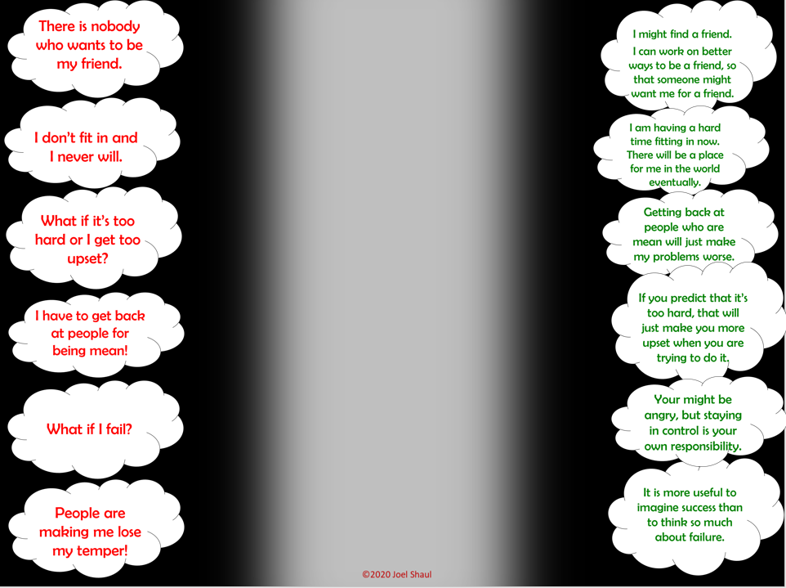
On four consecutive slides, there is a series of 24 Poison Thoughts matched on the right by 24 Antidote Thoughts.

Slide 4
You can drag and drop these thought bubbles anywhere you want. See one example on this slide and the next slide.

Slide 5
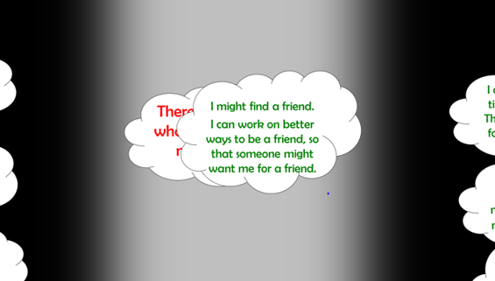
You can zoom in to enlarge the particular Poison Thoughts and Antidote Thoughts you are focusing on.

Slide 6
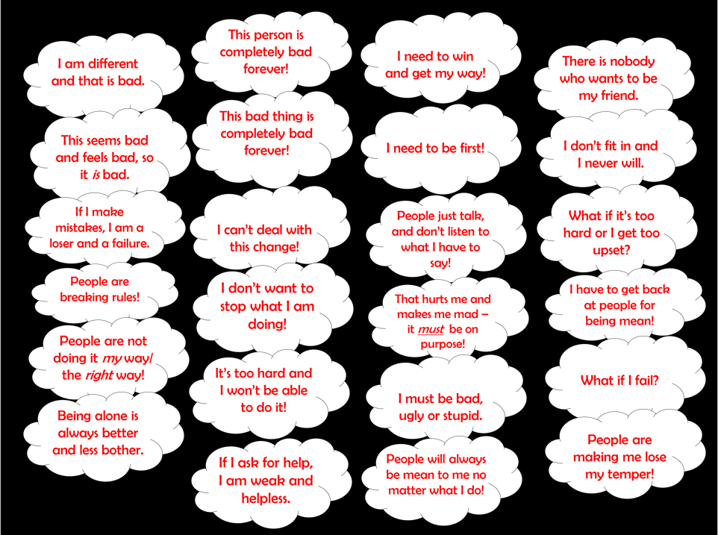
This screen contains a wide variety of typical Poison Thoughts.

Slide 7
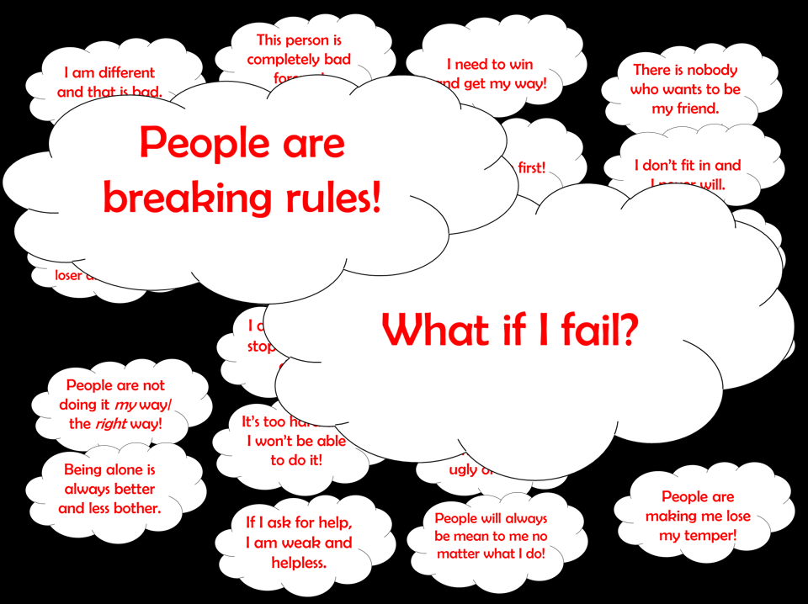
You can enlarge the ones that you wish to focus on, as shown below.

Slide 8
These slides are equipped with editable thought bubbles so you can create your own.

Slide 9
Below I provide an example illustrating how the editable thought bubbles might be
filled out.

Slide 10
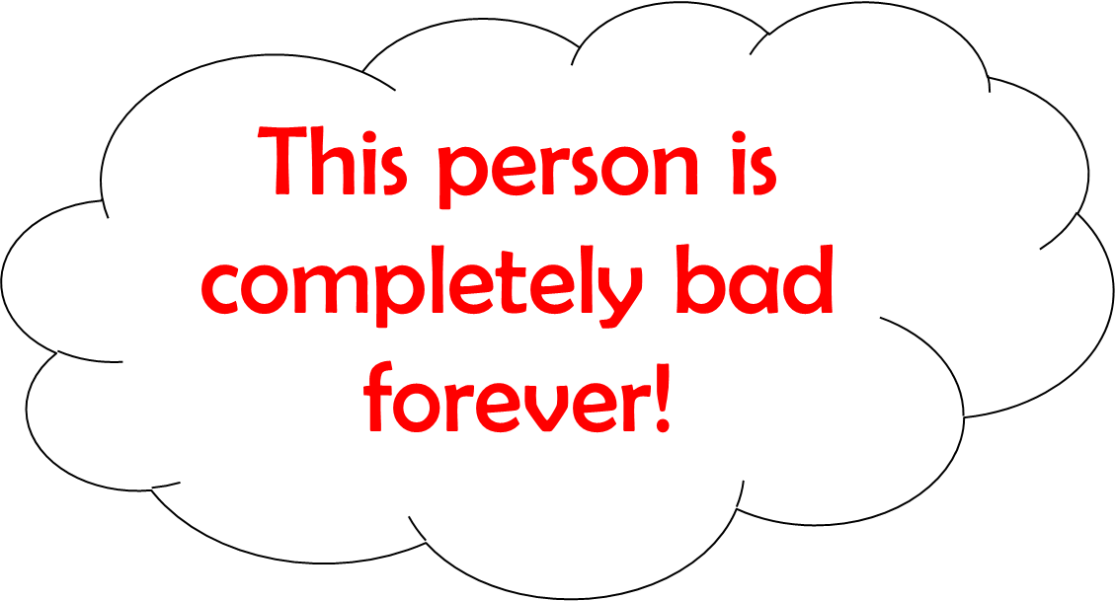
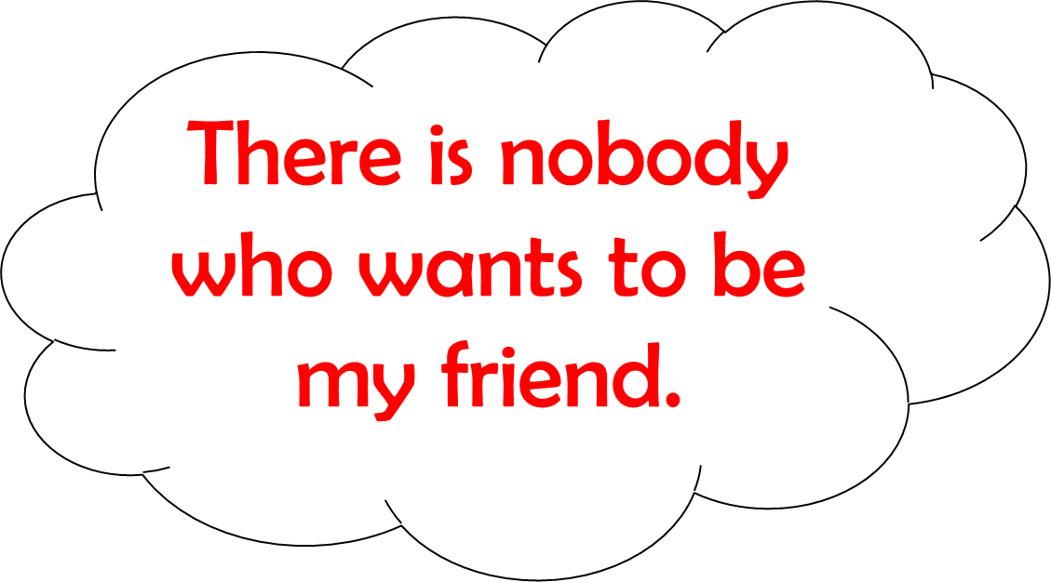
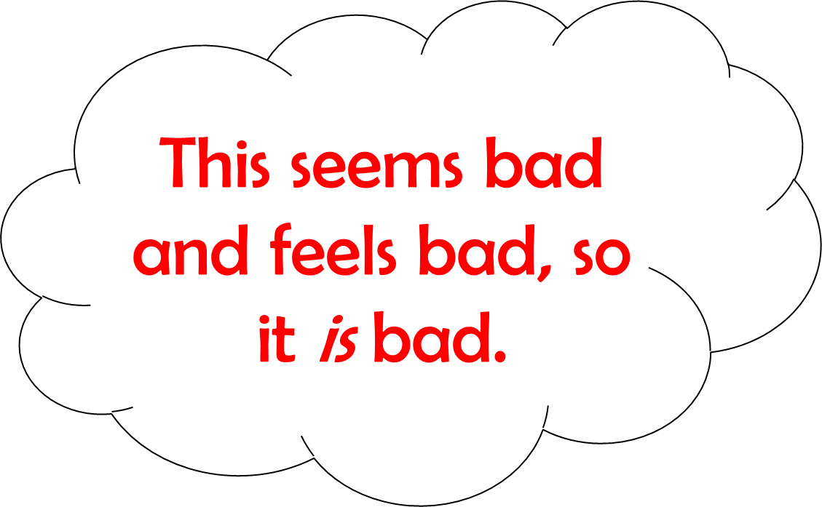
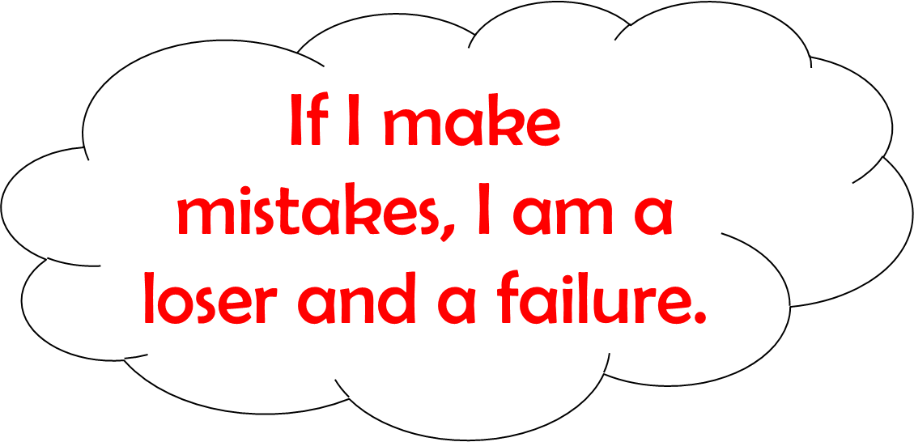
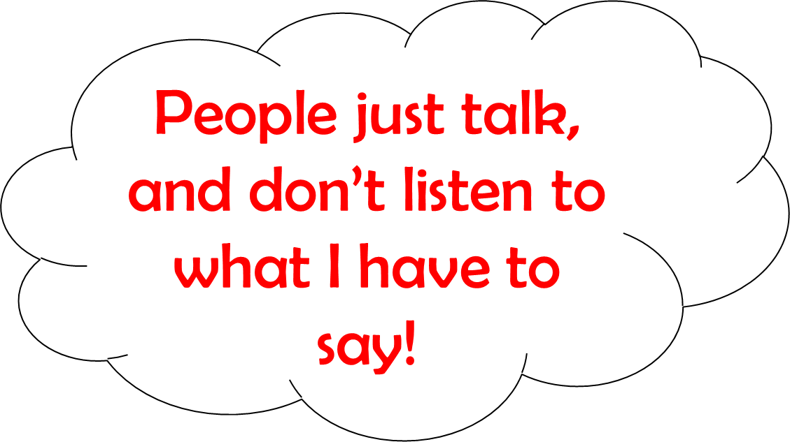
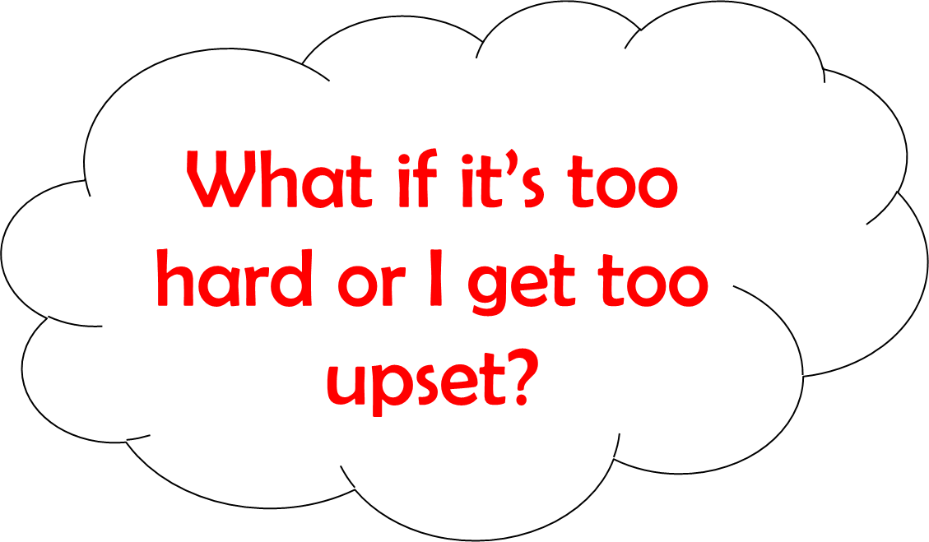
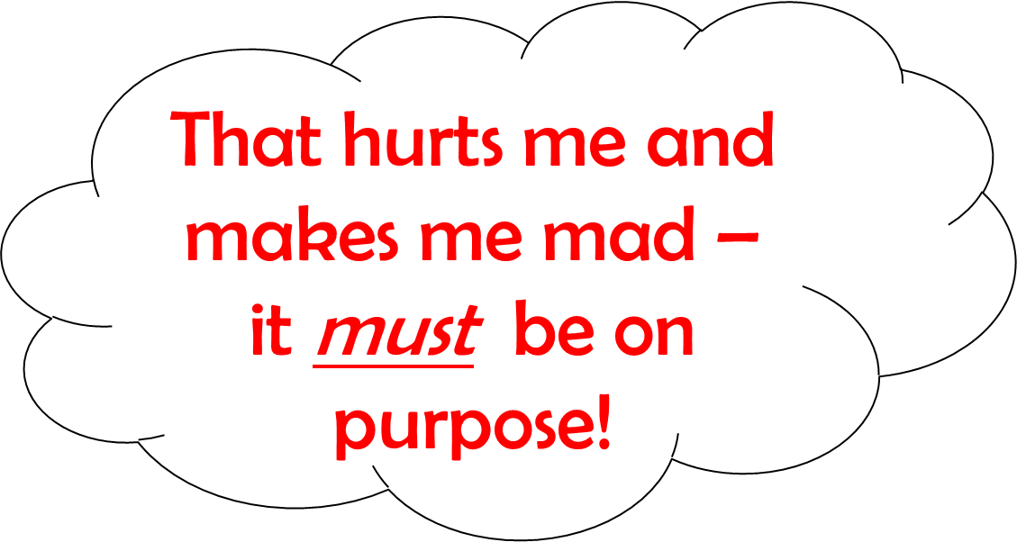
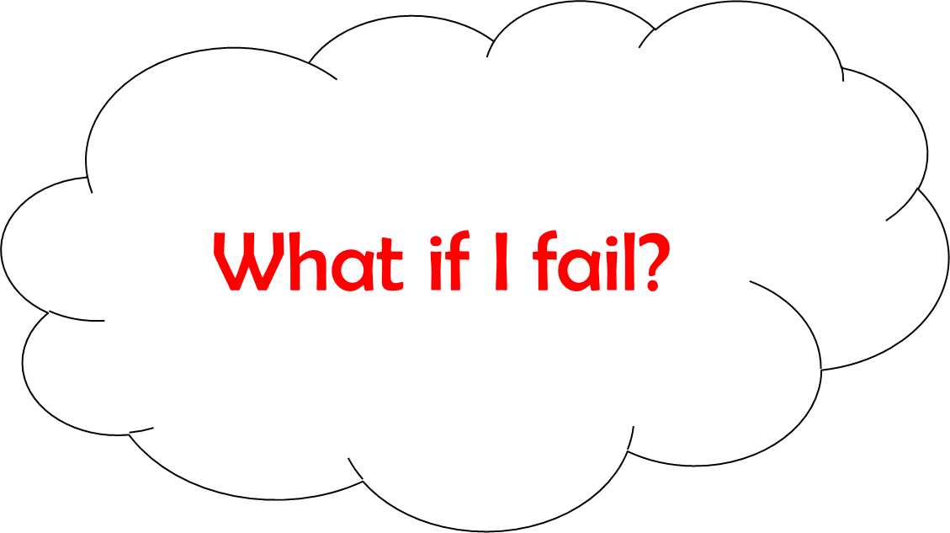
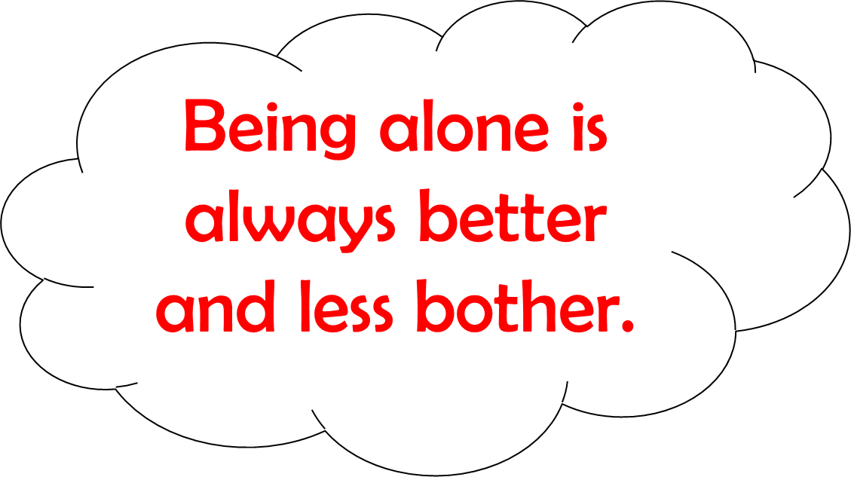
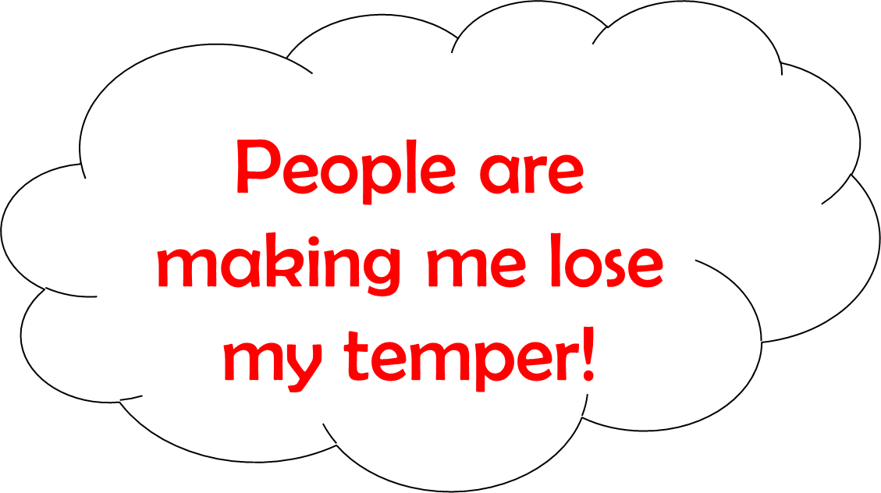
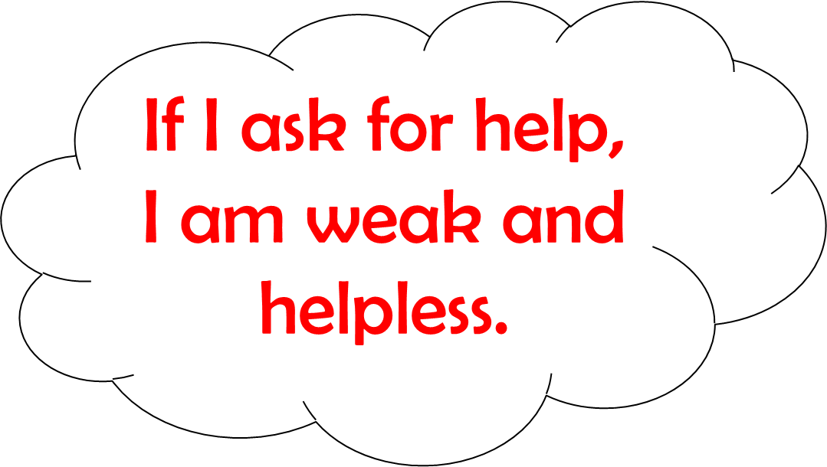
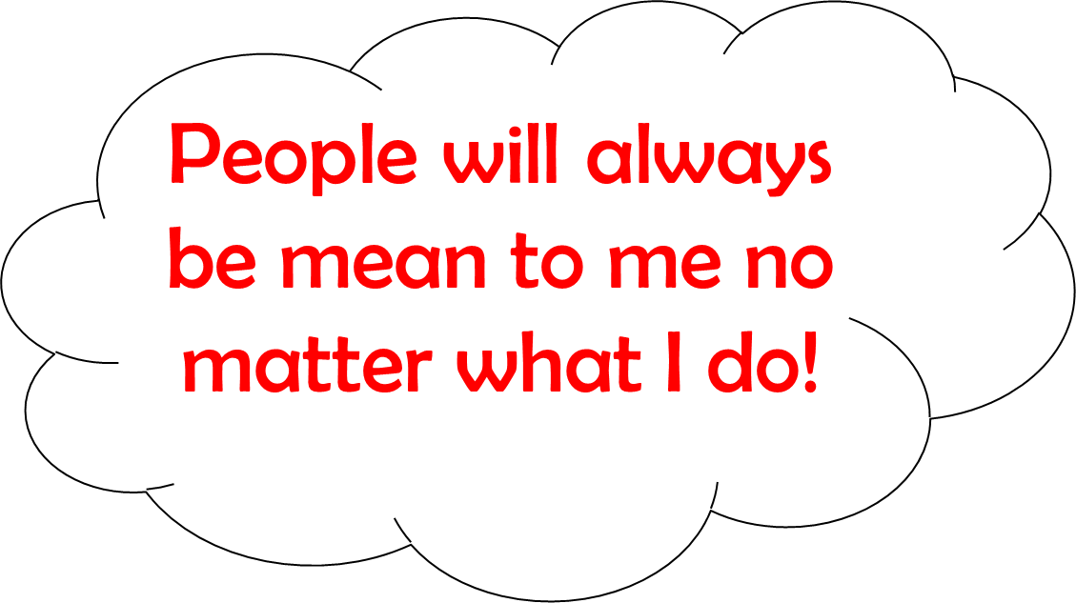

Slide 11
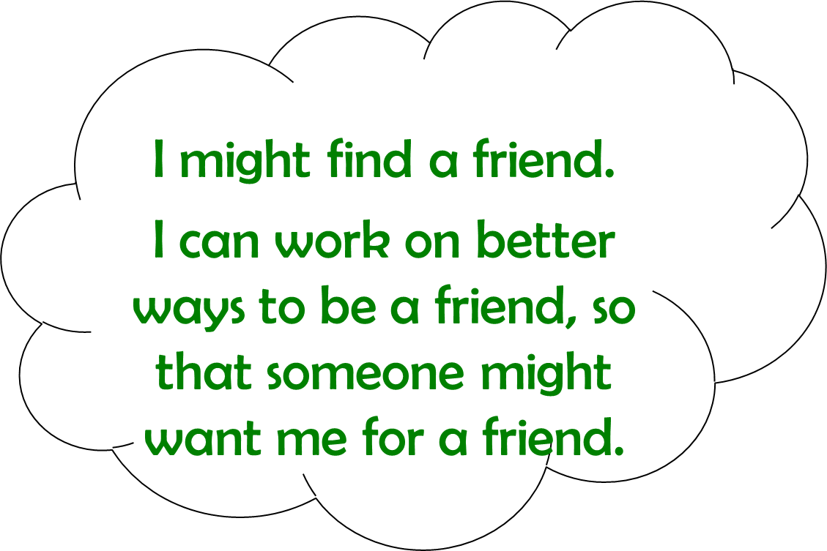
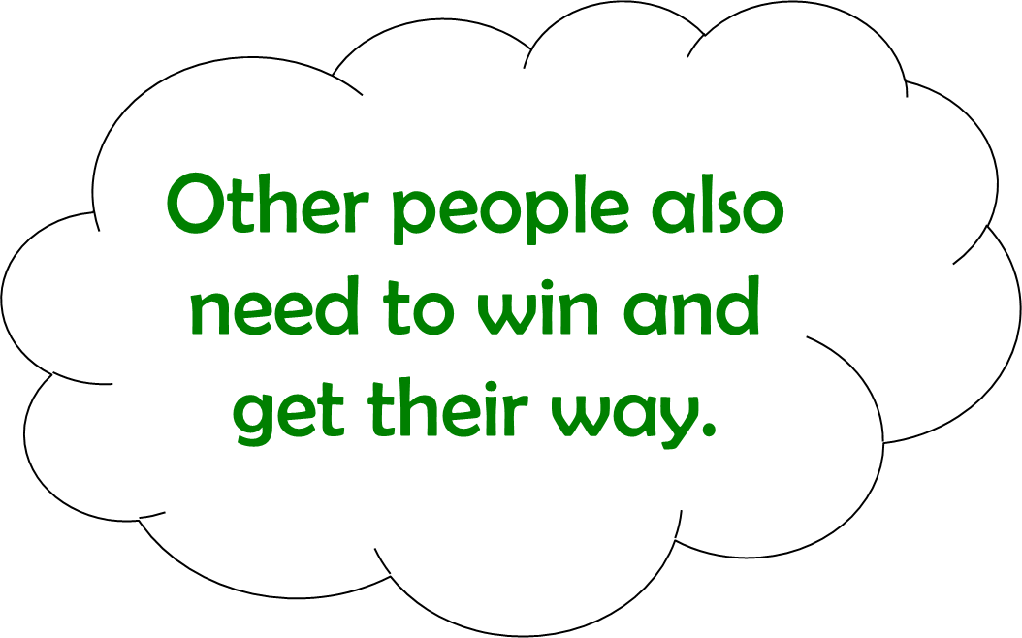
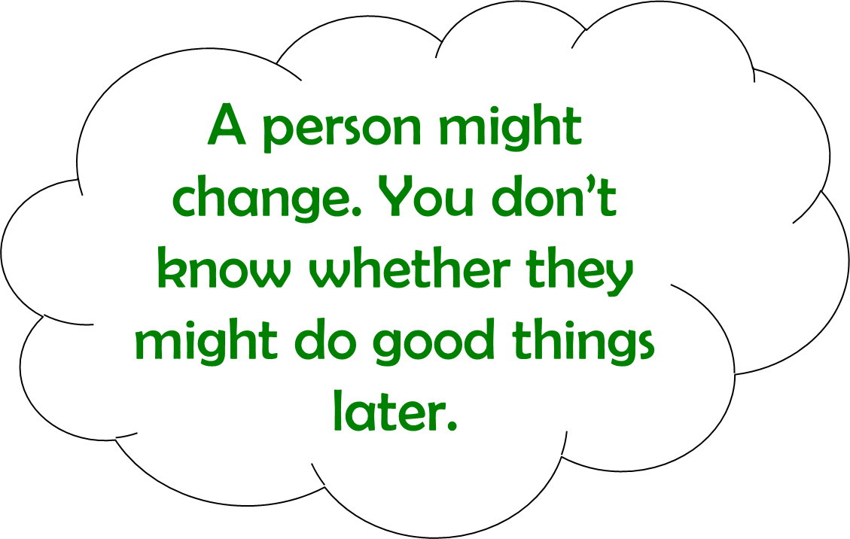
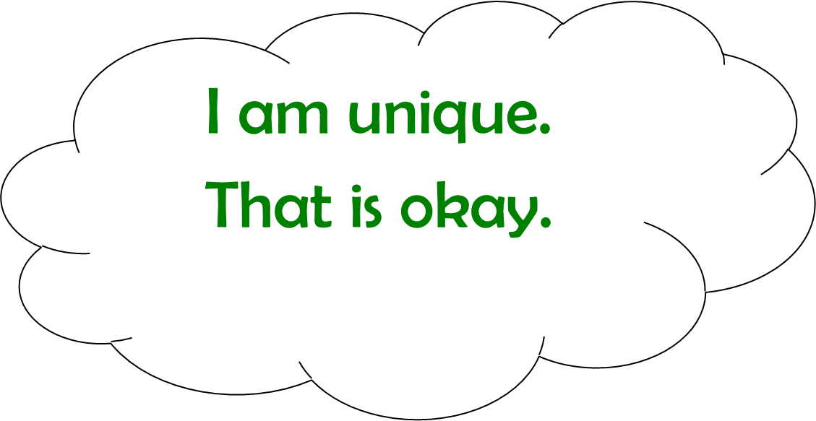
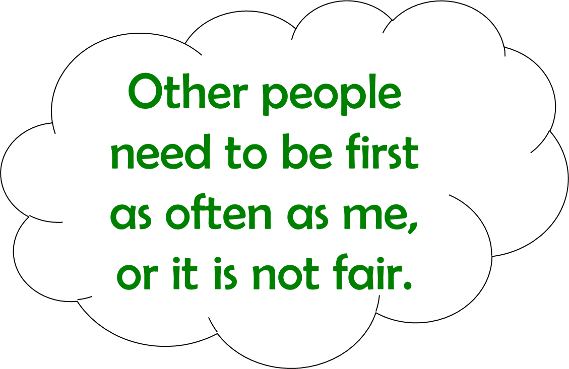
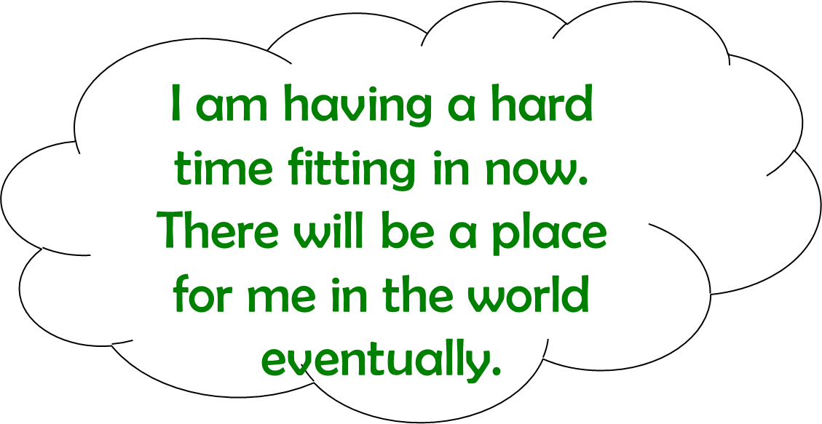
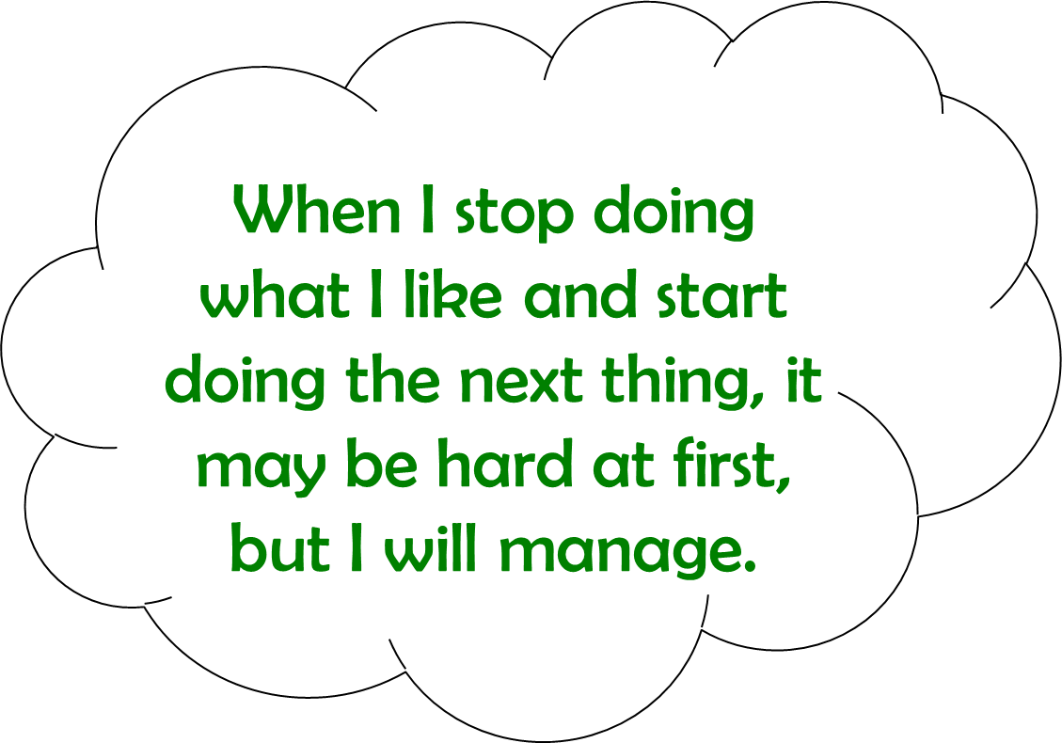
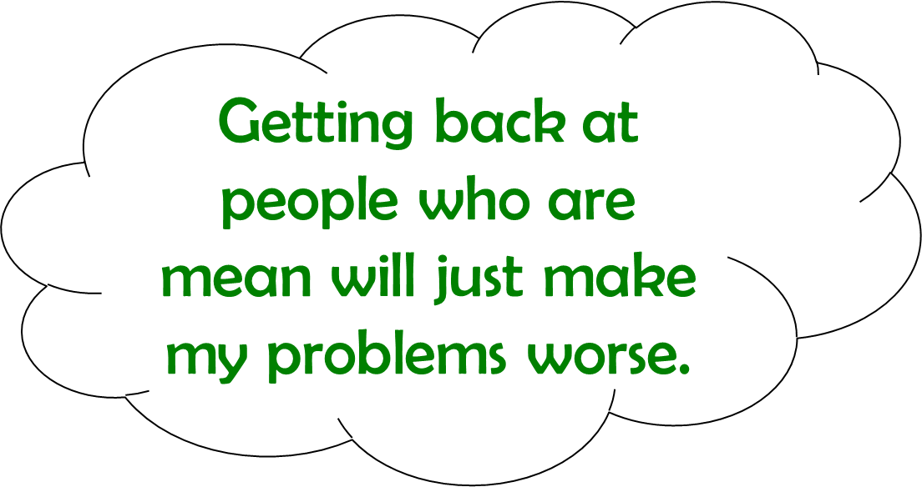
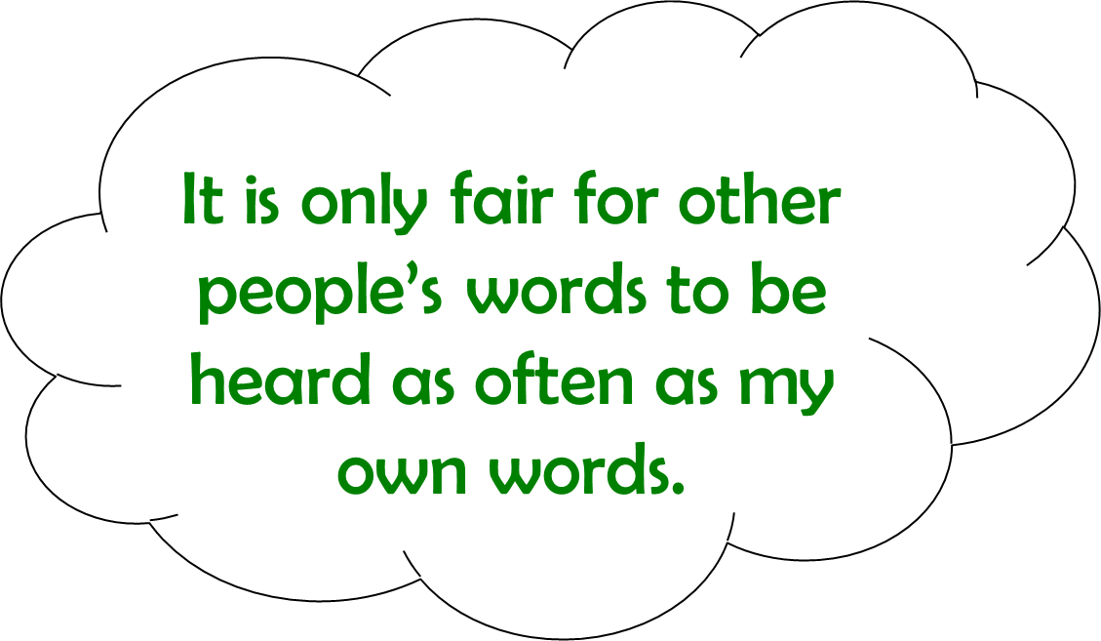
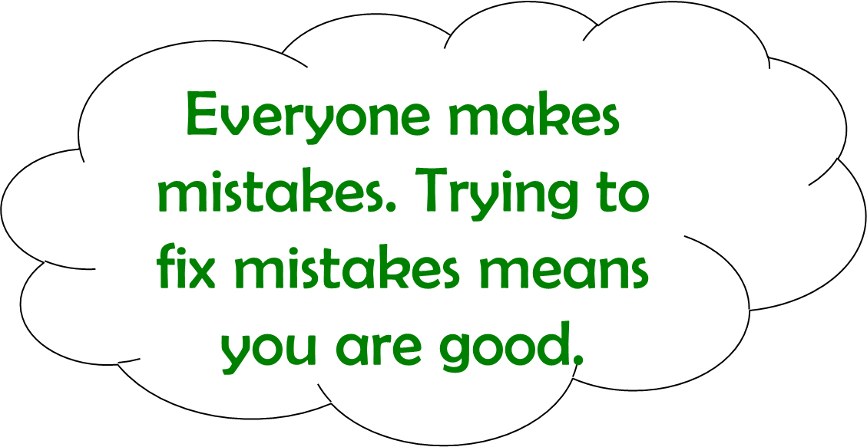
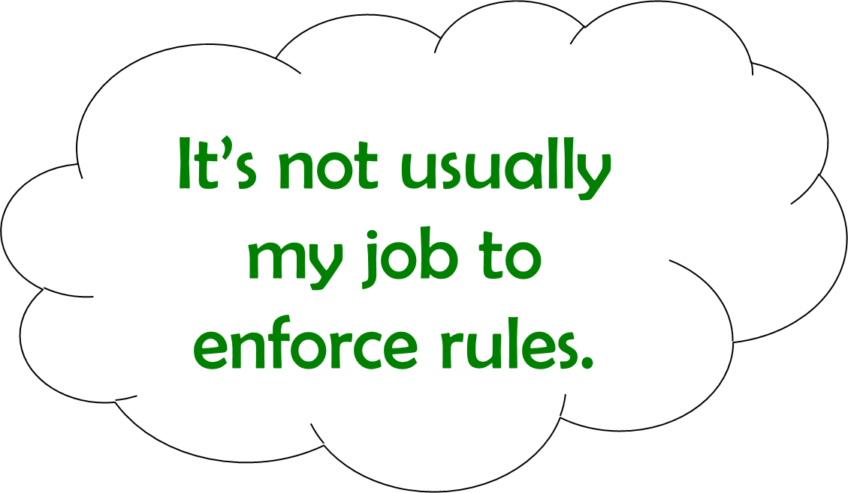
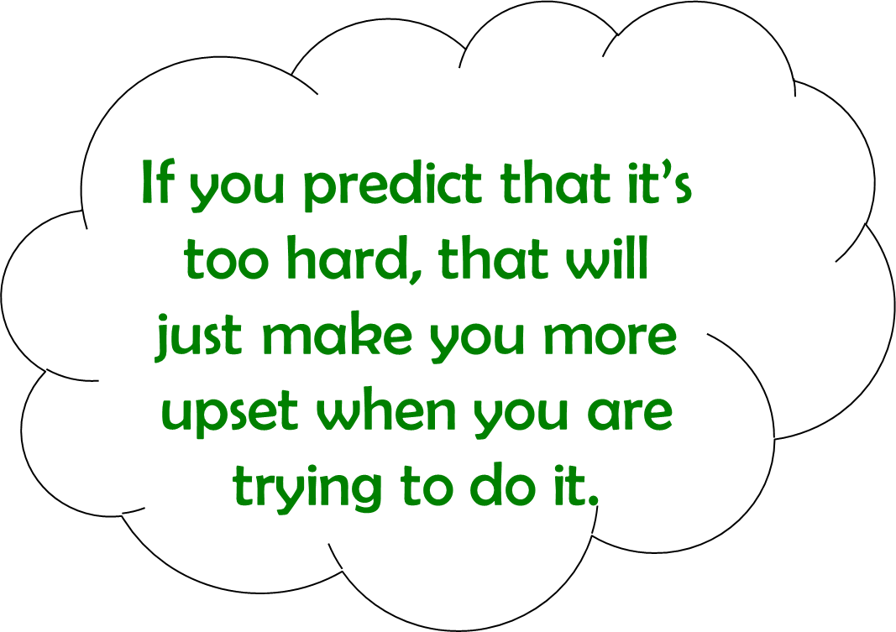
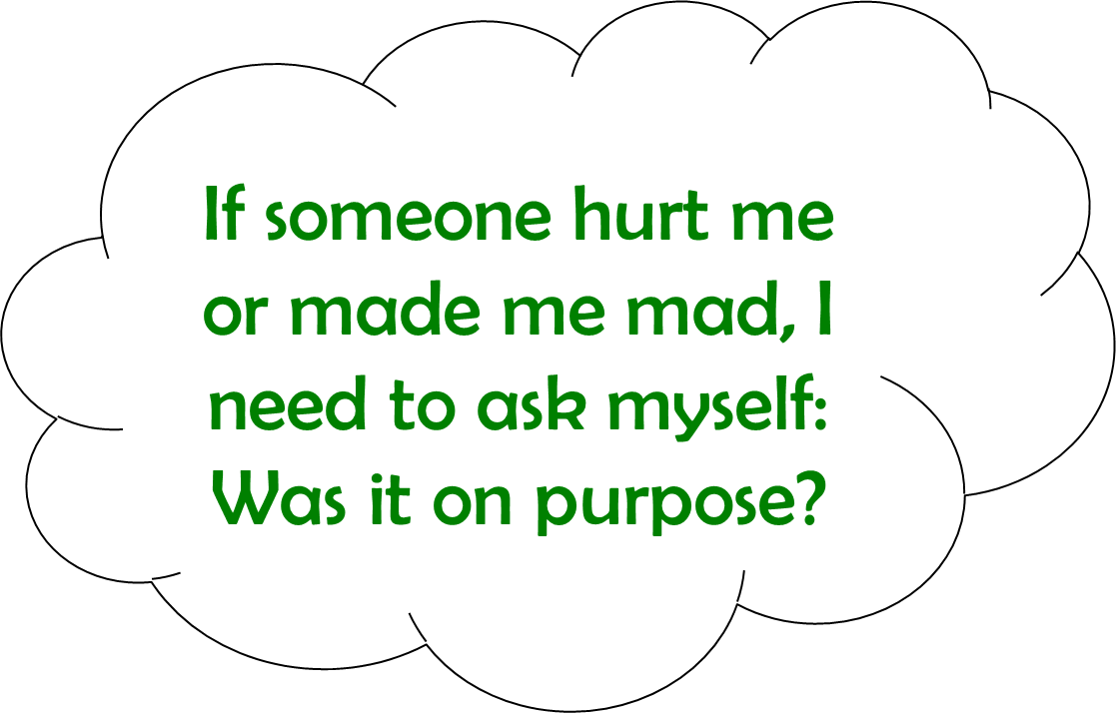
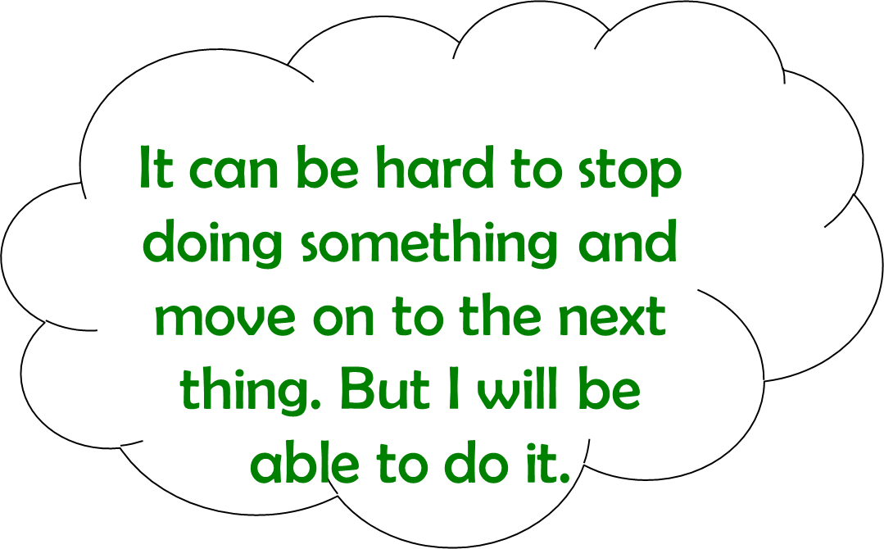
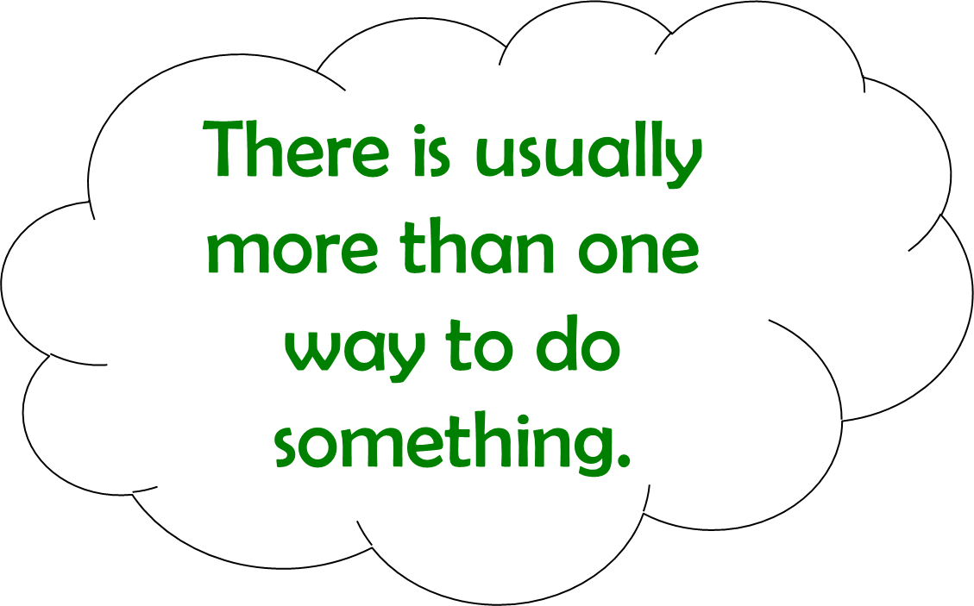
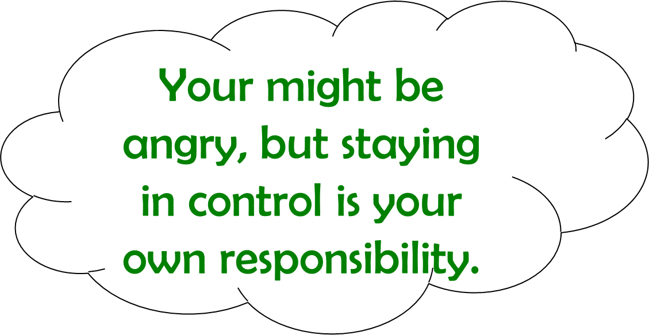
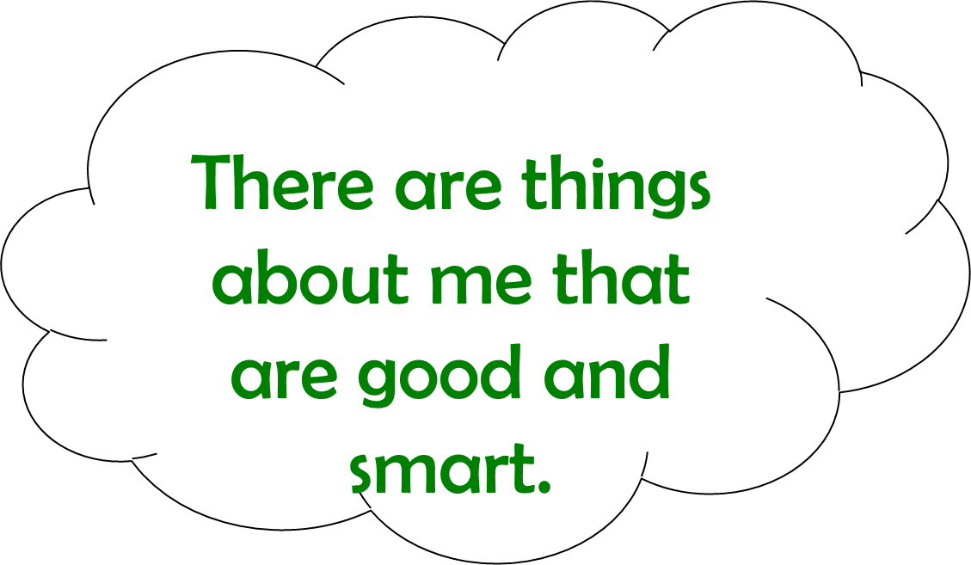
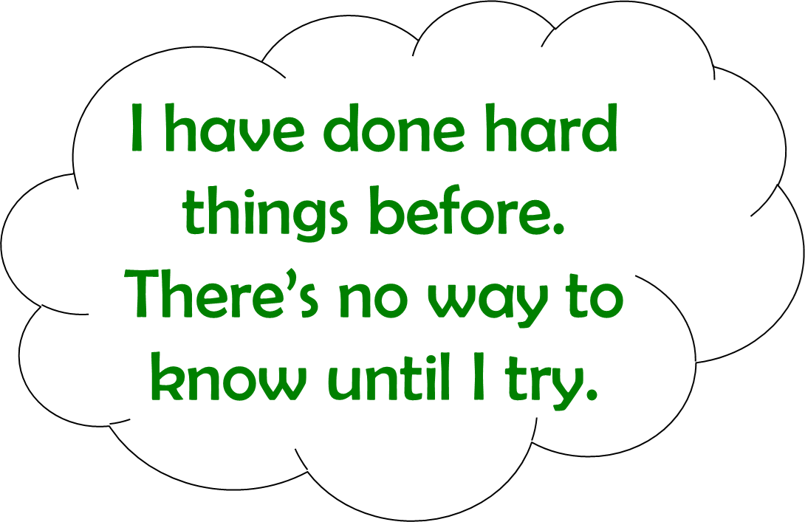
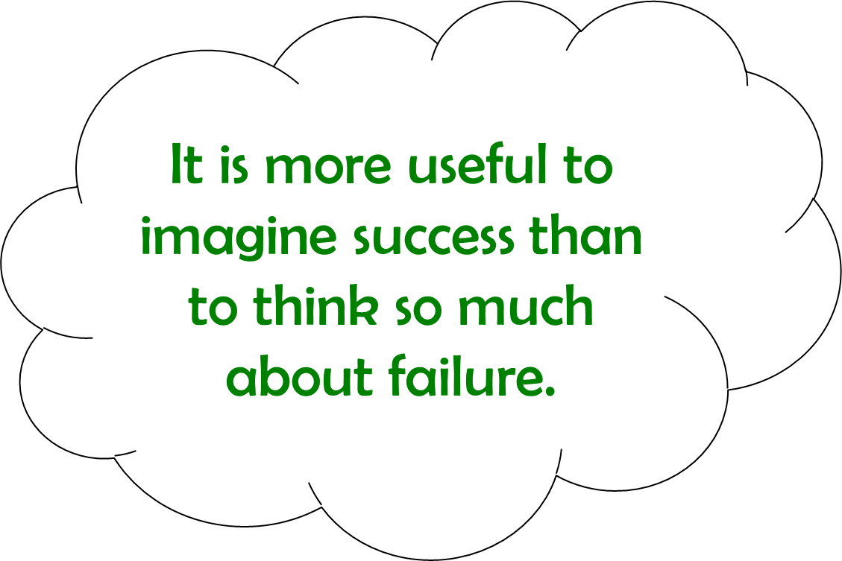
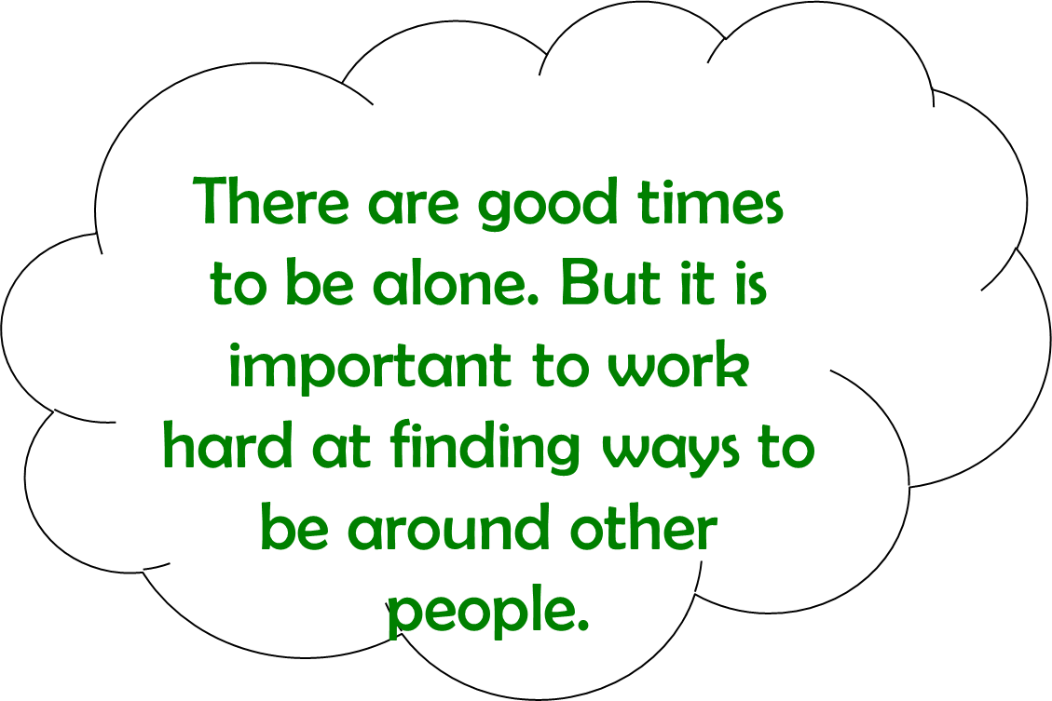
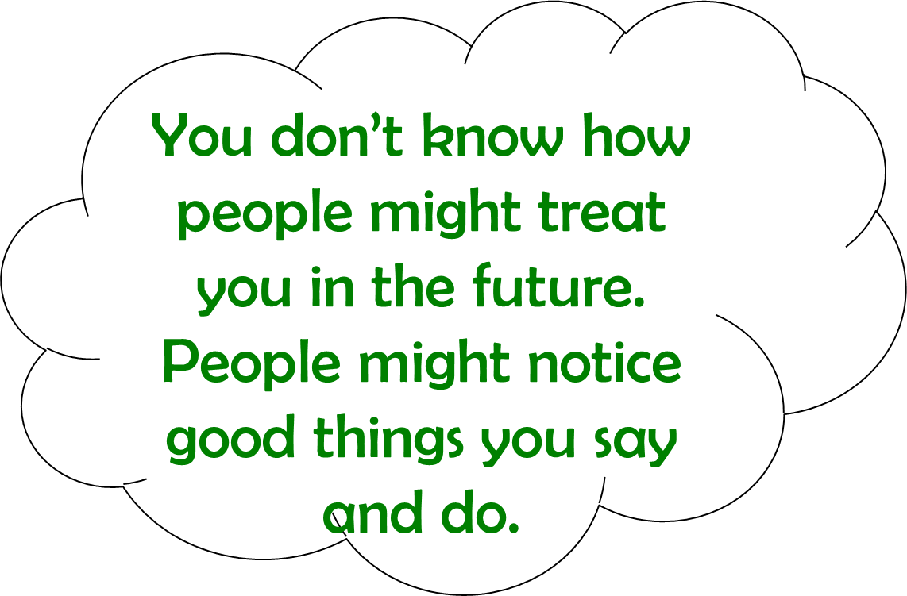
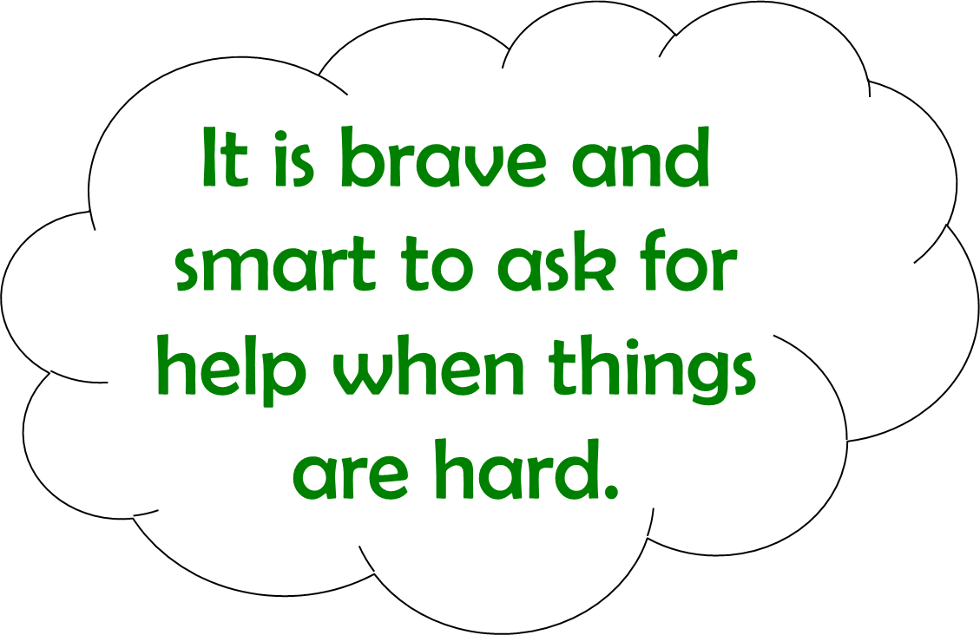

Slide 16
This is a text box to write in your own Poison Thought!
This is a text box to write in your own Antidote Thought!
This is a text box to write in your own Poison Thought!
This is a text box to write in your own Antidote Thought!
This is a text box to write in your own Poison Thought!
This is a text box to write in your own Antidote Thought!
This is a text box to write in your own Poison Thought!
This is a text box to write in your own Antidote Thought!

Slide 17
This is a text box to write in your own Poison Thought!
This is a text box to write in your own Antidote Thought!
This is a text box to write in your own Poison Thought!
This is a text box to write in your own Antidote Thought!
This is a text box to write in your own Poison Thought!
This is a text box to write in your own Antidote Thought!
This is a text box to write in your own Poison Thought!
This is a text box to write in your own Antidote Thought!

Slide 18
This is a text box to write in your own Poison Thought!
This is a text box to write in your own Antidote Thought!
This is a text box to write in your own Poison Thought!
This is a text box to write in your own Antidote Thought!
This is a text box to write in your own Poison Thought!
This is a text box to write in your own Antidote Thought!
This is a text box to write in your own Poison Thought!
This is a text box to write in your own Antidote Thought!

Slide 19
This is a text box to write in your own Poison Thought!
This is a text box to write in your own Antidote Thought!
This is a text box to write in your own Poison Thought!
This is a text box to write in your own Antidote Thought!
This is a text box to write in your own Poison Thought!
This is a text box to write in your own Antidote Thought!
This is a text box to write in your own Poison Thought!
This is a text box to write in your own Antidote Thought!

Slide 20
This is a text box to write in your own Poison Thought!
This is a text box to write in your own Antidote Thought!
This is a text box to write in your own Poison Thought!
This is a text box to write in your own Antidote Thought!
This is a text box to write in your own Poison Thought!
This is a text box to write in your own Antidote Thought!
This is a text box to write in your own Poison Thought!
This is a text box to write in your own Antidote Thought!

Slide 21
If someone is not on my side, that means they are against me.
This is a text box to write in your own Antidote Thought!
This is a text box to write in your own Antidote Thought!
Other people keep breaking rules!
This is a text box to write in your own Antidote Thought!
This change is more than I can stand!
This is a text box to write in your own Antidote Thought!
There’s just one right way to do it –
my way.

Slide 22
This is a text box to write in your own Poison Thought!
This is a text box to write in your own Antidote Thought!
This is a text box to write in your own Poison Thought!
This is a text box to write in your own Antidote Thought!
This is a text box to write in your own Poison Thought!
This is a text box to write in your own Antidote Thought!
This is a text box to write in your own Poison Thought!
This is a text box to write in your own Antidote Thought!

Slide 23
This is a text box to write in your own Poison Thought!
This is a text box to write in your own Antidote Thought!
This is a text box to write in your own Poison Thought!
This is a text box to write in your own Antidote Thought!
This is a text box to write in your own Poison Thought!
This is a text box to write in your own Antidote Thought!
This is a text box to write in your own Poison Thought!
This is a text box to write in your own Antidote Thought!

