Slide 2
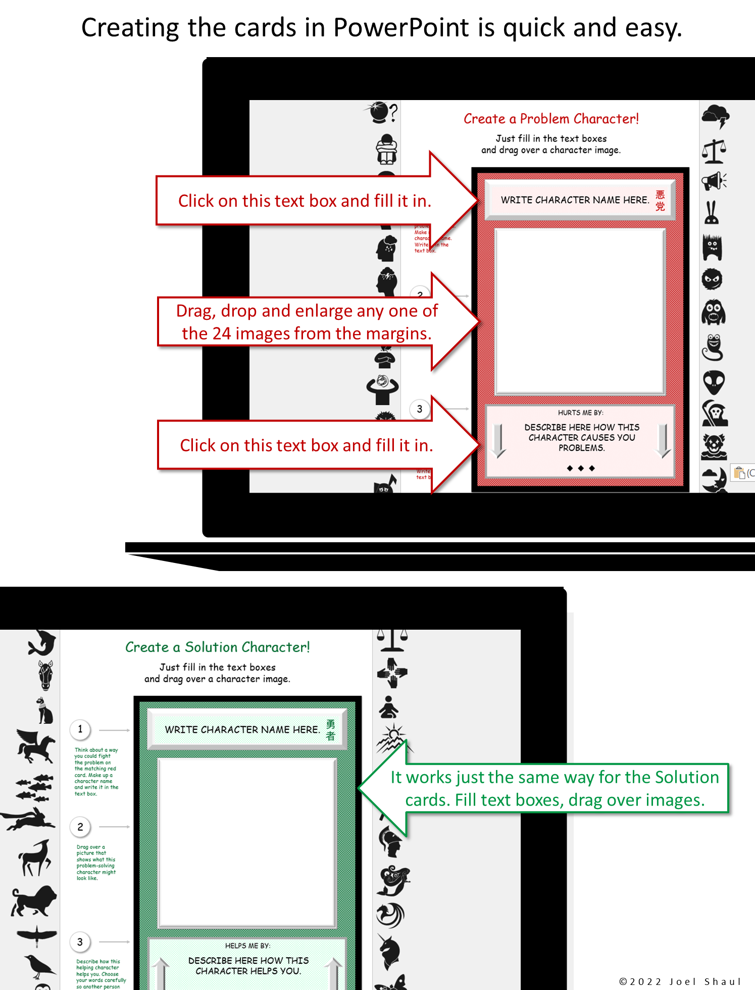

Slide 3
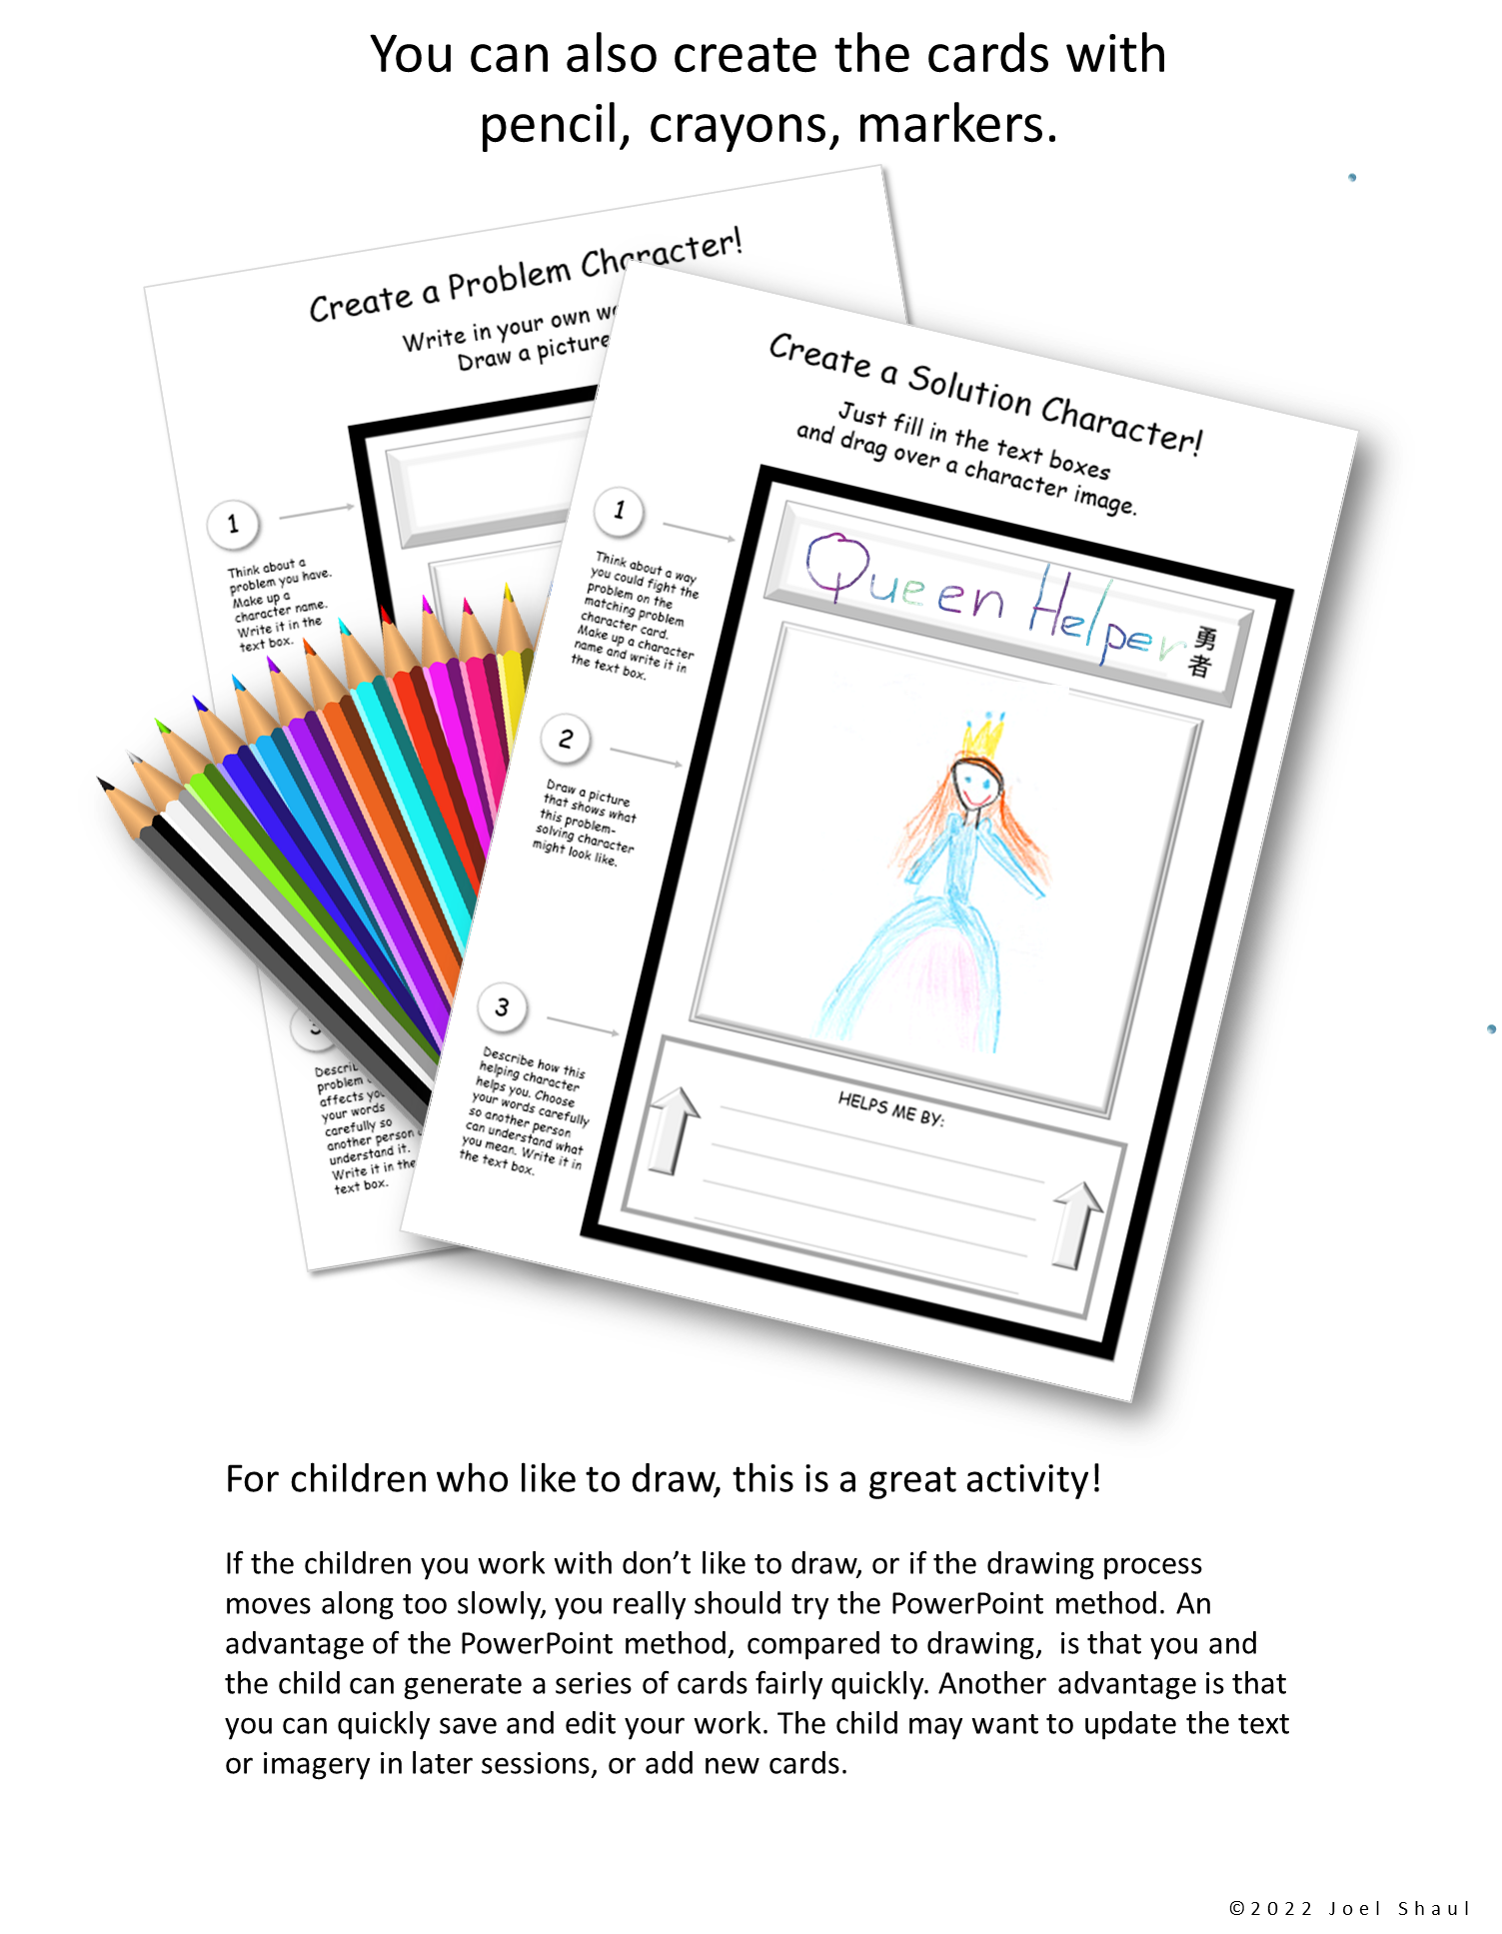

Slide 4
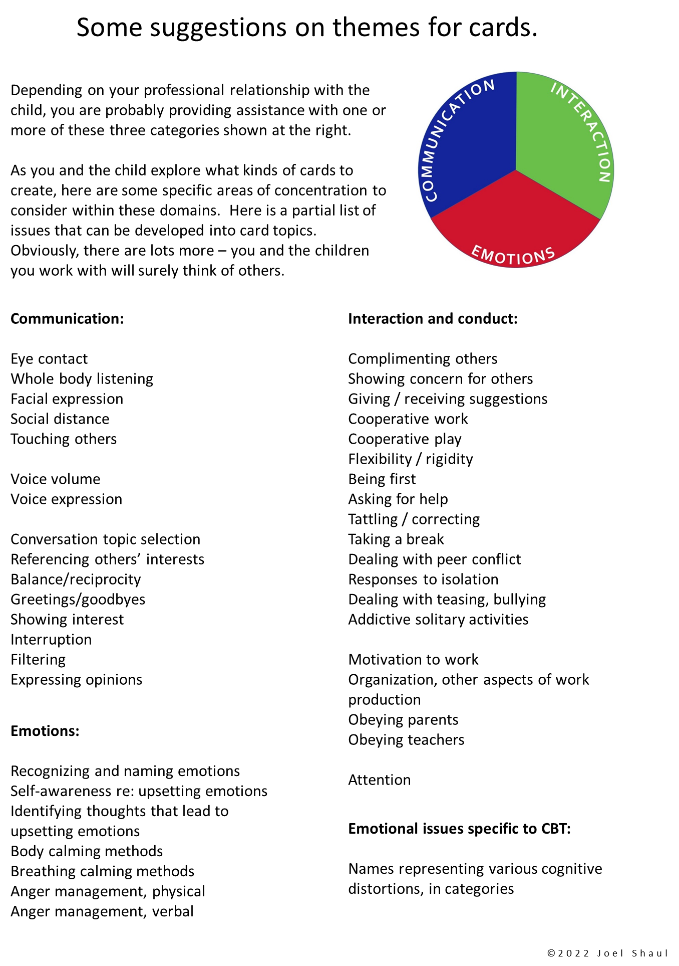

Slide 7
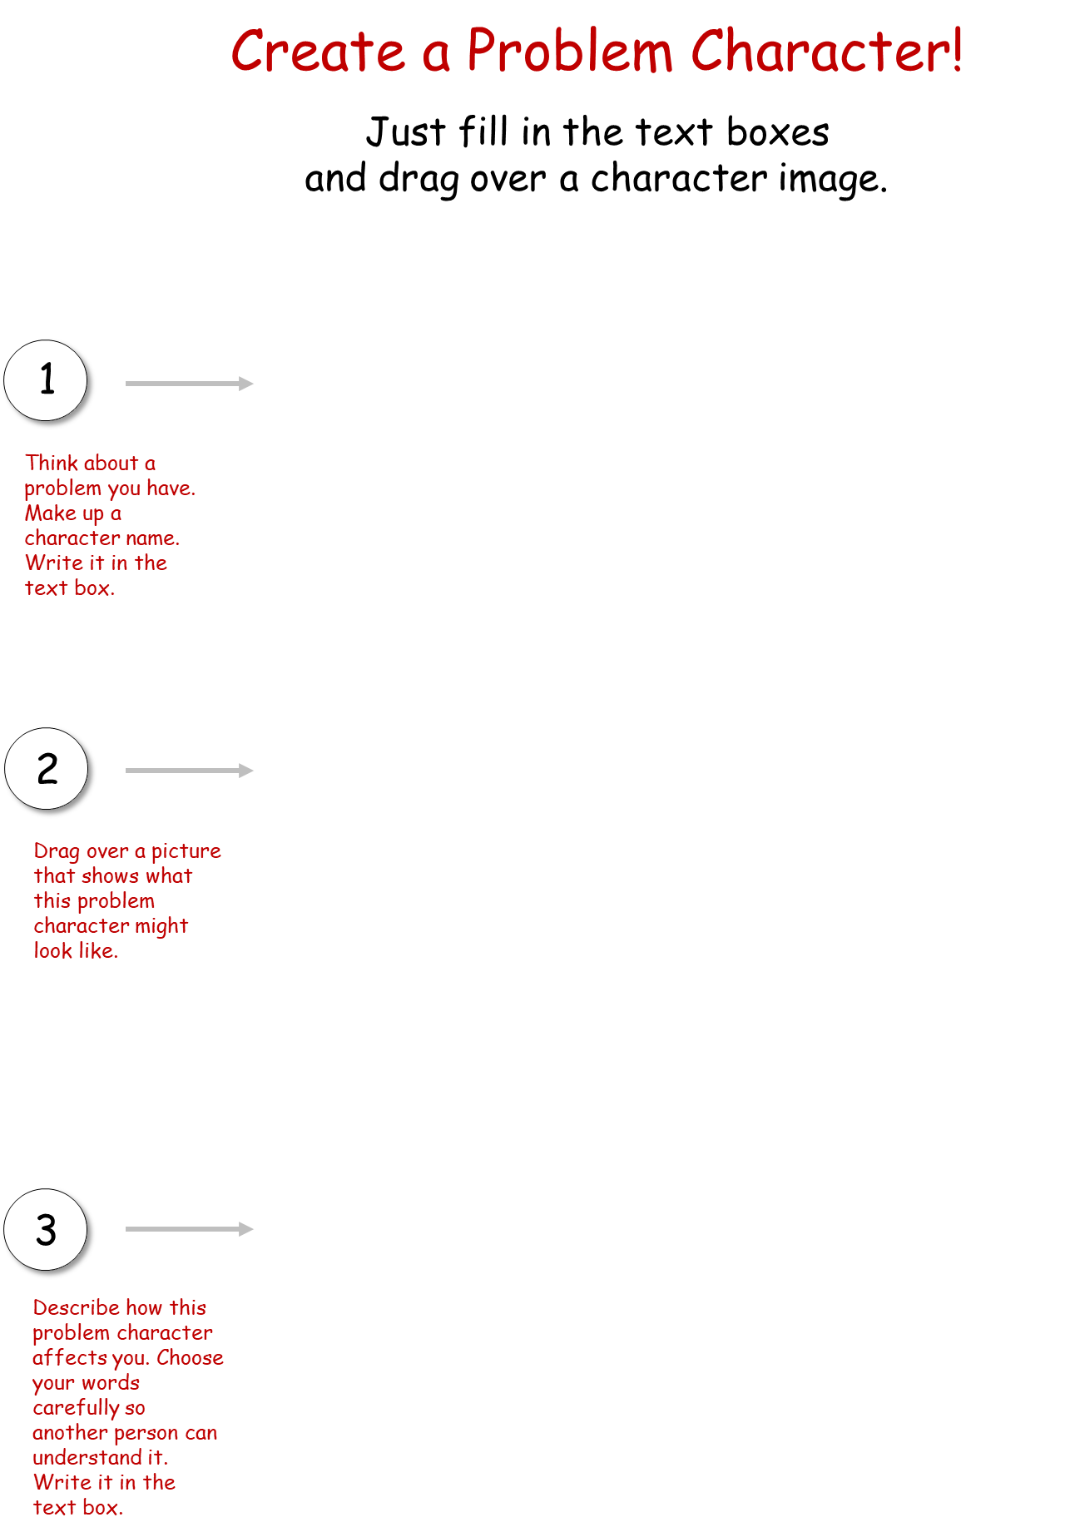
WRITE CHARACTER NAME HERE.
DESCRIBE HERE HOW THIS CHARACTER CAUSES YOU PROBLEMS.

Slide 8
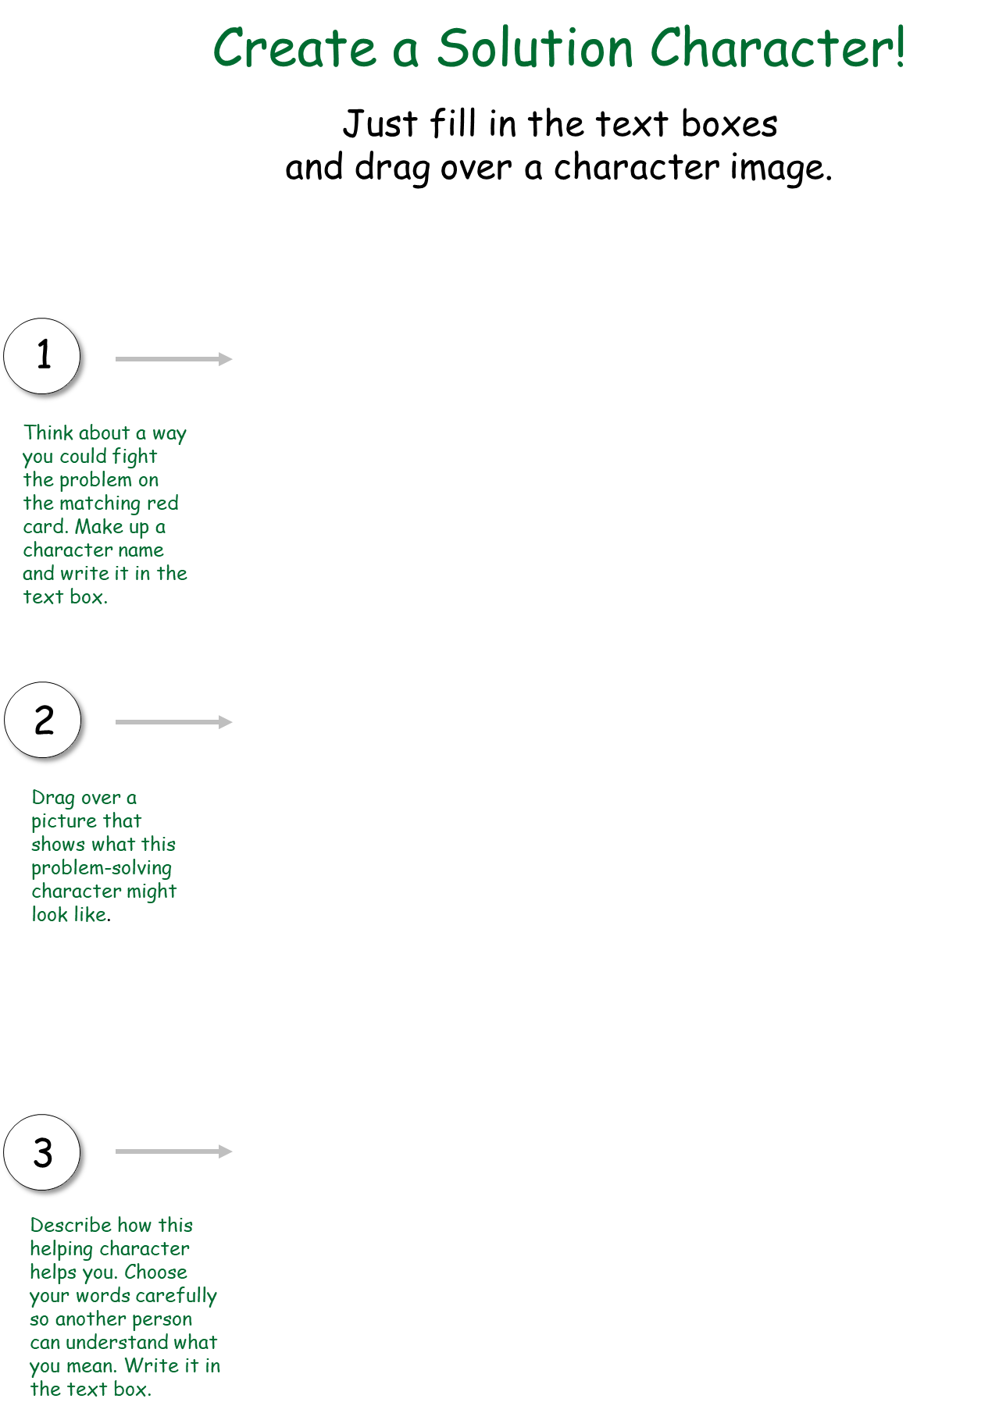
WRITE CHARACTER NAME HERE.
DESCRIBE HERE HOW THIS CHARACTER HELPS YOU.

Slide 9
WRITE CHARACTER NAME HERE.
DESCRIBE HERE HOW THIS CHARACTER CAUSES YOU PROBLEMS.

Slide 10
WRITE CHARACTER NAME HERE.
DESCRIBE HERE HOW THIS CHARACTER HELPS YOU.

Slide 11
WRITE CHARACTER NAME HERE.
DESCRIBE HERE HOW THIS CHARACTER CAUSES YOU PROBLEMS.

Slide 12
WRITE CHARACTER NAME HERE.
DESCRIBE HERE HOW THIS CHARACTER HELPS YOU.

Slide 13
WRITE CHARACTER NAME HERE.
DESCRIBE HERE HOW THIS CHARACTER CAUSES YOU PROBLEMS.

Slide 14
WRITE CHARACTER NAME HERE.
DESCRIBE HERE HOW THIS CHARACTER HELPS YOU.

Slide 15
WRITE CHARACTER NAME HERE.
DESCRIBE HERE HOW THIS CHARACTER CAUSES YOU PROBLEMS.

Slide 16
WRITE CHARACTER NAME HERE.
DESCRIBE HERE HOW THIS CHARACTER HELPS YOU.

Slide 17
WRITE CHARACTER NAME HERE.
DESCRIBE HERE HOW THIS CHARACTER CAUSES YOU PROBLEMS.

Slide 18
WRITE CHARACTER NAME HERE.
DESCRIBE HERE HOW THIS CHARACTER HELPS YOU.

Slide 19
WRITE CHARACTER NAME HERE.
DESCRIBE HERE HOW THIS CHARACTER CAUSES YOU PROBLEMS.

Slide 20
WRITE CHARACTER NAME HERE.
DESCRIBE HERE HOW THIS CHARACTER HELPS YOU.

Slide 21
WRITE CHARACTER NAME HERE.
DESCRIBE HERE HOW THIS CHARACTER CAUSES YOU PROBLEMS.

Slide 22
WRITE CHARACTER NAME HERE.
DESCRIBE HERE HOW THIS CHARACTER HELPS YOU.

Slide 23
WRITE CHARACTER NAME HERE.
DESCRIBE HERE HOW THIS CHARACTER CAUSES YOU PROBLEMS.

Slide 24
WRITE CHARACTER NAME HERE.
DESCRIBE HERE HOW THIS CHARACTER HELPS YOU.

Slide 25
WRITE CHARACTER NAME HERE.
DESCRIBE HERE HOW THIS CHARACTER CAUSES YOU PROBLEMS.

Slide 26
WRITE CHARACTER NAME HERE.
DESCRIBE HERE HOW THIS CHARACTER HELPS YOU.

Slide 27
WRITE CHARACTER NAME HERE.
DESCRIBE HERE HOW THIS CHARACTER CAUSES YOU PROBLEMS.

Slide 28
WRITE CHARACTER NAME HERE.
DESCRIBE HERE HOW THIS CHARACTER HELPS YOU.

Slide 29
WRITE CHARACTER NAME HERE.
DESCRIBE HERE HOW THIS CHARACTER CAUSES YOU PROBLEMS.

Slide 30
WRITE CHARACTER NAME HERE.
DESCRIBE HERE HOW THIS CHARACTER HELPS YOU.

Slide 31
WRITE CHARACTER NAME HERE.
DESCRIBE HERE HOW THIS CHARACTER CAUSES YOU PROBLEMS.

Slide 32
WRITE CHARACTER NAME HERE.
DESCRIBE HERE HOW THIS CHARACTER HELPS YOU.

Slide 33
WRITE CHARACTER NAME HERE.
DESCRIBE HERE HOW THIS CHARACTER CAUSES YOU PROBLEMS.

Slide 34
WRITE CHARACTER NAME HERE.
DESCRIBE HERE HOW THIS CHARACTER HELPS YOU.

Slide 35
WRITE CHARACTER NAME HERE.
DESCRIBE HERE HOW THIS CHARACTER CAUSES YOU PROBLEMS.

Slide 36
WRITE CHARACTER NAME HERE.
DESCRIBE HERE HOW THIS CHARACTER HELPS YOU.

Slide 37
WRITE CHARACTER NAME HERE.
DESCRIBE HERE HOW THIS CHARACTER CAUSES YOU PROBLEMS.

Slide 38
WRITE CHARACTER NAME HERE.
DESCRIBE HERE HOW THIS CHARACTER HELPS YOU.

Slide 39
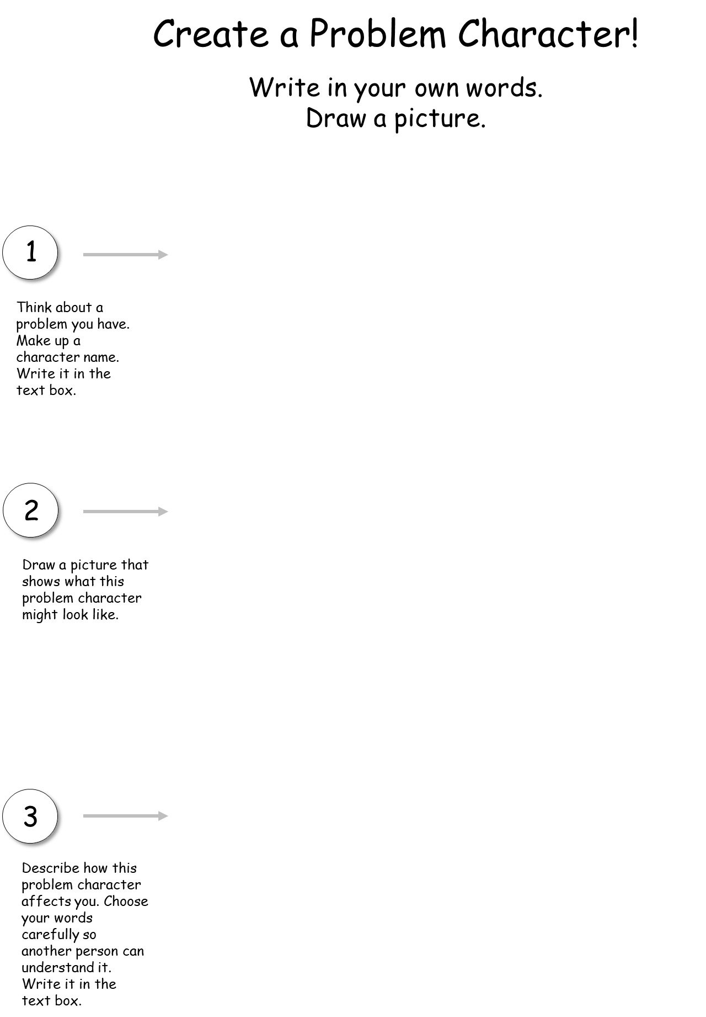

Slide 40
