Slide 1
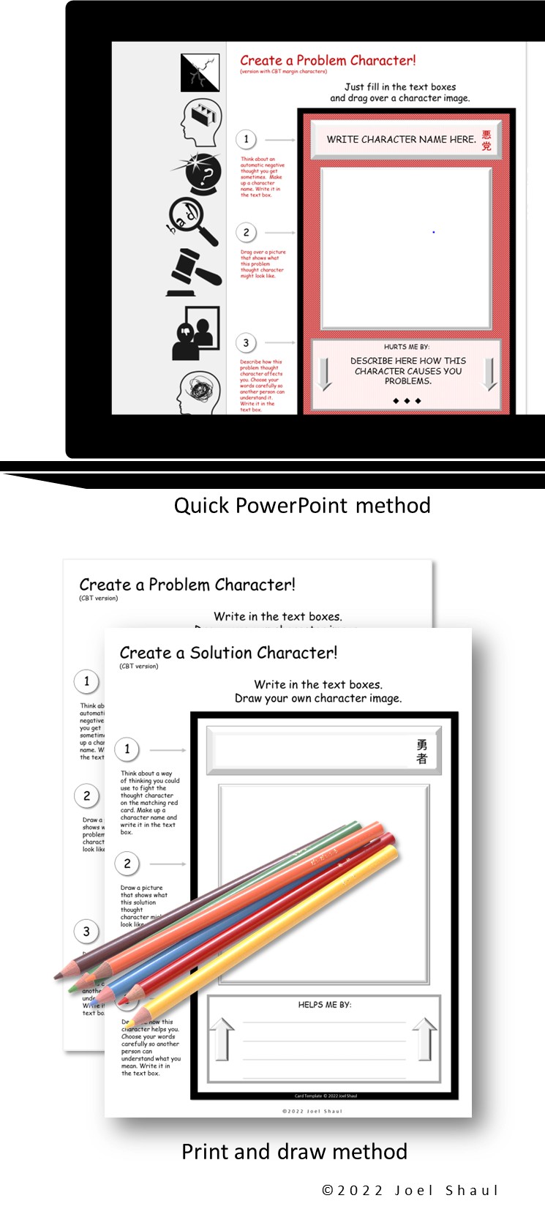
Creating character cards based on
problems and solutions –
(CBT Variation Download)
This card-making kit is a supplement or alternative to another free download, Problem & Solution Cards. I designed that first kit for general use by mental health, speech and school behavior specialists. (Check it out for 48 additional drag-and-drop images if you need them.)
This CBT Variation Download featured here has features making it better suited for mental health specialists, especially those working in CBT modalities.
Introduction
Children in mental health treatment can feel demoralized by being the “problem child” all the time. It can be useful sometimes to help our young clients externalize their problems onto fantasy characters which we can help them to fight against.
Many young people relate strongly to youth culture themes of “good guys” and “bad guys” through movies, stories, video games, and in trading card sets such as Pokémon and
Yu-gi-oh. To capitalize on this, I designed this free, easy
card-making project to help children focus on therapy
issues and coping strategies.
Ways to get started
Build a foundation of child-friendly CBT knowledge
On my website, there are lots of CBT materials. This 6-minute video provides a child-friendly CBT introduction.
Reference existing social skills character systems
You could introduce Social Thinking Unthinkables materials, which employ appealing and fanciful characters based on issues and solutions. Or you can lead a discussion about heroes and villains known to the child.
Create a few examples of Problem & Solution cards
To model admitting to problems and to demonstrate the basic process of creating these cards, you can make a card or two for yourself, using some simple problem examples worrying about finishing paperwork or panic when your computer freezes. Next, you could help the child create a hypothetical card for a kid with a certain problem. After this introduction, I find that most children are more than willing to attempt designing cards for themselves.
I hope this is a useful and fun project for the children you work with.
Joel Shaul

Slide 2
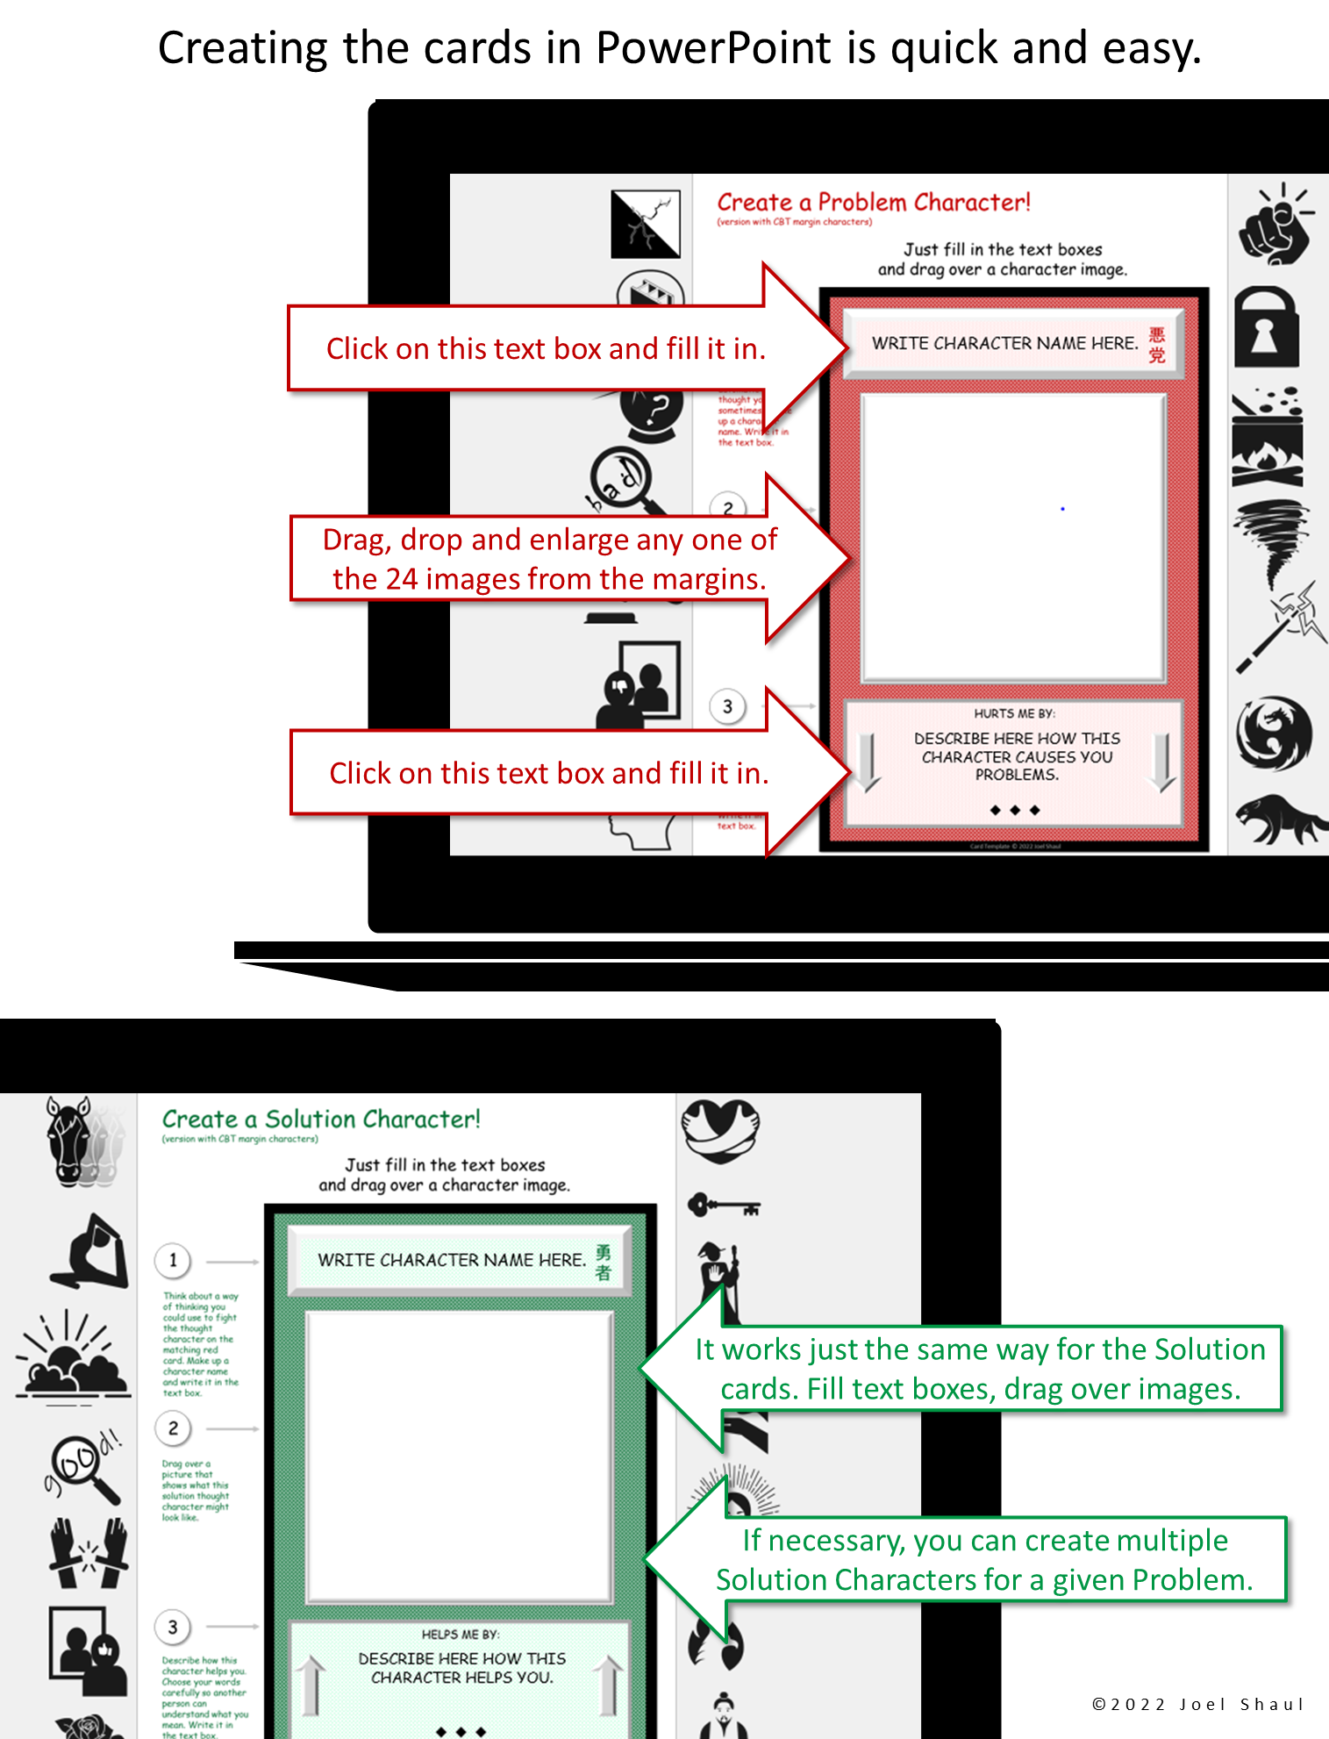

Slide 4
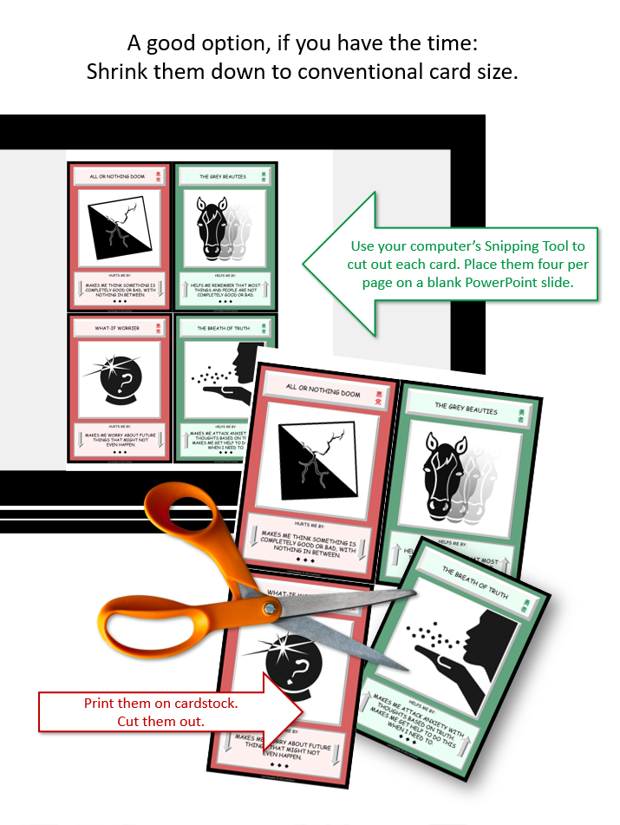

Slide 6
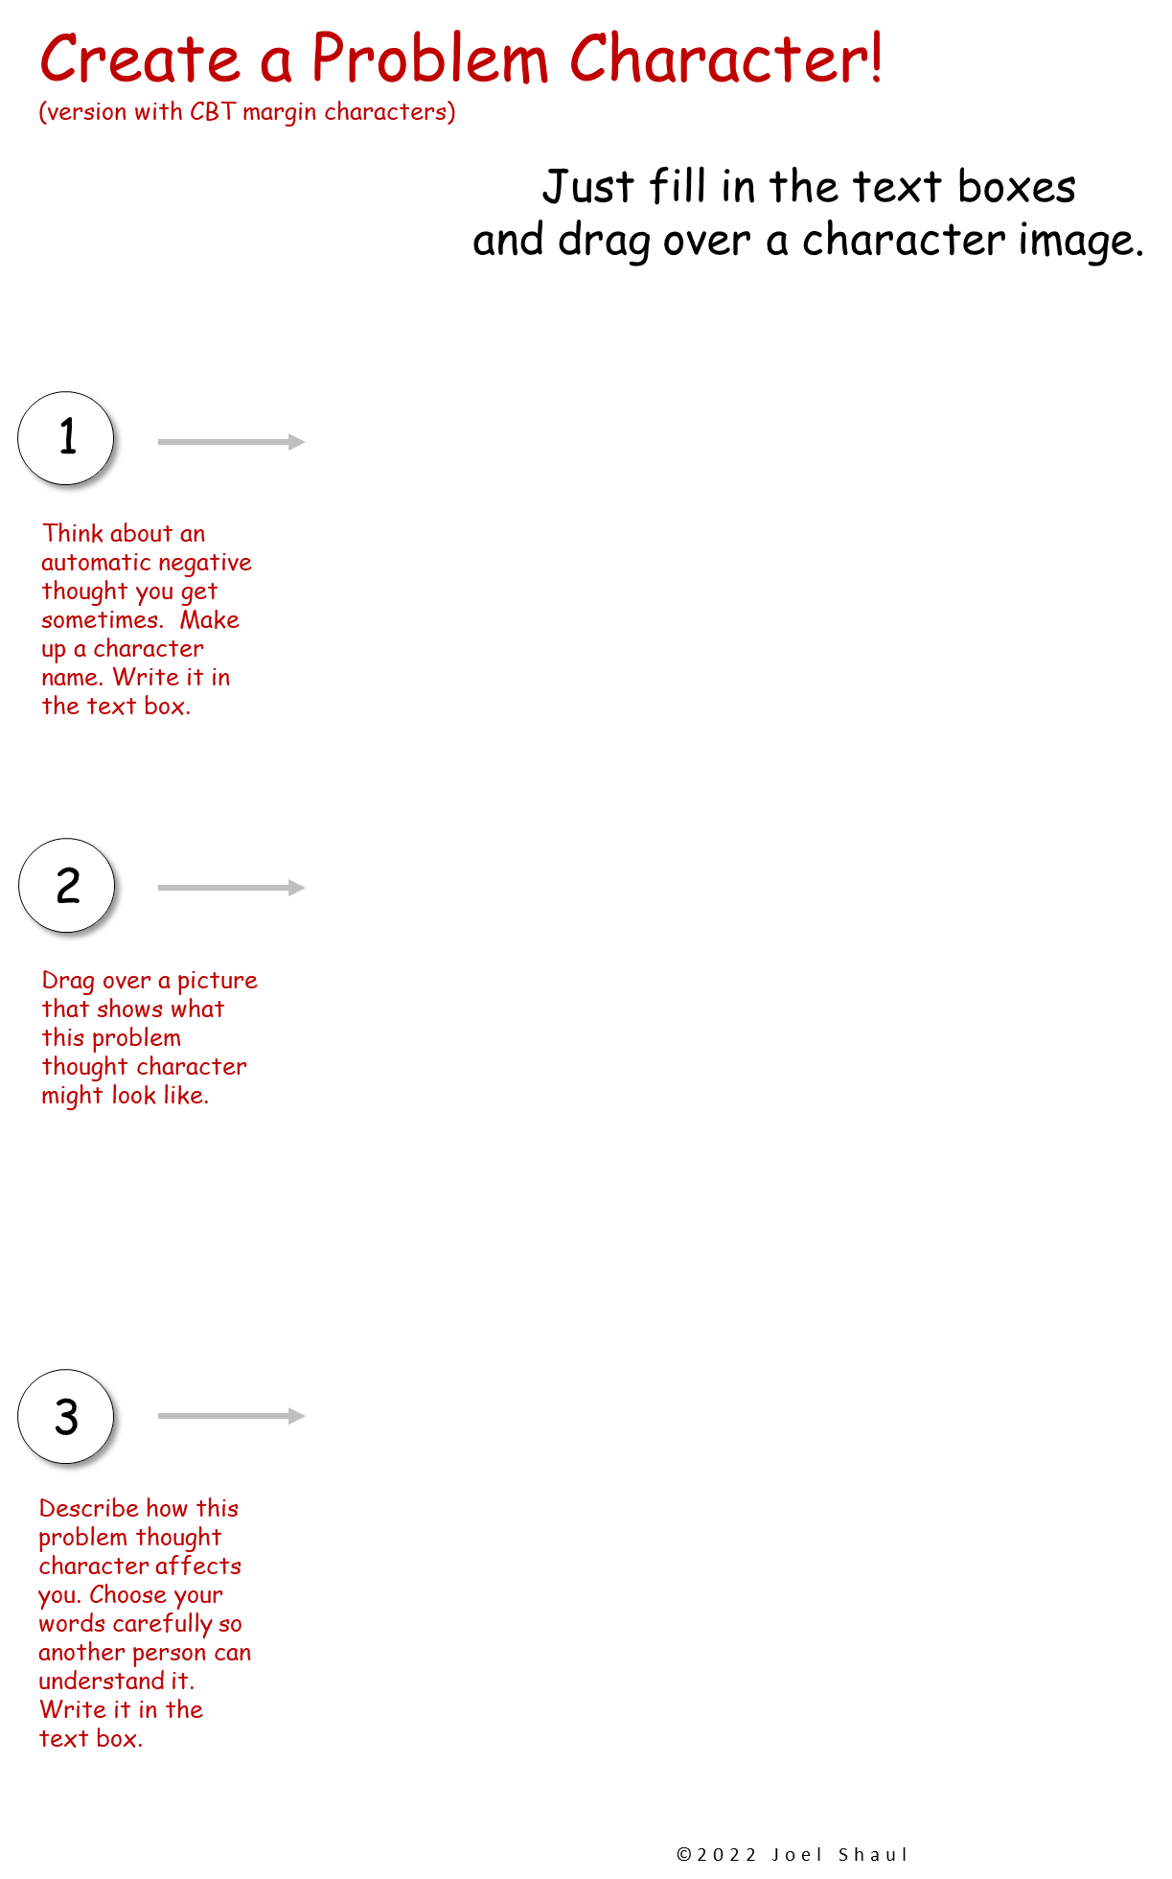
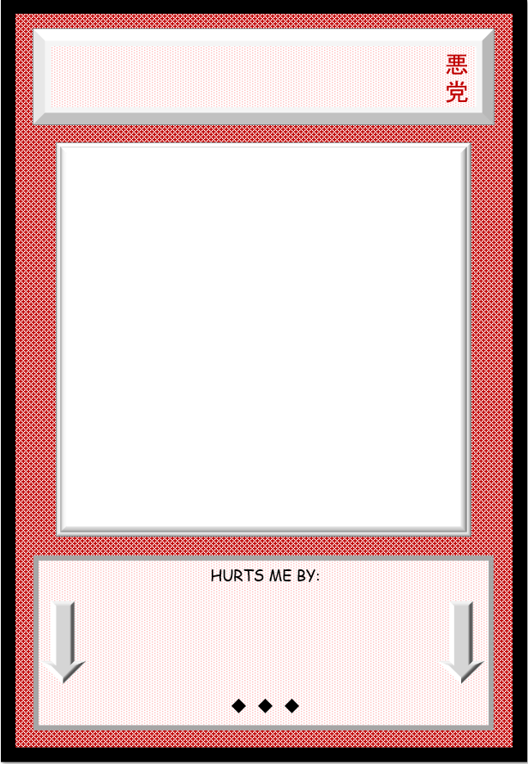
WRITE CHARACTER NAME HERE.
DESCRIBE HERE HOW THIS CHARACTER CAUSES YOU PROBLEMS.

Slide 7
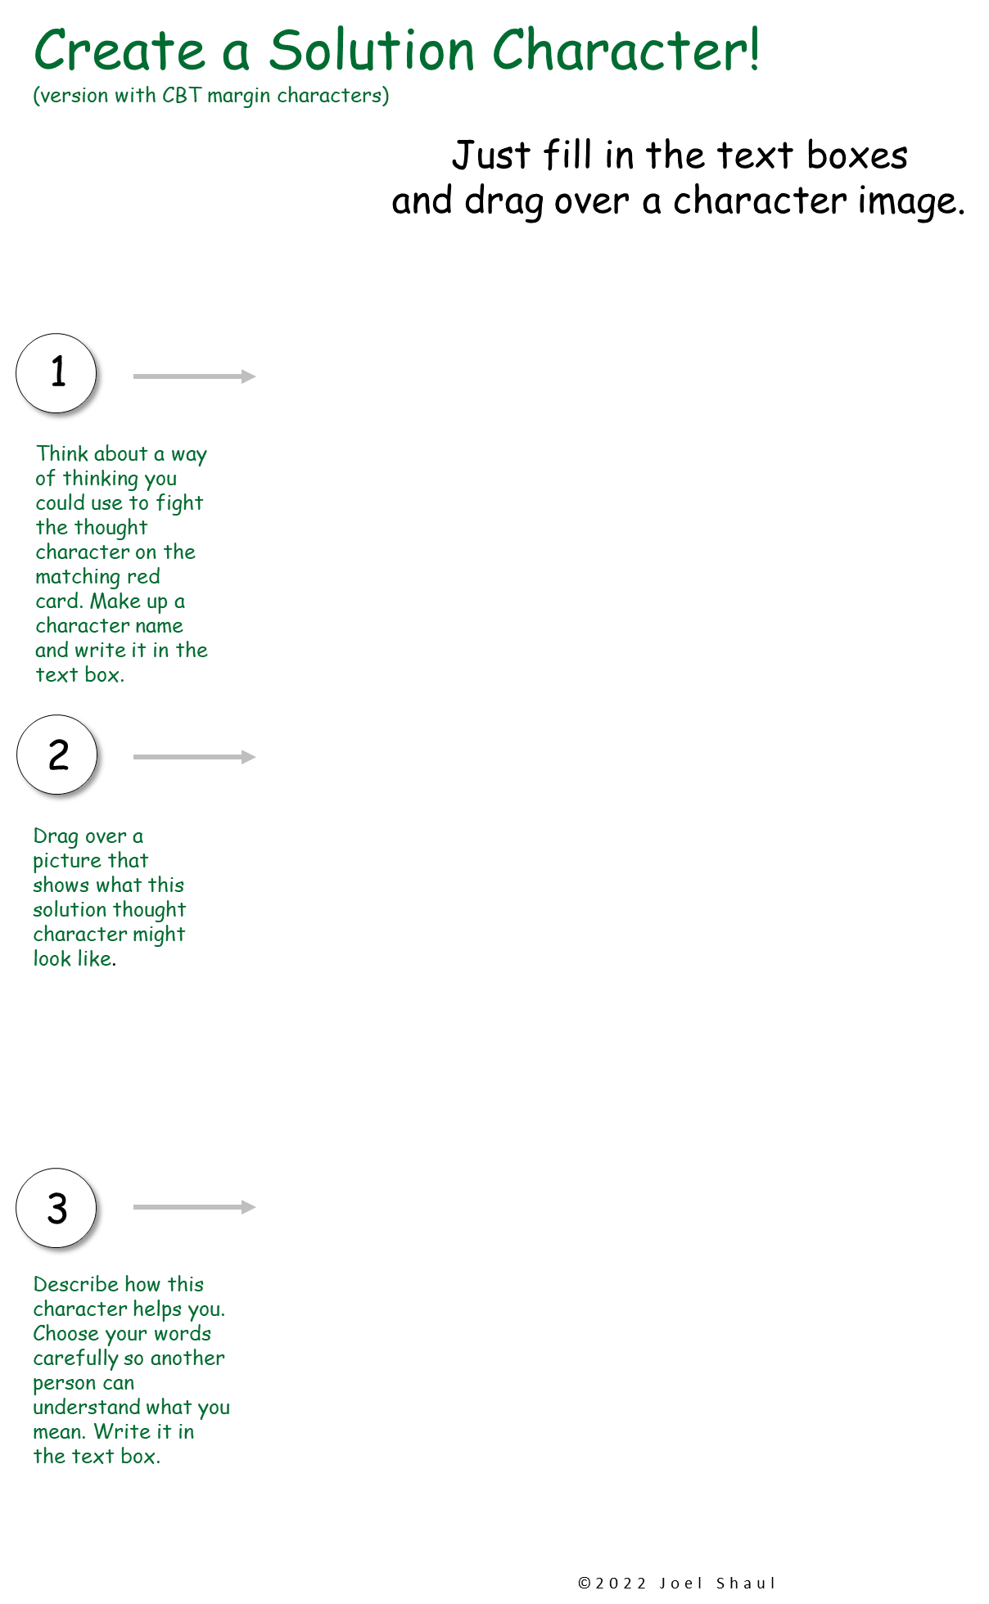
WRITE CHARACTER NAME HERE.
DESCRIBE HERE HOW THIS CHARACTER HELPS YOU.

Slide 8
WRITE CHARACTER NAME HERE.
DESCRIBE HERE HOW THIS CHARACTER CAUSES YOU PROBLEMS.

Slide 9
WRITE CHARACTER NAME HERE.
DESCRIBE HERE HOW THIS CHARACTER HELPS YOU.

Slide 10
WRITE CHARACTER NAME HERE.
DESCRIBE HERE HOW THIS CHARACTER CAUSES YOU PROBLEMS.

Slide 11
WRITE CHARACTER NAME HERE.
DESCRIBE HERE HOW THIS CHARACTER HELPS YOU.

Slide 12
WRITE CHARACTER NAME HERE.
DESCRIBE HERE HOW THIS CHARACTER CAUSES YOU PROBLEMS.

Slide 13
WRITE CHARACTER NAME HERE.
DESCRIBE HERE HOW THIS CHARACTER HELPS YOU.

Slide 14
WRITE CHARACTER NAME HERE.
DESCRIBE HERE HOW THIS CHARACTER CAUSES YOU PROBLEMS.

Slide 15
WRITE CHARACTER NAME HERE.
DESCRIBE HERE HOW THIS CHARACTER HELPS YOU.

Slide 16
WRITE CHARACTER NAME HERE.
DESCRIBE HERE HOW THIS CHARACTER CAUSES YOU PROBLEMS.

Slide 17
WRITE CHARACTER NAME HERE.
DESCRIBE HERE HOW THIS CHARACTER HELPS YOU.

Slide 18
WRITE CHARACTER NAME HERE.
DESCRIBE HERE HOW THIS CHARACTER CAUSES YOU PROBLEMS.

Slide 19
WRITE CHARACTER NAME HERE.
DESCRIBE HERE HOW THIS CHARACTER HELPS YOU.

Slide 20
WRITE CHARACTER NAME HERE.
DESCRIBE HERE HOW THIS CHARACTER CAUSES YOU PROBLEMS.

Slide 21
WRITE CHARACTER NAME HERE.
DESCRIBE HERE HOW THIS CHARACTER HELPS YOU.

Slide 22
WRITE CHARACTER NAME HERE.
DESCRIBE HERE HOW THIS CHARACTER CAUSES YOU PROBLEMS.

Slide 23
WRITE CHARACTER NAME HERE.
DESCRIBE HERE HOW THIS CHARACTER HELPS YOU.

Slide 24
WRITE CHARACTER NAME HERE.
DESCRIBE HERE HOW THIS CHARACTER CAUSES YOU PROBLEMS.

Slide 25
WRITE CHARACTER NAME HERE.
DESCRIBE HERE HOW THIS CHARACTER HELPS YOU.

Slide 26
WRITE CHARACTER NAME HERE.
DESCRIBE HERE HOW THIS CHARACTER CAUSES YOU PROBLEMS.

Slide 27
WRITE CHARACTER NAME HERE.
DESCRIBE HERE HOW THIS CHARACTER HELPS YOU.

Slide 28
WRITE CHARACTER NAME HERE.
DESCRIBE HERE HOW THIS CHARACTER CAUSES YOU PROBLEMS.

Slide 29
WRITE CHARACTER NAME HERE.
DESCRIBE HERE HOW THIS CHARACTER HELPS YOU.

Slide 30
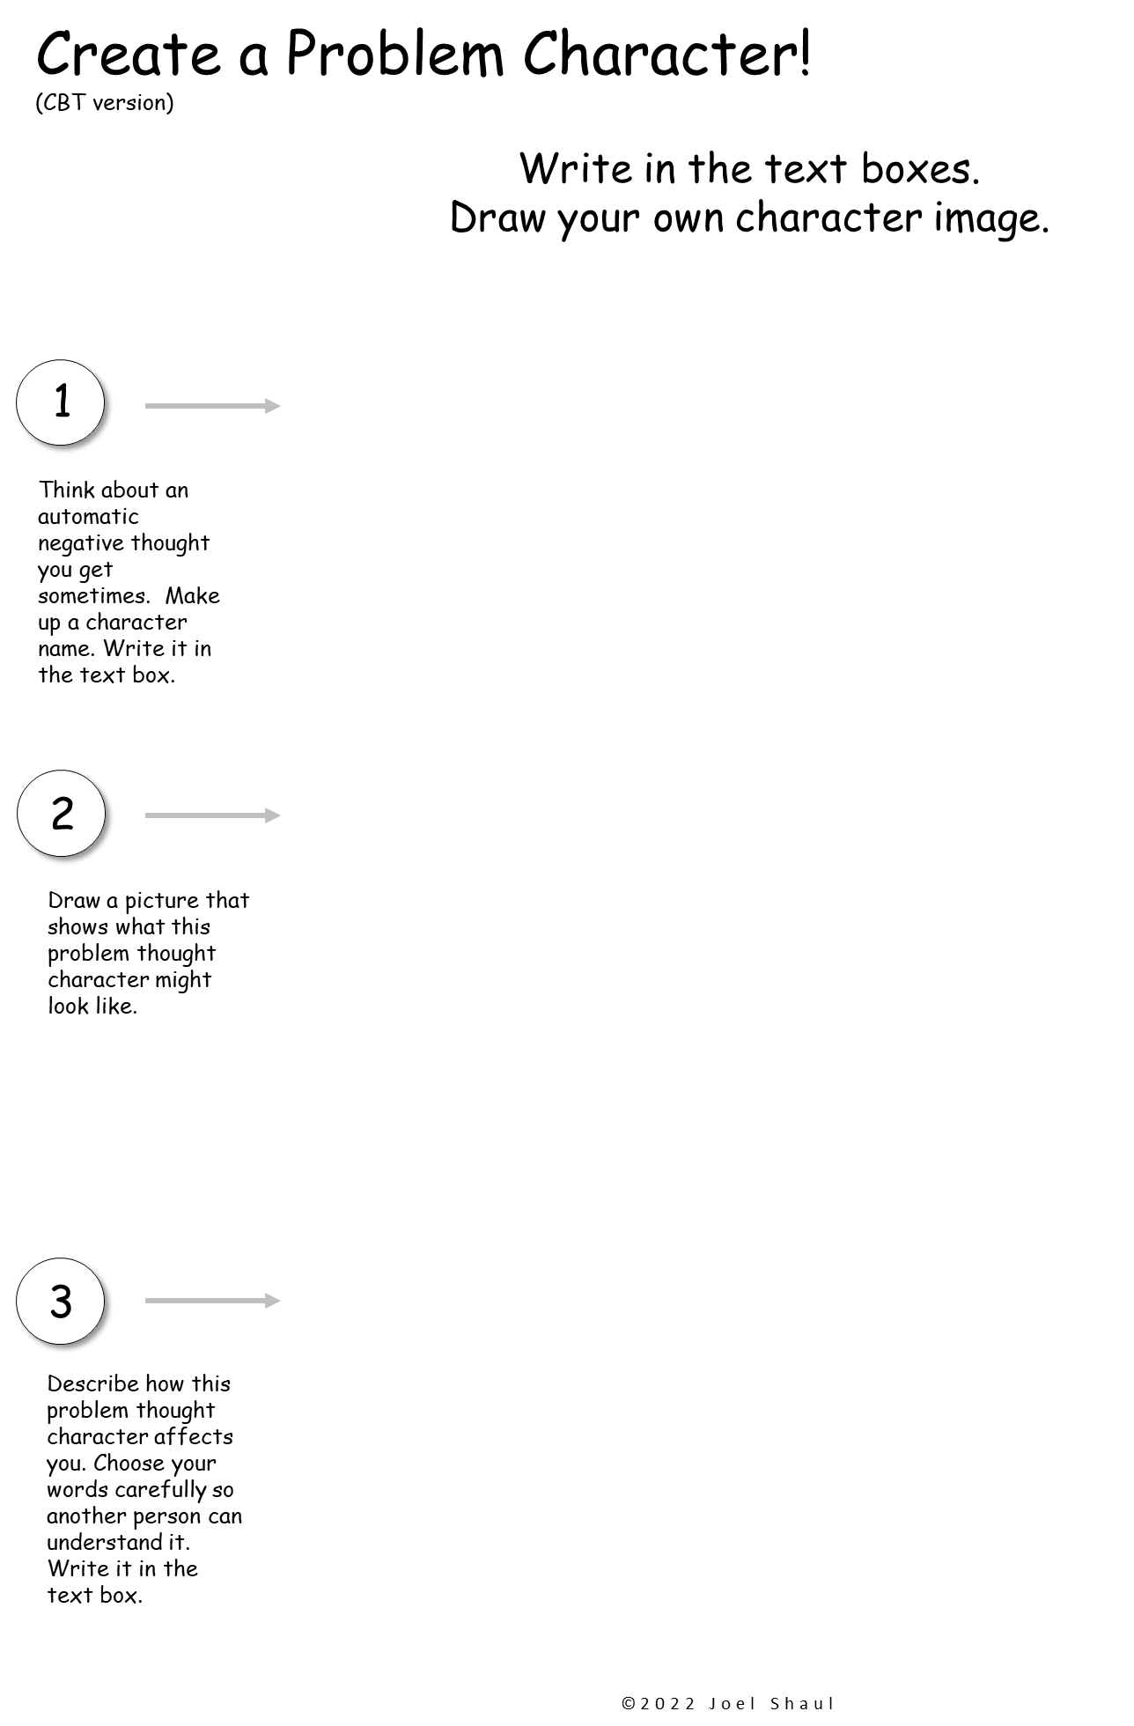

Slide 31
