Slide 1
Tattling & Correcting Question Cards
& Teaching Panels
Screen-based Version
Joel Shaul
© 2022 Joel Shaul

Slide 2
Young people with ASD often find it hard to know when, and when not, to tell on someone or tell someone they are wrong. These teaching materials are to raise awareness about the social aspects of correcting and tattling.
Teaching Panels
These are to establish basic guidelines for making informed decisions about tattling and correcting. I suggest you print out the Teaching Panels and keep them nearby when you are showing the Question Cards on your computer.
Question Cards
I designed these 48 cards to cover a wide variety of scenarios. Some of them are “easy” and others I deliberately created to be ambiguous and thought-provoking.
This kit is also available in a printable version at autismteachingstrategies.com.
© 2022 Joel Shaul

Slide 3
Before tattling,
ask yourself:
Is anyone
really
getting hurt?
Are you the one in
charge?
Is it
really important?
© 2022 Joel Shaul

Slide 4
Before correcting someone,
ask yourself:
Does it
really
matter?
Are you the one in
charge?
Will your words bother
someone?
© 2022 Joel Shaul

Slide 5
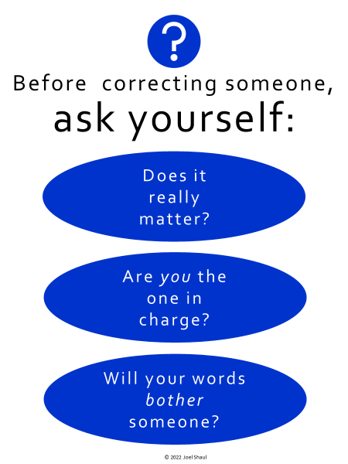
Correcting:
Telling someone they did something
or said something
wrong or incorrect.
Is this important to others,
or just to you?
Are you saying this to
be helpful, or just to
make you feel good?
Usually, grown-ups
do the correcting,
unless it’s really important
for someone to know
what you think.
Will people think you
are bossy?
Will people think you
can’t mind your
own business?
© 2022 Joel Shaul

Slide 6
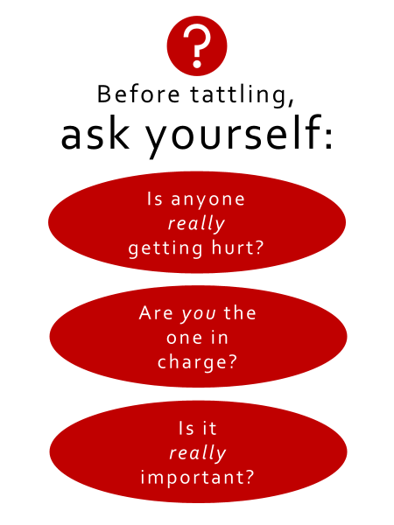
Tattling:
Telling another person that
someone did something
wrong or harmful.
Will someone’s body
or feelings get hurt
if you don’t
tell on the person?
Is it your job to
tell on someone now,
or are you just
one of the kids?
Will tattling annoy
someone a lot?
Is this a big deal
for other people,
or mainly just for you?
© 2022 Joel Shaul

Slide 7
Tattling choices:
Should you tattle? There are choices. Think first.
You could…
…tell a grown-up right away
…say nothing at all.
…watch and think before deciding whether to tell.
…say something to the person instead of tattling.
…ask someone if telling a
grown-up is necessary.
Correcting choices:
Should you correct someone? There are choices. Think first.
You could…
..tell the person they are wrong.
…disagree in your brain, but say nothing out loud.
…ask yourself if the other person may actually be right, or else maybe
not completely wrong.
…talk with the person, using friendly words like:
“Did you know that what you’re doing is against the rules?”
“I think I might not agree.”
“Can I tell you what I think?”
.
© 2022 Joel Shaul

Slide 10
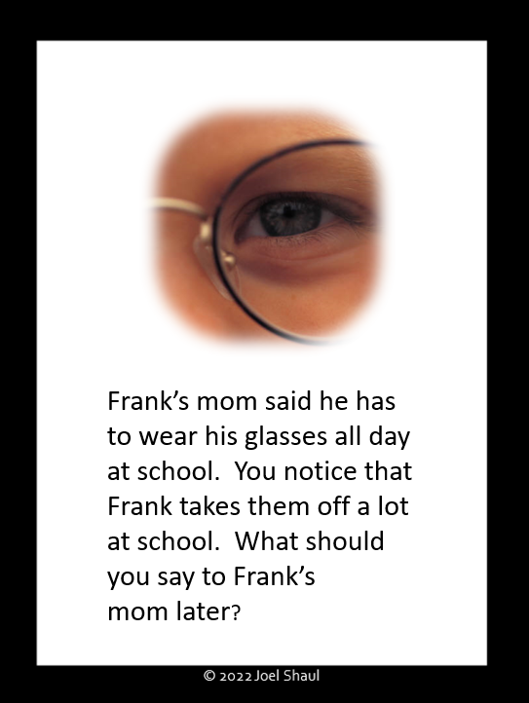

Slide 33
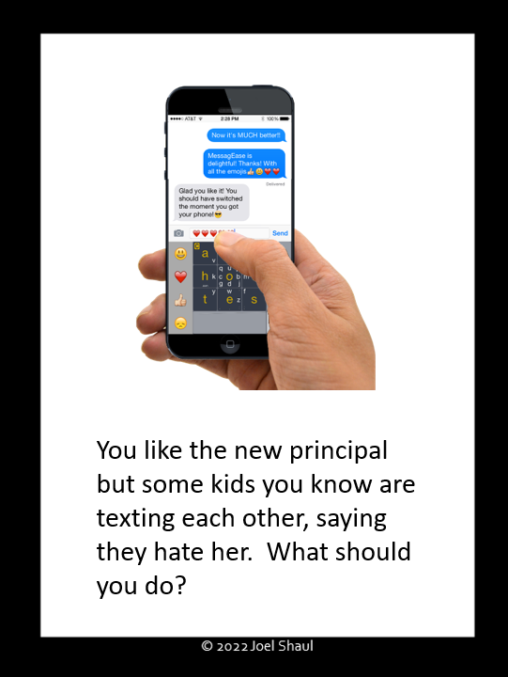

Slide 37
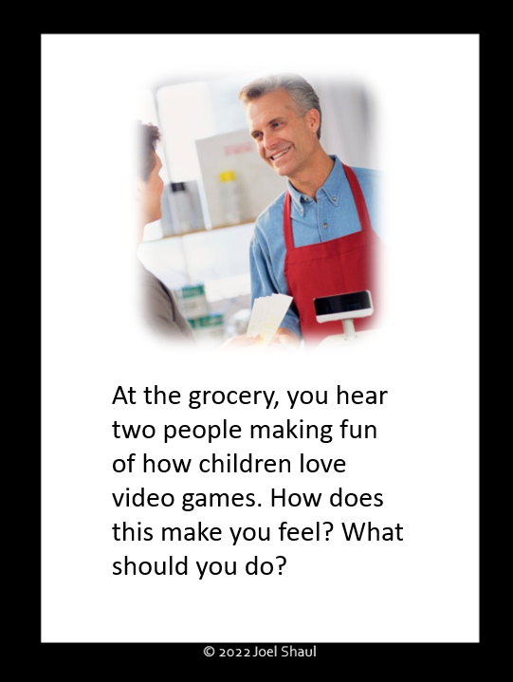

Slide 40
