Slide 1
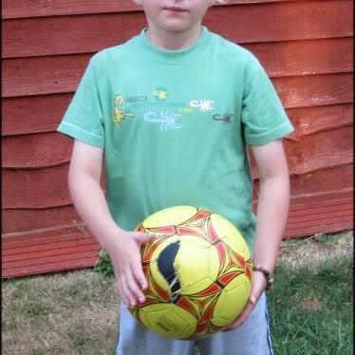
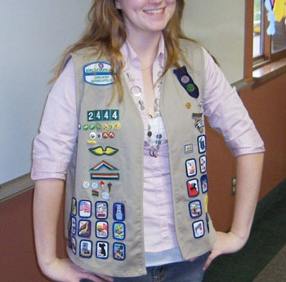
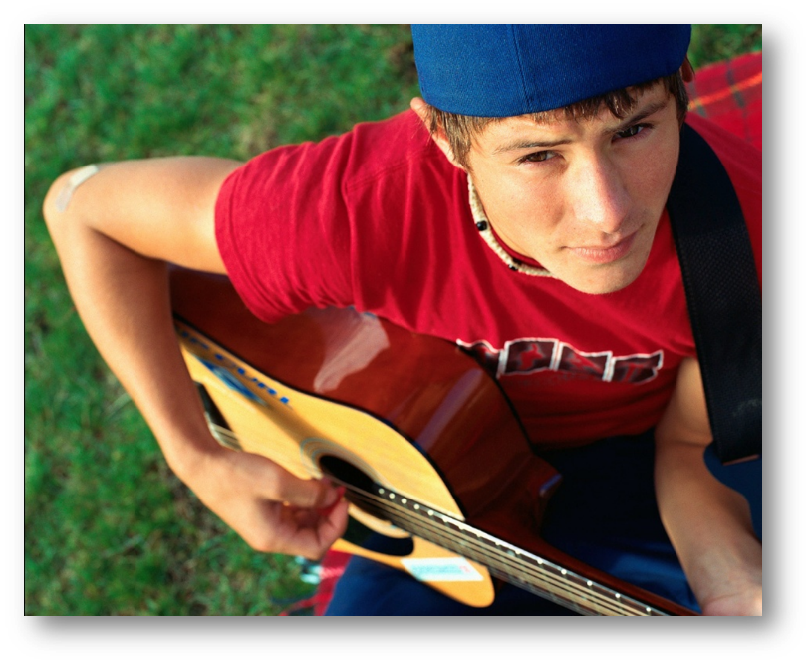
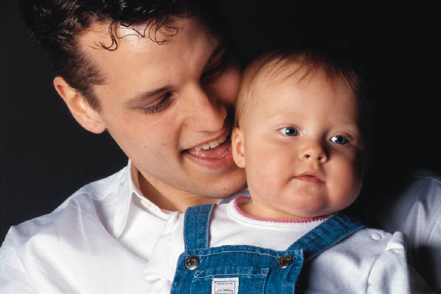
100 Cool People Photos
for Conversation Practice!
An animated PowerPoint
to practice
talking with people
Joel Shaul, LCSW

Slide 2
Introduction and instructions for the teacher/therapist/adult:
Children with autism spectrum disorders usually find it quite difficult to start conversations based on other people’s interests. We need to provide opportunities for practice.
This set of materials is designed to provide conversation-starting practice in an engaging, game-like fashion.
Suggestions:
It works well if you, the adult, act out the role of the person in each slide. The child then talks to you while you stay in character.
For children who read, print out the Question/Compliment/Comment Page (next slide) for each child to use as a reference for words and phrases.
It helps enormously if you give out any kind of tokens while you are going through the various scenarios.
Visit my website, autismteachingstrategies.com, for lots more free materials on social communication, as well as links to my children’s books published by Jessica Kingsley.
Joel Shaul, LCSW

Slide 3
Question/Compliment/Comment Helper Page
USE THIS AS A VISUAL PROMPT AS NEEDED IN CONVERSATION PRACTICE AND ROLE PLAYS
Do you like...
What is your favorite…
QUESTIONS
What do you think about…
Where…
How did you…
When did you…
Cool
Awesome
Interesting
COMPLIMENTS
I like how you…
You’re good at…
You know a lot about…
I like your…
Tell me something about …
I noticed you seem to like…
FRIENDLY COMMENTS
I’m wondering about your…
You said something about…
© Joel Shaul, 2010

Slide 4
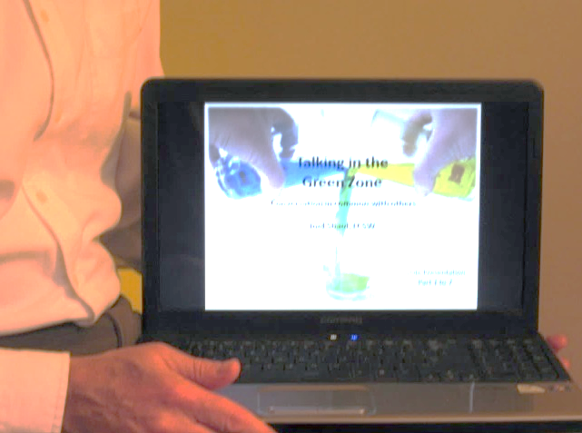
Show it on a small computer
Project it on a screen
© Joel Shaul, 2010

Slide 5
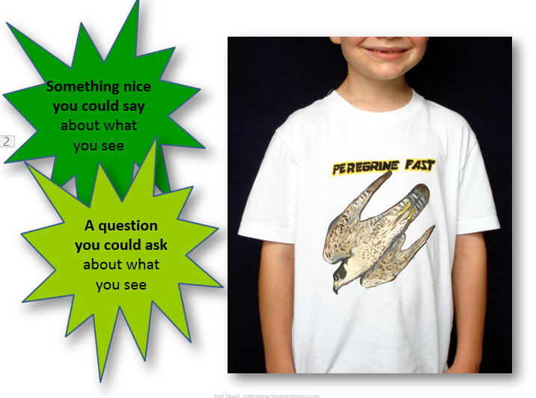
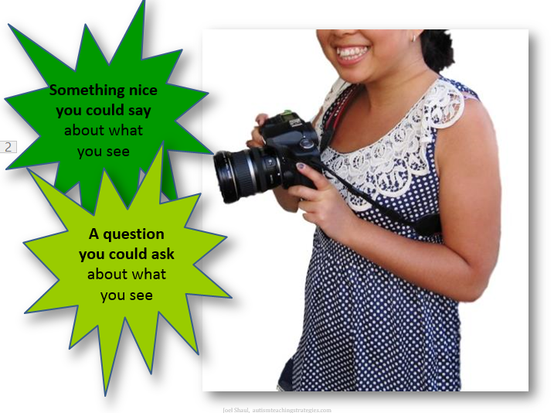
You can also print out the pages.
© Joel Shaul, 2010

Slide 6
People’s minds fill up with the things they like.
© Joel Shaul, 2010

Slide 7
Then, people like to talk about these things they like.
Which of these things do you like to talk about?

Slide 8
© Joel Shaul, 2010

Slide 9
© Joel Shaul, 2010

Slide 10
© Joel Shaul, 2010

Slide 11
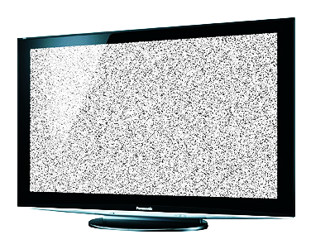
© Joel Shaul, 2010

Slide 12
?
What are some other things you like – things you like to
talk about?
?
© Joel Shaul, 2010

Slide 13
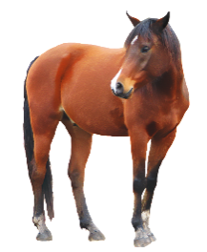
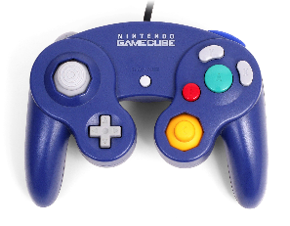
Other people have their own thoughts.
Usually, other people’s thoughts are not the same as your own.
© Joel Shaul, 2010

Slide 14
If you only talk about your own interests, it’s not fair. It’s not nice.
© Joel Shaul, 2010

Slide 15
You don’t ever want other people to feel like you are pushing the DELETE button on their own thoughts and interests!
© Joel Shaul, 2010

Slide 16
Now, we are going to practice how to watch carefully
for the things that other people like…
…and how to talk about these things.
…how to think about the things people like…
© Joel Shaul, 2010

Slide 17
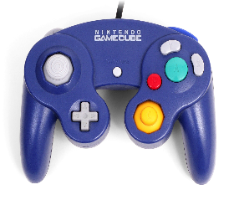
How to do it: Step One:
Try to shrink your own interests smaller for a moment in your brain.
© Joel Shaul, 2010

Slide 18
How to do it: Step Two:
Look at what the other person is doing, what they are holding, what they are making.
© Joel Shaul, 2010

Slide 19
How to do it: Step Three:
Do your best to talk about these things that the other person likes.
© Joel Shaul, 2010

Slide 20
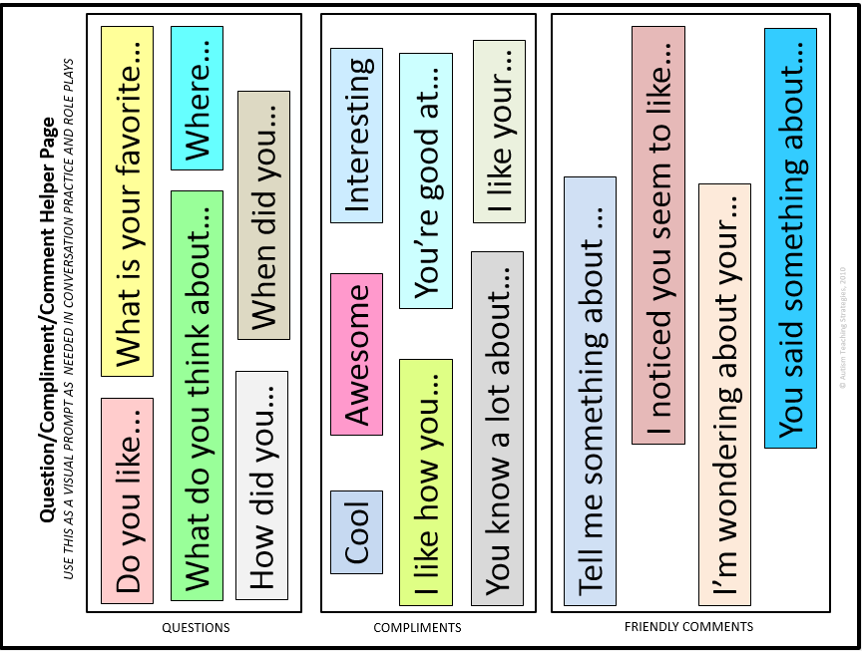
Some words you can use–
The adult with you can give you this sheet for some ideas.
© Joel Shaul, 2010

Slide 21
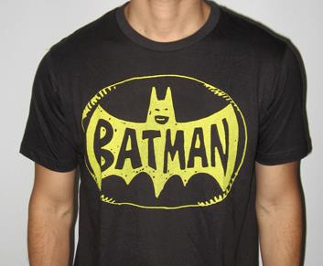
Example:
(keep clicking to make various text options appear)
Something nice you could say about what
you see
Looks like you’re into Batman.
A question you could ask about what you see
Cool shirt.
Where did you get that shirt?
© Joel Shaul, 2010

Slide 22
Now, try these on your own! Good luck!
Something nice you could say about what
you see
A question you could ask about what you see
© Joel Shaul, 2010

Slide 23
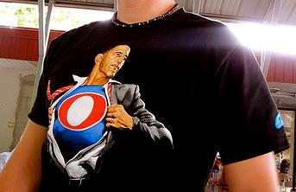
Something nice you could say about what
you see
A question you could ask about what you see
© Joel Shaul, 2010

Slide 24
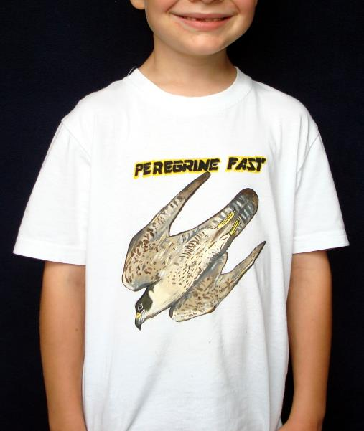
Something nice you could say about what
you see
A question you could ask about what you see
© Joel Shaul, 2010

Slide 25
Something nice you could say about what
you see
A question you could ask about what you see
© Joel Shaul, 2010

Slide 26
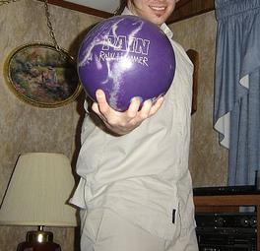
Something nice you could say about what
you see
A question you could ask about what you see
© Joel Shaul, 2010

Slide 27
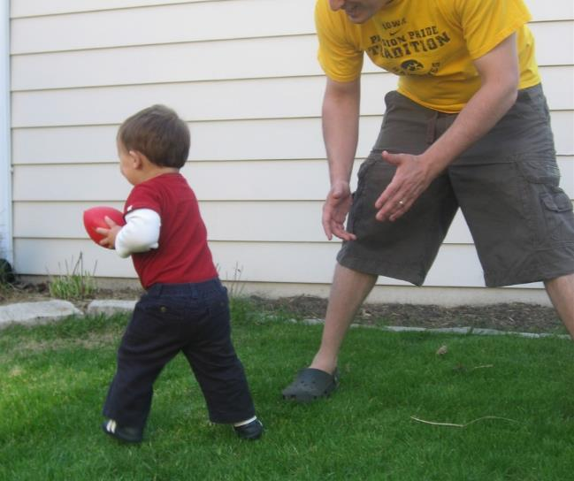
Something nice you could say about what
you see
A question you could ask about what you see
© Joel Shaul, 2010

Slide 28
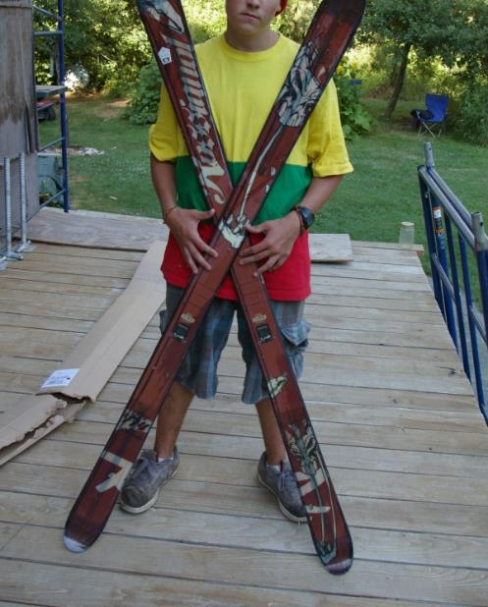
Something nice you could say about what
you see
A question you could ask about what you see
© Joel Shaul, 2010

Slide 29
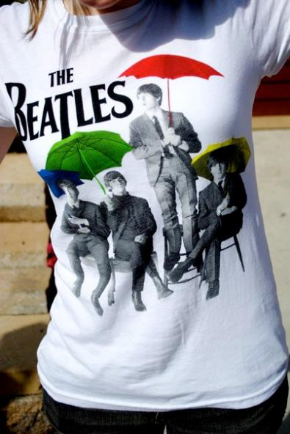
Something nice you could say about what
you see
A question you could ask about what you see
© Joel Shaul, 2010

Slide 30
Something nice you could say about what you see
A question you could ask about what you see
© Joel Shaul, 2010

Slide 31
Something nice you could say about what
you see
A question you could ask about what you see
© Joel Shaul, 2010

Slide 32
Something nice you could say about what
you see
A question you could ask about what you see
© Joel Shaul, 2010

Slide 33
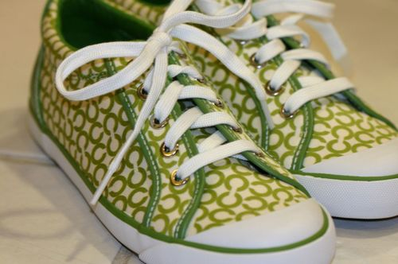
Something nice you could say about what
you see
A question you could ask about what you see
© Joel Shaul, 2010

Slide 34
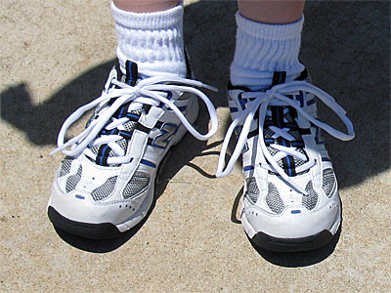
Something nice you could say about what
you see
A question you could ask about what you see
© Joel Shaul, 2010

Slide 35
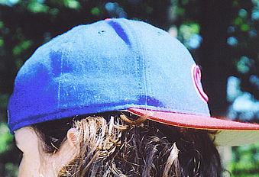
Something nice you could say about what
you see
A question you could ask about what you see
© Joel Shaul, 2010

Slide 36
Something nice you could say about what
you see
A question you could ask about what you see
© Joel Shaul, 2010

Slide 37
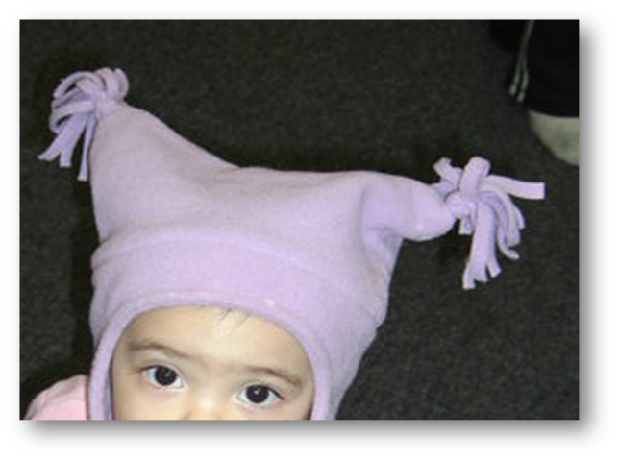
Something nice you could say about what
you see
A question you could ask about what you see
© Joel Shaul, 2010

Slide 38
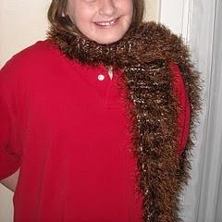
Something nice you could say about what
you see
A question you could ask about what you see
© Joel Shaul, 2010

Slide 39
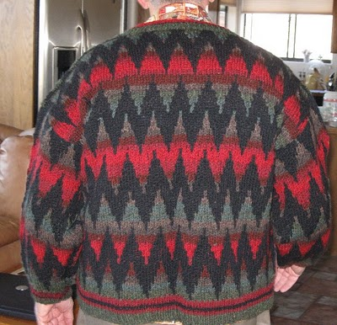
Something nice you could say about what you see
A question you could ask about what you see
© Joel Shaul, 2010

Slide 40
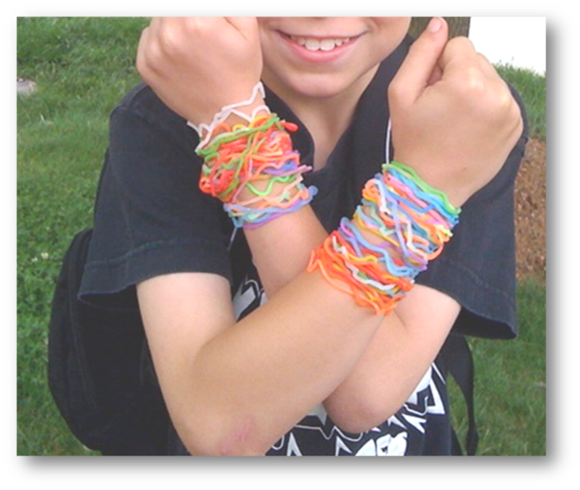
Something nice you could say about what
you see
A question you could ask about what you see

Slide 41
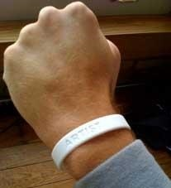
Something nice you could say about what
you see
A question you could ask about what you see
© Joel Shaul, 2010

Slide 42
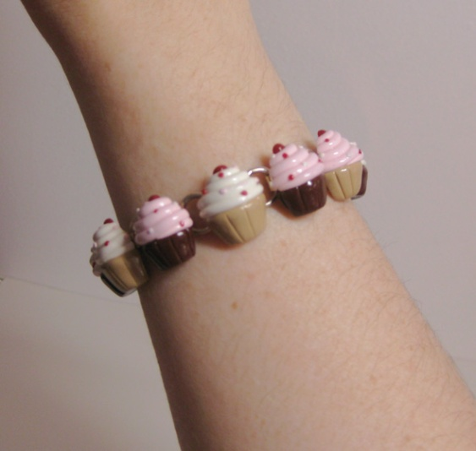
Something nice you could say about what
you see
A question you could ask about what you see
© Joel Shaul, 2010

Slide 43
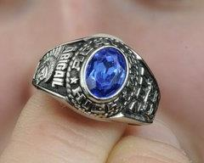
Something nice you could say about what
you see
A question you could ask about what you see
© Joel Shaul, 2010

Slide 44
Something nice you could say about what
you see
A question you could ask about what you see
© Joel Shaul, 2010

Slide 45
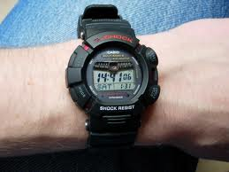
Something nice you could say about what
you see
A question you could ask about what you see
© Joel Shaul, 2010

Slide 46
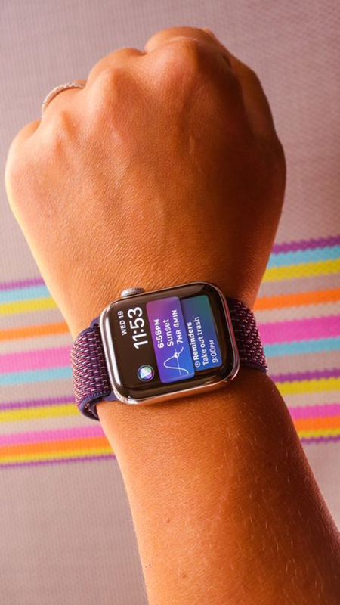
Something nice you could say about what
you see
A question you could ask about what you see
© Joel Shaul, 2010

Slide 47
Something nice you could say about what
you see
A question you could ask about what you see
© Joel Shaul, 2010

Slide 48
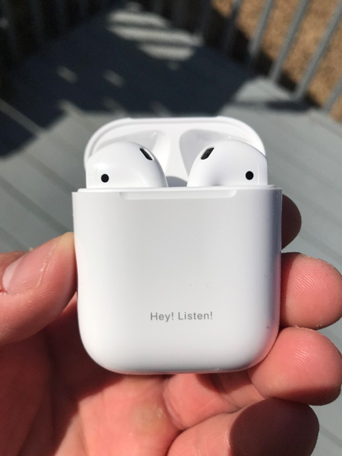
Something nice you could say about what
you see
A question you could ask about what you see
© Joel Shaul, 2010

Slide 49
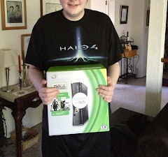
Something nice you could say about what
you see
A question you could ask about what you see
© Joel Shaul, 2010

Slide 50
Something nice you could say about what
you see
A question you could ask about what you see
© Joel Shaul, 2010

Slide 51
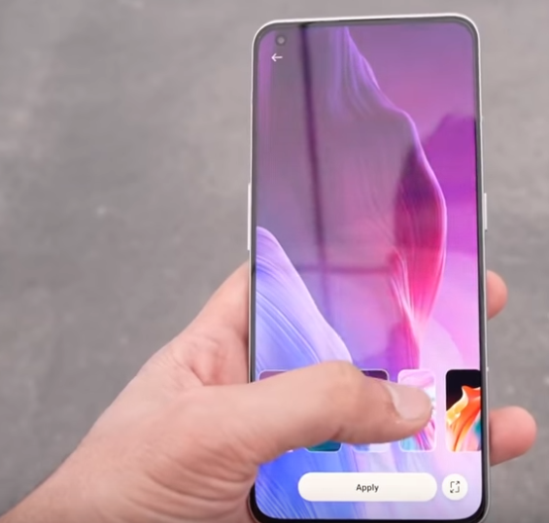
Something nice you could say about what
you see
A question you could ask about what you see
© Joel Shaul, 2010

Slide 52
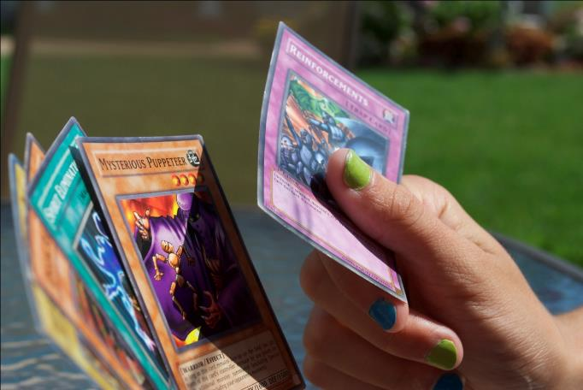
Something nice you could say about what
you see
A question you could ask about what you see
© Joel Shaul, 2010

Slide 53
Something nice you could say about what
you see
A question you could ask about what you see
© Joel Shaul, 2010

Slide 54
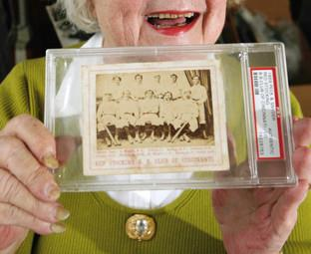
Something nice you could say about what
you see
A question you could ask about what you see
© Joel Shaul, 2010

Slide 55
Something nice you could say about what
you see
A question you could ask about what you see
© Joel Shaul, 2010

Slide 56
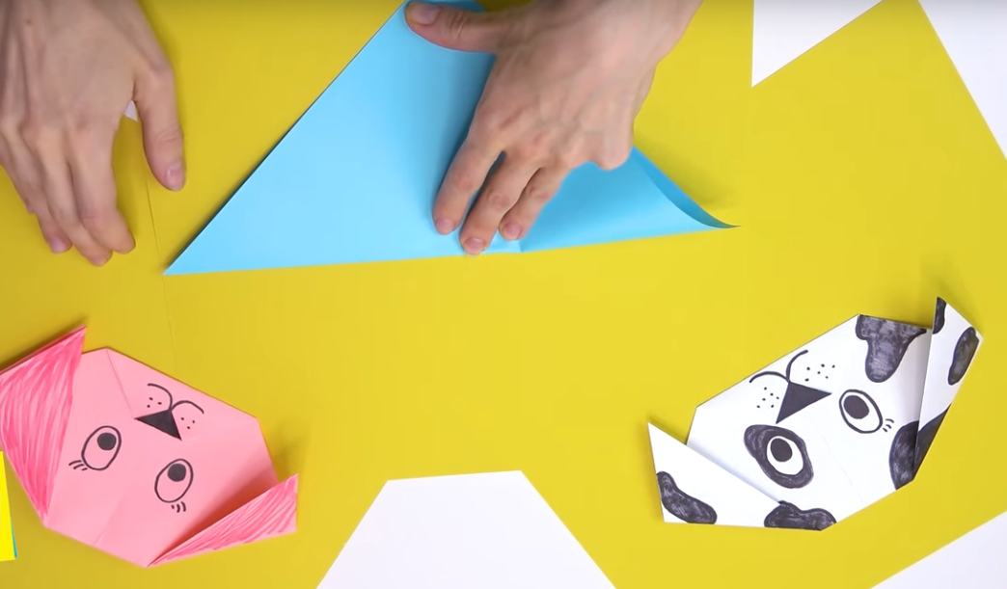
Something nice you could say about what
you see
A question you could ask about what you see
© Joel Shaul, 2010

Slide 57
Something nice you could say about what
you see
A question you could ask about what you see
© Joel Shaul, 2010

Slide 58
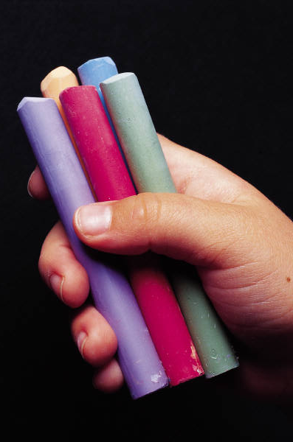
Something nice you could say about what
you see
A question you could ask about what you see

Slide 59
Something nice you could say about what
you see
A question you could ask about what you see
© Joel Shaul, 2010

Slide 60
Something nice you could say about what
you see
A question you could ask about what you see
© Joel Shaul, 2010

Slide 61
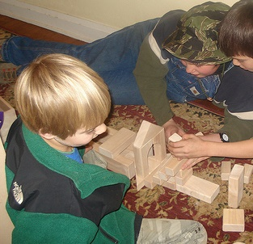
Something nice you could say about what
you see
A question you could ask about what you see
© Joel Shaul, 2010

Slide 62
Something nice you could say about what
you see
A question you could ask about what you see
© Joel Shaul, 2010

Slide 63
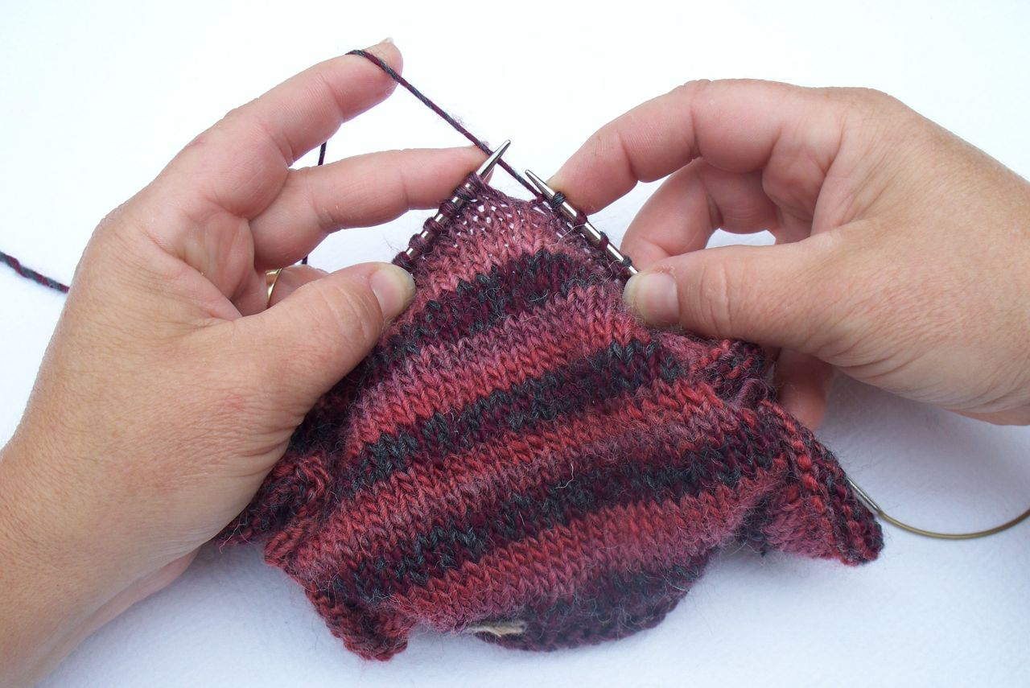
Something nice you could say about what
you see
A question you could ask about what you see
© Joel Shaul, 2010

Slide 64
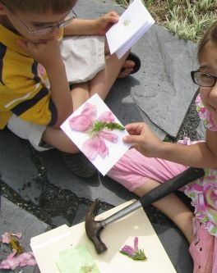
Something nice you could say about what
you see
A question you could ask about what you see
© Joel Shaul, 2010

Slide 65
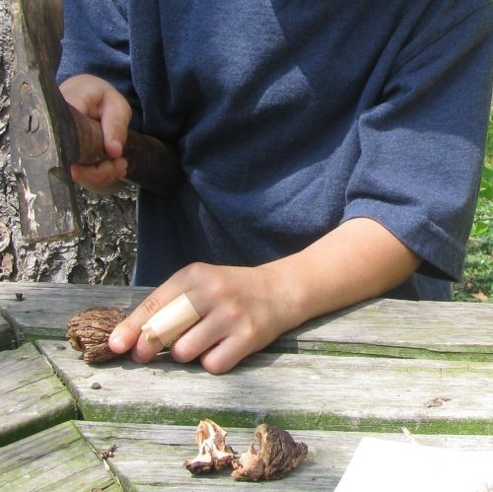
Something nice you could say about what
you see
A question you could ask about what you see
© Joel Shaul, 2010

Slide 66
Something nice you could say about what
you see
A question you could ask about what you see
© Joel Shaul, 2010

Slide 67
Something nice you could say about what
you see
A question you could ask about what you see
© Joel Shaul, 2010

Slide 68
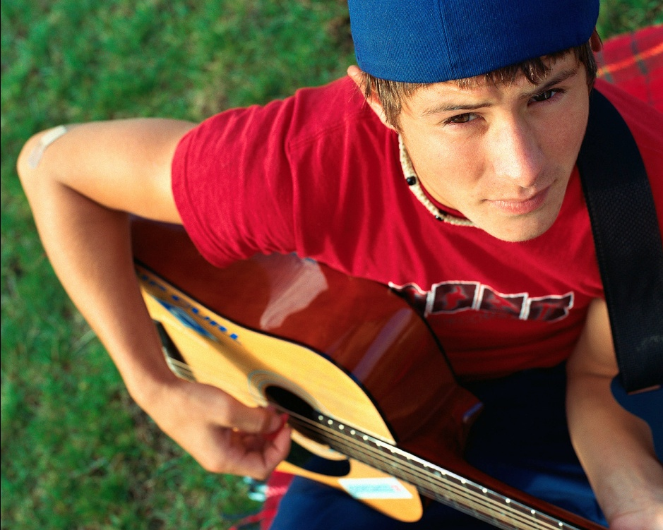
Something nice you could say about what
you see
A question you could ask about what you see
© Joel Shaul, 2010

Slide 69
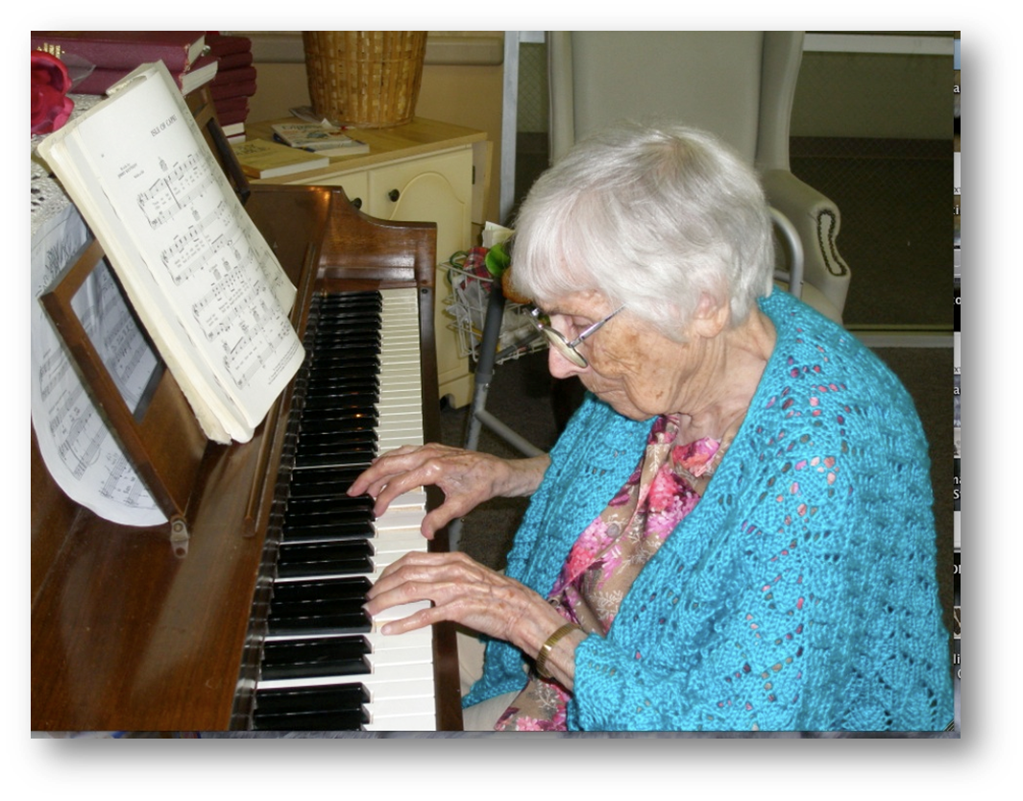
Something nice you could say about what
you see
A question you could ask about what you see
© Joel Shaul, 2010

Slide 70
Something nice you could say about what
you see
A question you could ask about what you see
© Joel Shaul, 2010

Slide 71
Something nice you could say about what
you see
A question you could ask about what you see
© Joel Shaul, 2010

Slide 72
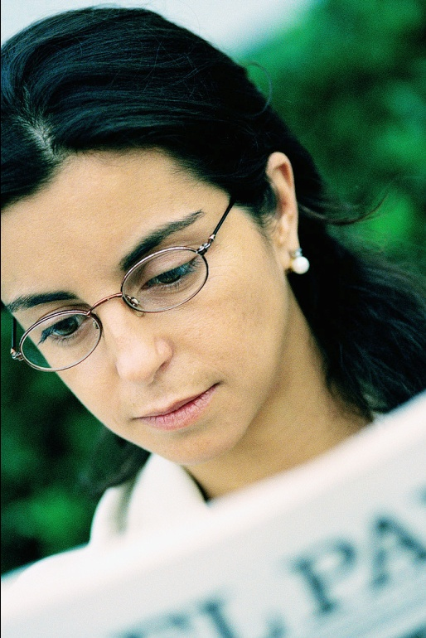
Something nice you could say about what
you see
A question you could ask about what you see
© Joel Shaul, 2010

Slide 73
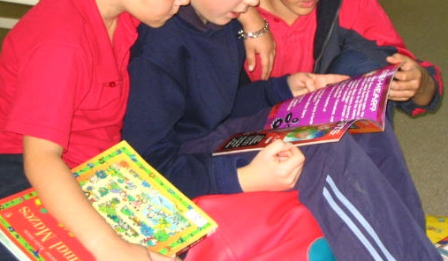
Something nice you could say about what
you see
A question you could ask about what you see
© Joel Shaul, 2010

Slide 74
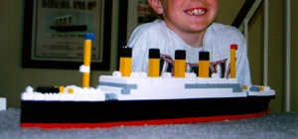
Something nice you could say about what
you see
A question you could ask about what you see
© Joel Shaul, 2010

Slide 75
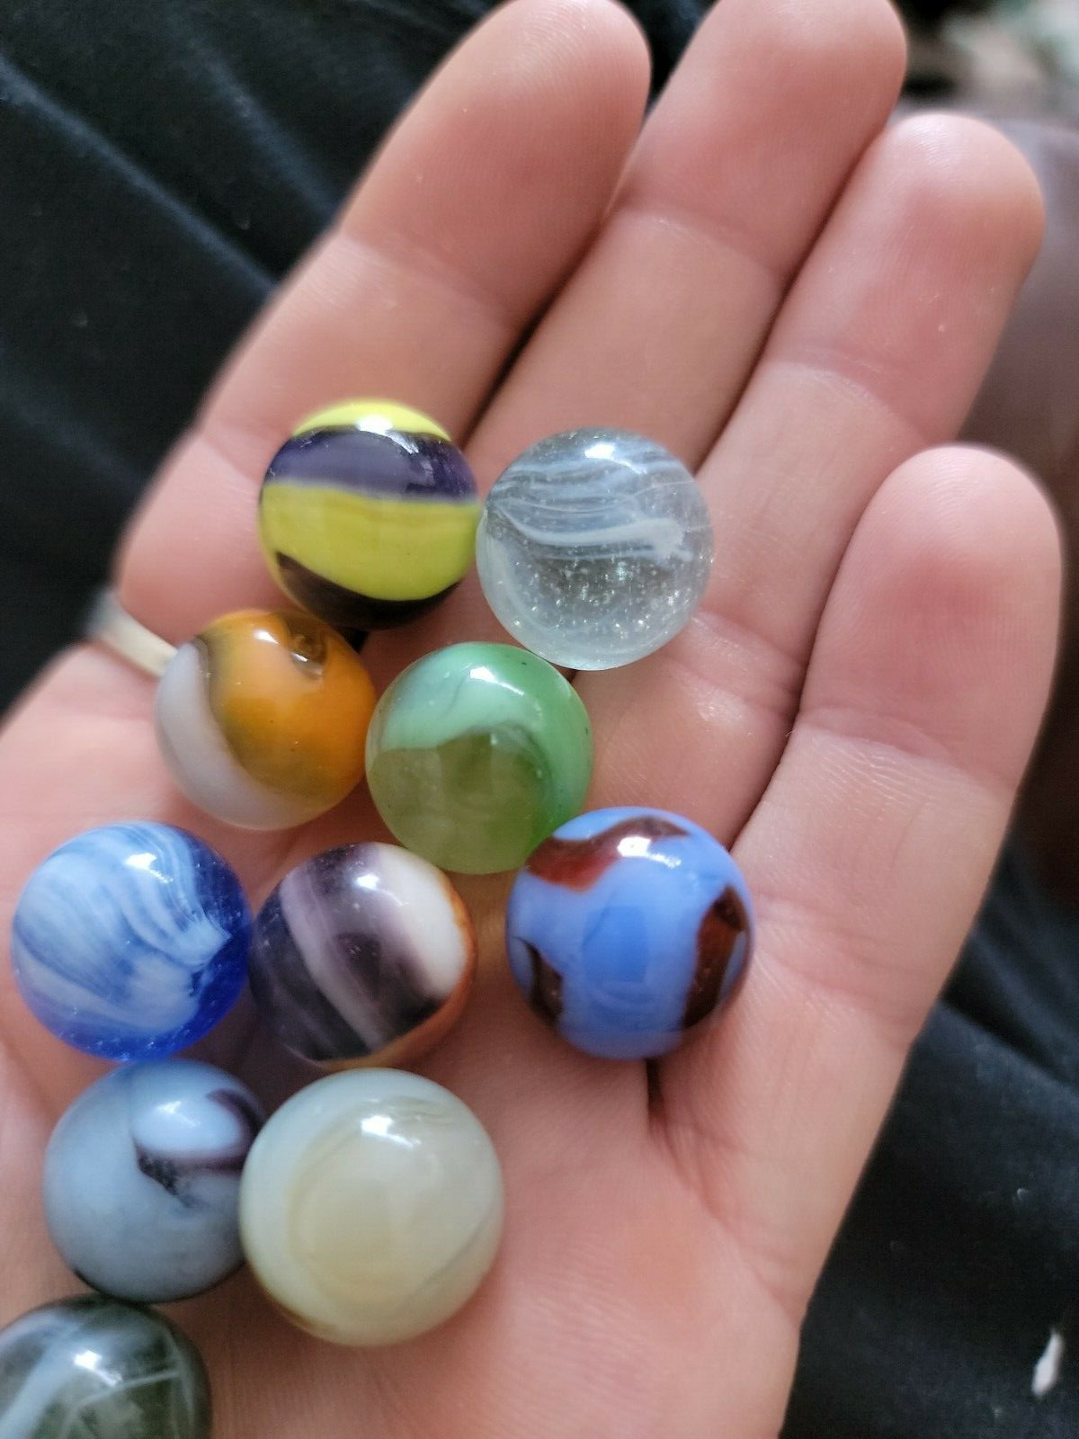
Something nice you could say about what
you see
A question you could ask about what you see
© Joel Shaul, 2010

Slide 76
Something nice you could say about what
you see
A question you could ask about what you see
© Joel Shaul, 2010

Slide 77
Something nice you could say about what
you see
A question you could ask about what you see
© Joel Shaul, 2010

Slide 78
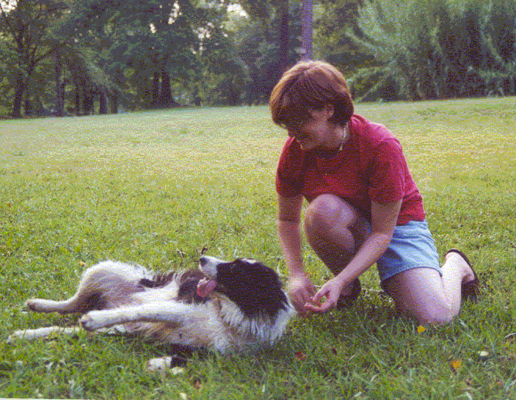
Something nice you could say about what
you see
A question you could ask about what you see
© Joel Shaul, 2010

Slide 79
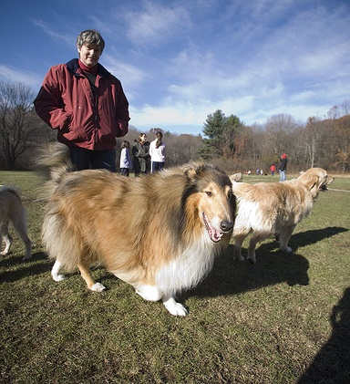
Something nice you could say about what
you see
A question you could ask about what you see
Joel Shaul, autismteachingstrategies.com

Slide 80
Something nice you could say about what
you see
A question you could ask about what you see
© Joel Shaul, 2010

Slide 81
Something nice you could say about what
you see
A question you could ask about what you see
© Joel Shaul, 2010

Slide 82
Something nice you could say about what
you see
A question you could ask about what you see
© Joel Shaul, 2010

Slide 83
Something nice you could say about what
you see
A question you could ask about what you see
© Joel Shaul, 2010

Slide 84
Something nice you could say about what
you see
A question you could ask about what you see
© Joel Shaul, 2010

Slide 85
Something nice you could say about what
you see
A question you could ask about what you see
© Joel Shaul, 2010

Slide 86
Something nice you could say about what
you see
A question you could ask about what you see
© Joel Shaul, 2010

Slide 87
Something nice you could say about what
you see
A question you could ask about what you see
© Joel Shaul, 2010

Slide 88
Something nice you could say about what
you see
A question you could ask about what you see

Slide 89
Something nice you could say about what
you see
A question you could ask about what you see
© Joel Shaul, 2010

Slide 90
Something nice you could say about what
you see
A question you could ask about what you see
© Joel Shaul, 2010

Slide 91
Something nice you could say about what
you see
A question you could ask about what you see
© Joel Shaul, 2010

Slide 92
Something nice you could say about what
you see
A question you could ask about what you see
© Joel Shaul, 2010

Slide 93
Something nice you could say about what
you see
A question you could ask about what you see
© Joel Shaul, 2010

Slide 94
Something nice you could say about what
you see
A question you could ask about what you see
© Joel Shaul, 2010

Slide 95
Something nice you could say about what
you see
A question you could ask about what you see
© Joel Shaul, 2010

Slide 96
Something nice you could say about what
you see
A question you could ask about what you see
© Joel Shaul, 2010

Slide 97
Something nice you could say about what
you see
A question you could ask about what you see
© Joel Shaul, 2010

Slide 98
Something nice you could say about what
you see
A question you could ask about what you see
© Joel Shaul, 2010

Slide 99
Something nice you could say about what
you see
A question you could ask about what you see
© Joel Shaul, 2010

Slide 100
Something nice you could say about what
you see
A question you could ask about what you see
© Joel Shaul, 2010

Slide 101
Something nice you could say about what
you see
A question you could ask about what you see
© Joel Shaul, 2010

Slide 102
Something nice you could say about what
you see
A question you could ask about what you see
© Joel Shaul, 2010

Slide 103
Something nice you could say about what
you see
A question you could ask about what you see
© Joel Shaul, 2010

Slide 104
Something nice you could say about what
you see
A question you could ask about what you see
© Joel Shaul, 2010

Slide 105
Something nice you could say about what
you see
A question you could ask about what you see

Slide 106
Something nice you could say about what
you see
A question you could ask about what you see
© Joel Shaul, 2010

Slide 107
Something nice you could say about what
you see
A question you could ask about what you see
© Joel Shaul, 2010

Slide 108
Something nice you could say about what
you see
A question you could ask about what you see
© Joel Shaul, 2010

Slide 109
Something nice you could say about what
you see
A question you could ask about what you see
© Joel Shaul, 2010

Slide 110
Something nice you could say about what
you see
A question you could ask about what you see
© Joel Shaul, 2010

Slide 111
Something nice you could say about what
you see
A question you could ask about what you see

Slide 112
Something nice you could say about what
you see
A question you could ask about what you see
© Joel Shaul, 2010

Slide 113
Something nice you could say about what
you see
A question you could ask about what you see
© Joel Shaul, 2010

Slide 114
Something nice you could say about what
you see
A question you could ask about what you see
© Joel Shaul, 2010

Slide 115
Something nice you could say about what
you see
A question you could ask about what you see
© Joel Shaul, 2010

Slide 116
Something nice you could say about what
you see
A question you could ask about what you see
© Joel Shaul, 2010

Slide 117
Something nice you could say about what
you see
A question you could ask about what you see
© Joel Shaul, 2010

Slide 118
Something nice you could say about what
you see
A question you could ask about what you see
© Joel Shaul, 2010

