Slide 1
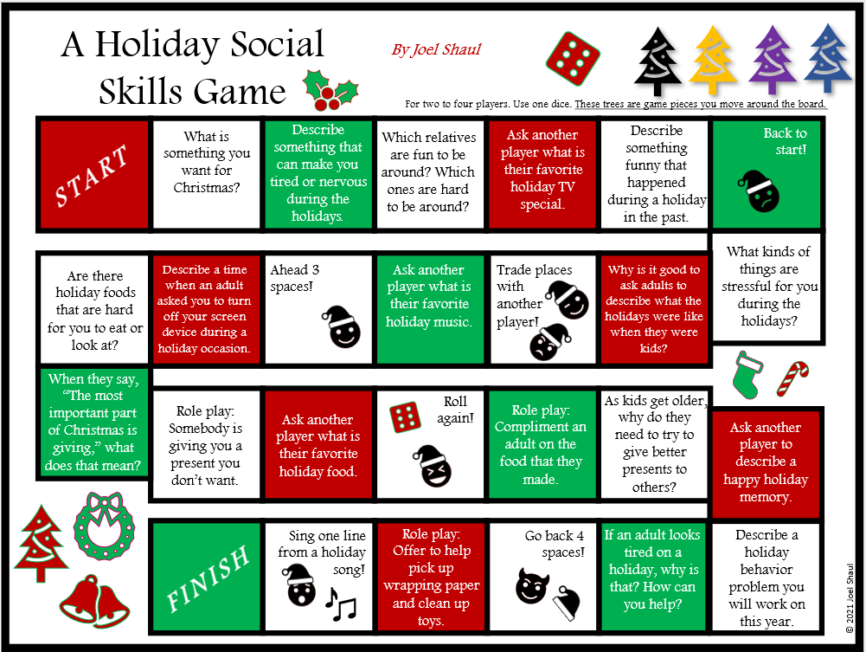
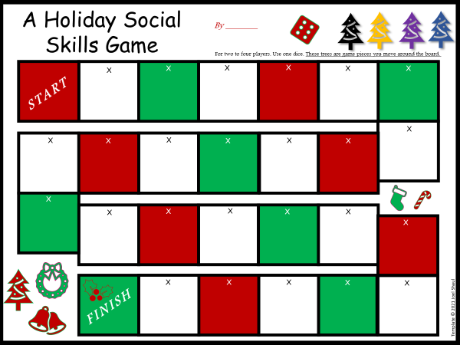
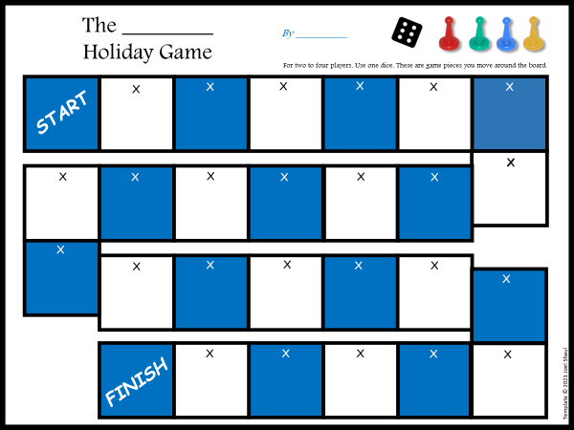
On-Screen Social Skills “Board Games”
with Holiday Themes
Pre-written and
Write-Your-Own options for Christmas and Non-Christmas
Joel Shaul

Slide 2
Holidays and ASD Challenges
All children, including children on the spectrum, get excited about upcoming holidays. As teachers, therapists and parents, there are some things we can help them with ahead of time so they can enjoy the holidays as much as possible and cope with aspects of holidays that might be difficult for them.
Sensory issues: Children with ASD might experience aversion to unfamiliar foods and cooking aromas. They might feel uncomfortable in loud, crowded spaces such as family get-togethers and concerts.
Conversation: Children with ASD often benefit from preparation and practice for the unique social communication opportunities that can occur during holidays.
Emotional regulation: Children who derive comfort from knowing what is going to happen next can find the unpredictable characteristics of holidays challenging, such as receiving unexpected gifts and experiencing sudden schedule changes.
Social expectations: Children with ASD can experience confusion regarding such social expectations as social reciprocity and the shifting of behavioral norms with increasing age.
© 2021 Joel Shaul

Slide 3
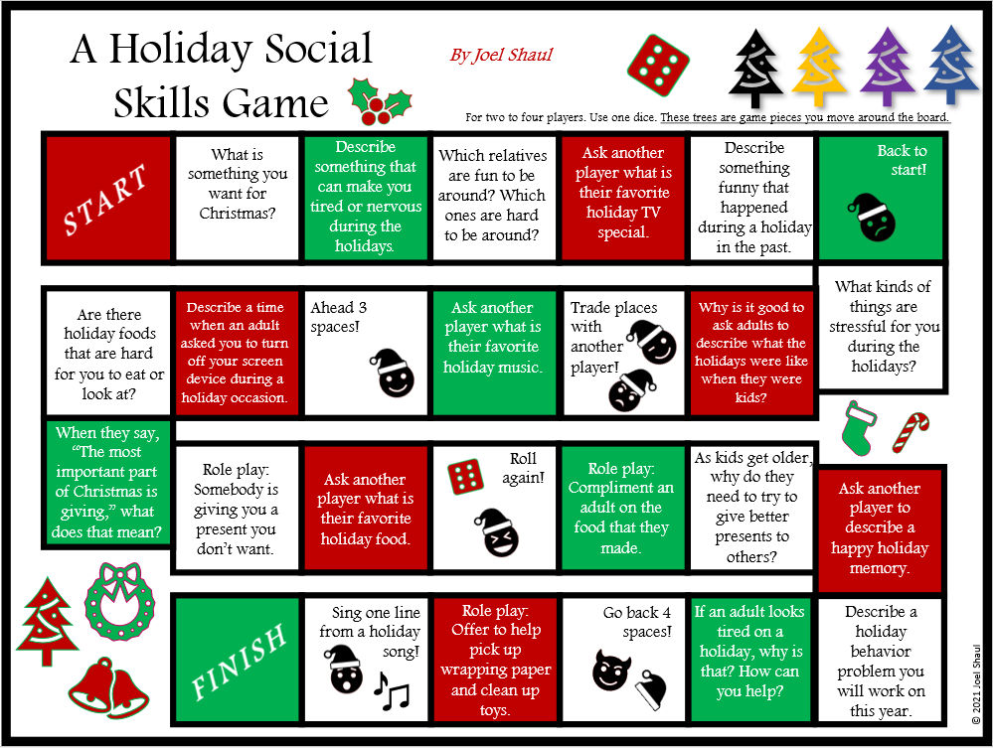
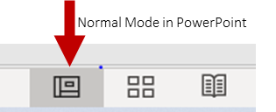
How to Use the On-Screen Board Games
This quick, light activity is not a comprehensive social skills lesson for holiday preparation. It is however a very useful way to add fun to social skills work and stimulate productive discussion.
This first one is completely finished. Open it in “Normal Mode” in PowerPoint. This allows
you to move the game pieces around.
Roll a dice for game play. The trees are game pieces you drag around the board. Expand discussion as much as possible while playing.
The second one is editable. You and the children get to make up the questions, which you write in the text boxes I have placed in each square. Be sure to add silly and fun questions, such as “What is your favorite YouTube video?” or “Go ‘Ho, ho, ho like Santa.’” Add squares that say, “Go back to start,” “Ahead 5 spaces,” “Trade places with another player,” etc.
This third editable version is in non-Christmas colors so that people who don’t celebrate Christmas can create their own game.
Try these other on-screen board games too.
© 2021 Joel Shaul

Slide 5
A Holiday Social Skills Game
By _______
X
X
X
X
X
X
X
X
X
X
X
X
X
X
X
X
X
X
X
X
X
X
X
X
X

Slide 6
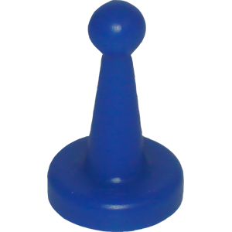
The ________
Holiday Game
By _________
X
X
X
X
X
X
X
X
X
X
X
X
X
X
X
X
X
X
X
X
X
X
X

