Slide 1
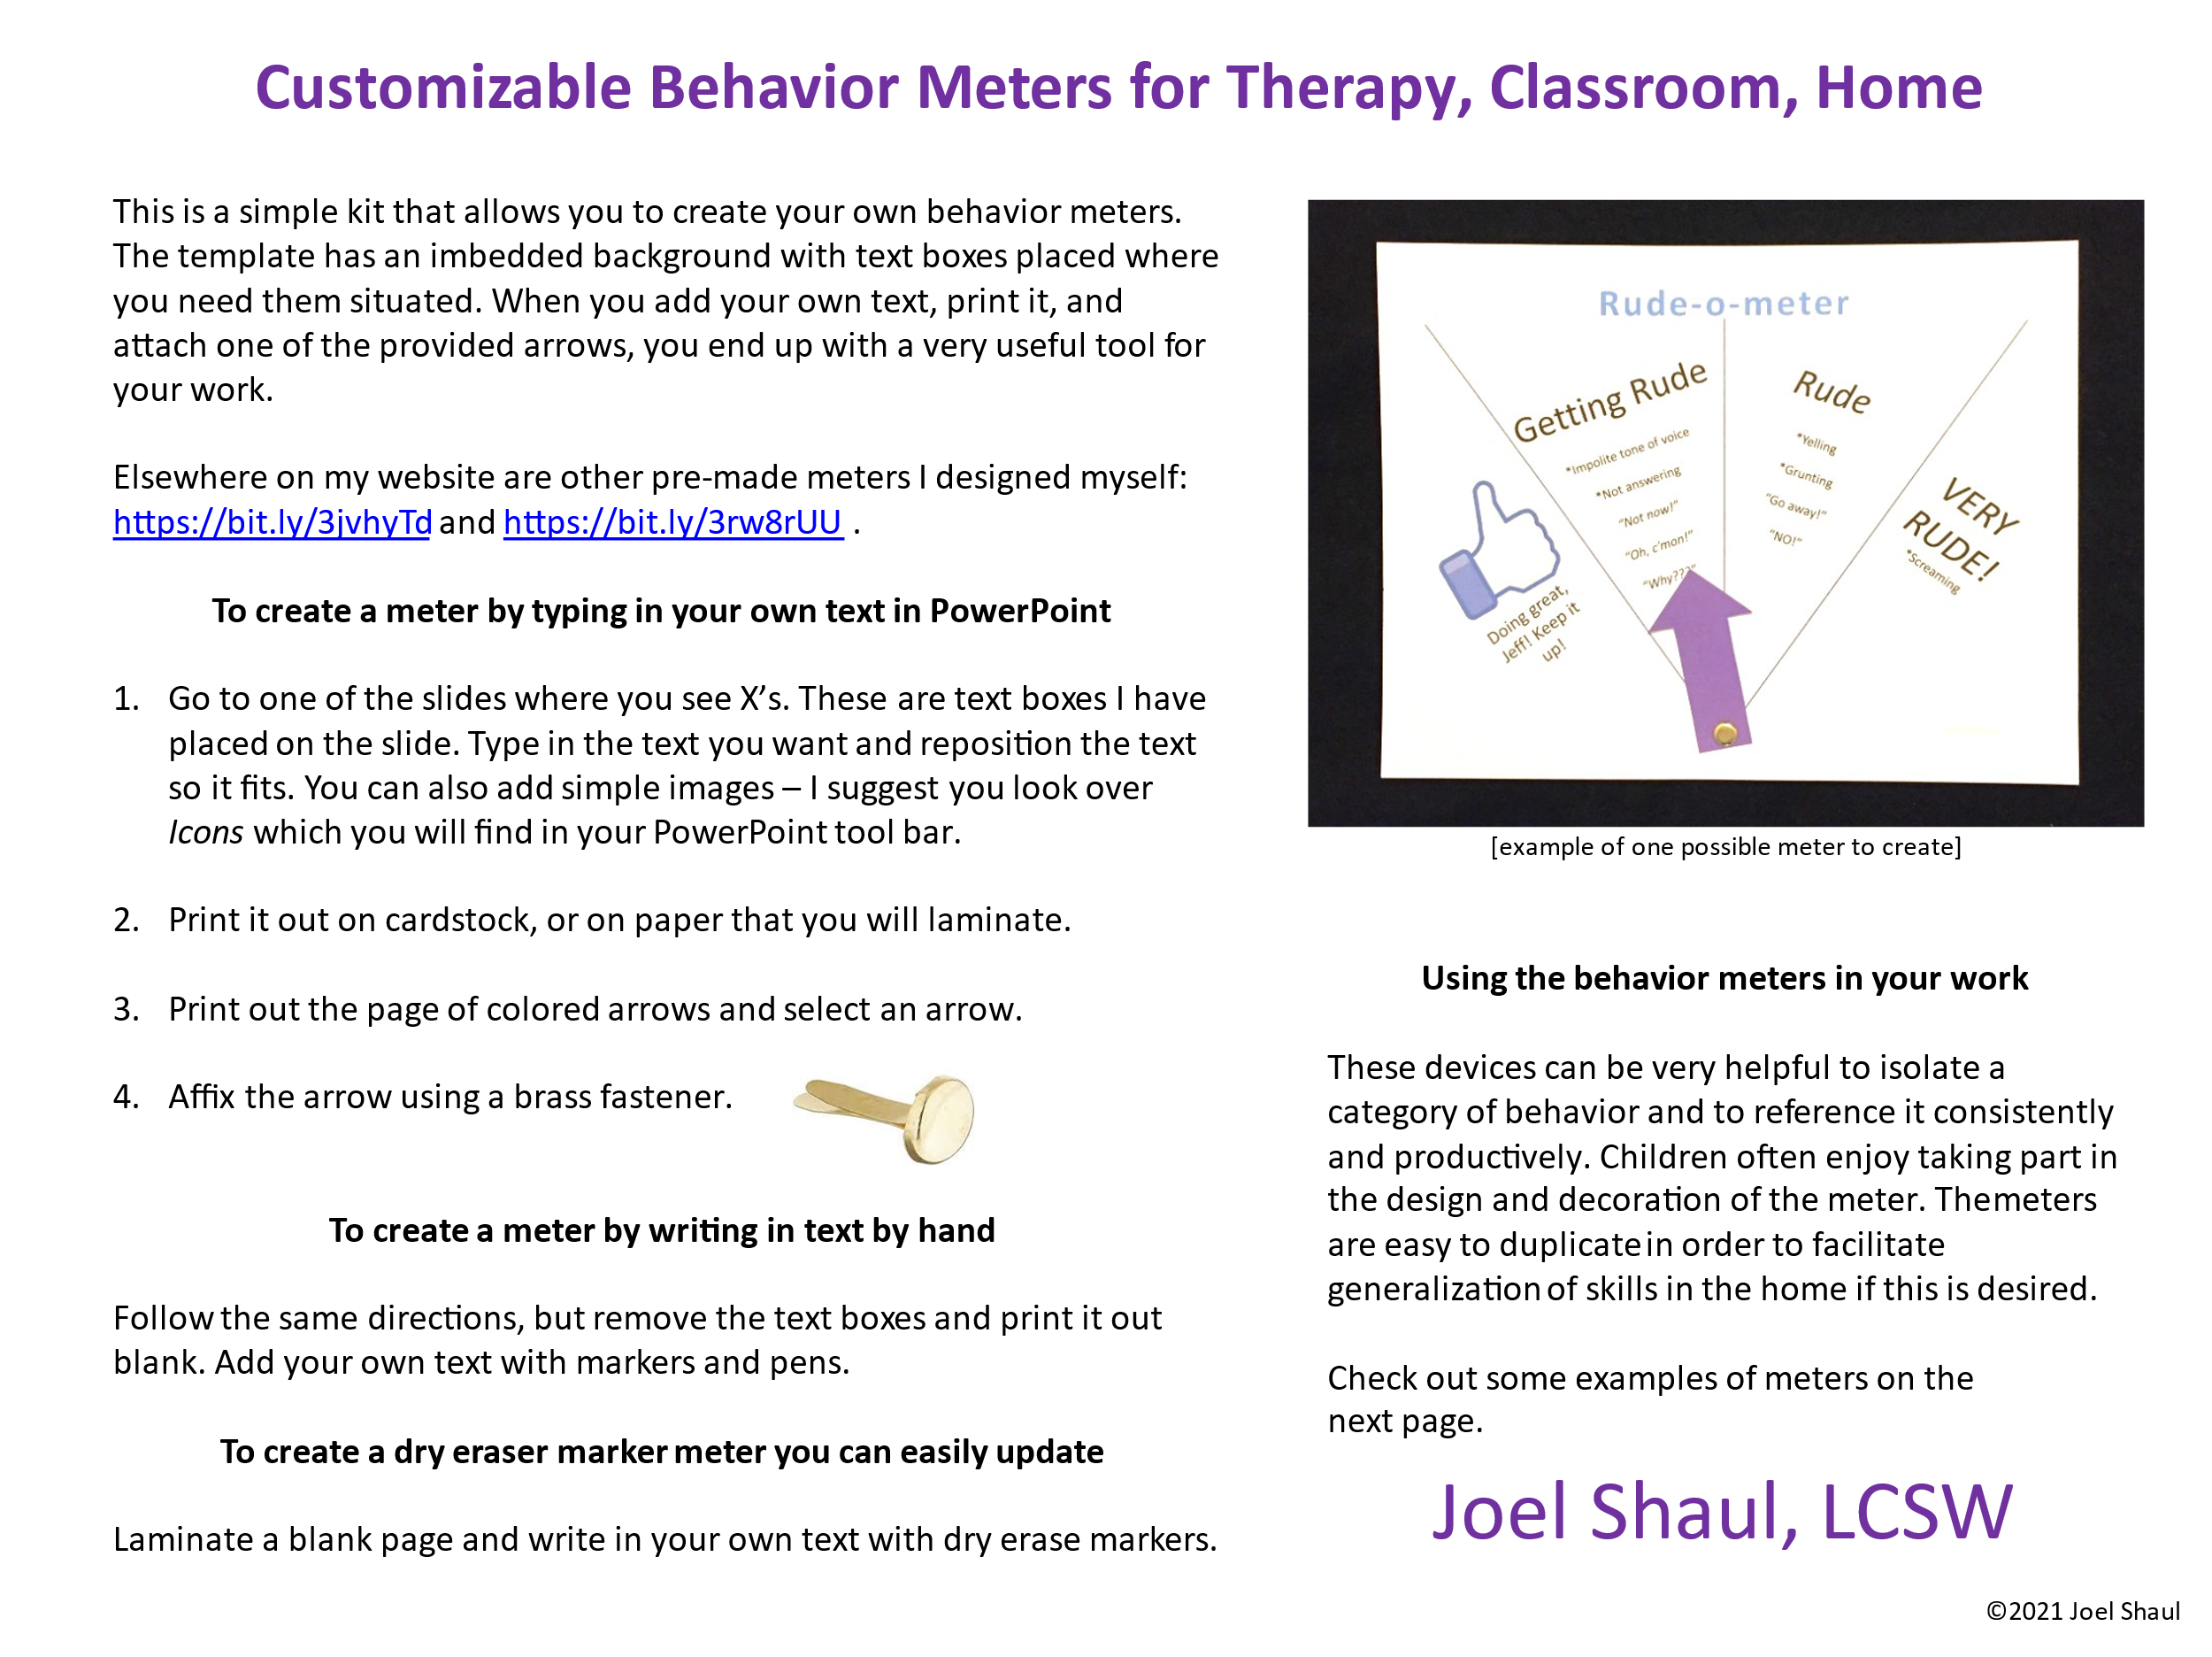

Slide 2
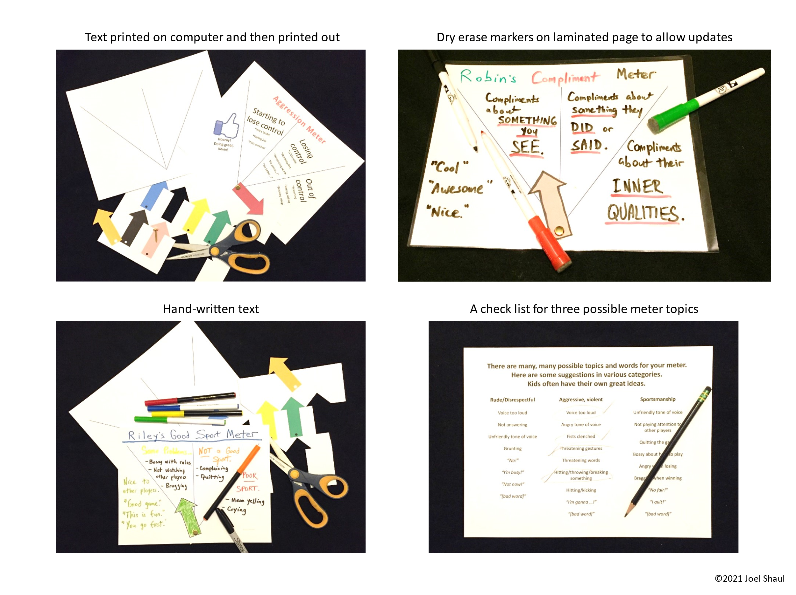

Slide 3
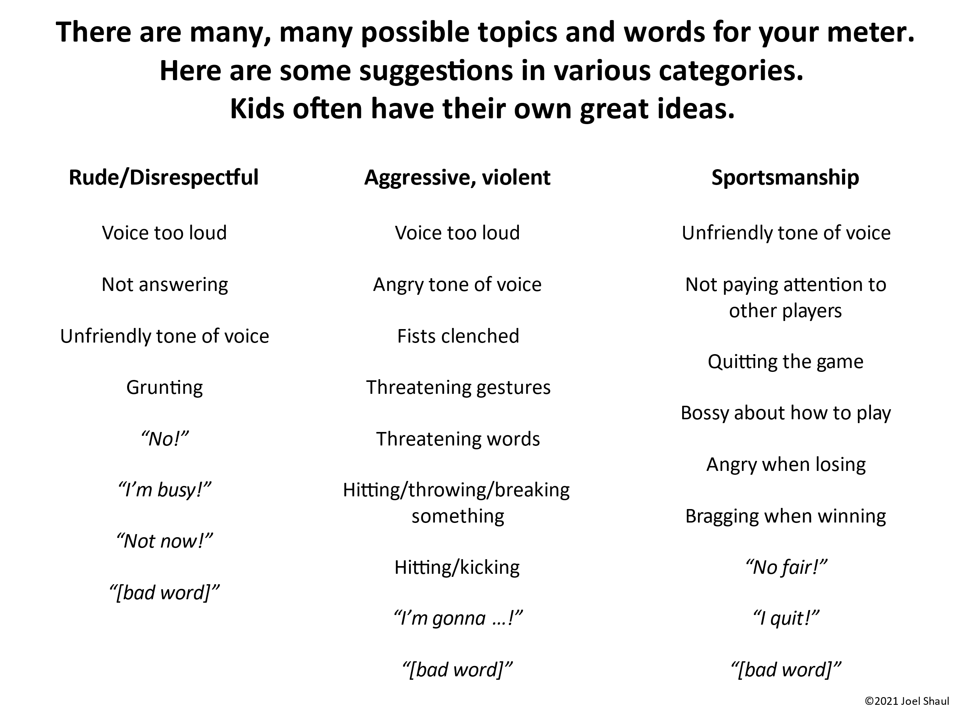

Slide 4
Pick out the best color arrow for your Behavior Meter.
(You can color in the white one.)
©2021 Joel Shaul

Slide 5

x
x
x
x
x
x
x
x

Slide 6
x
x
x
x
x
x
x
x

Slide 7
x
x
x
x
x
x
x
x

Slide 8
x
x
x
x
x
x
x
x

Slide 9
x
x
x
x
x
x
x
x

Slide 10
x
x
x
x
x
x
x
x

Slide 11
x
x
x
x
x
x
x
x

