Slide 1
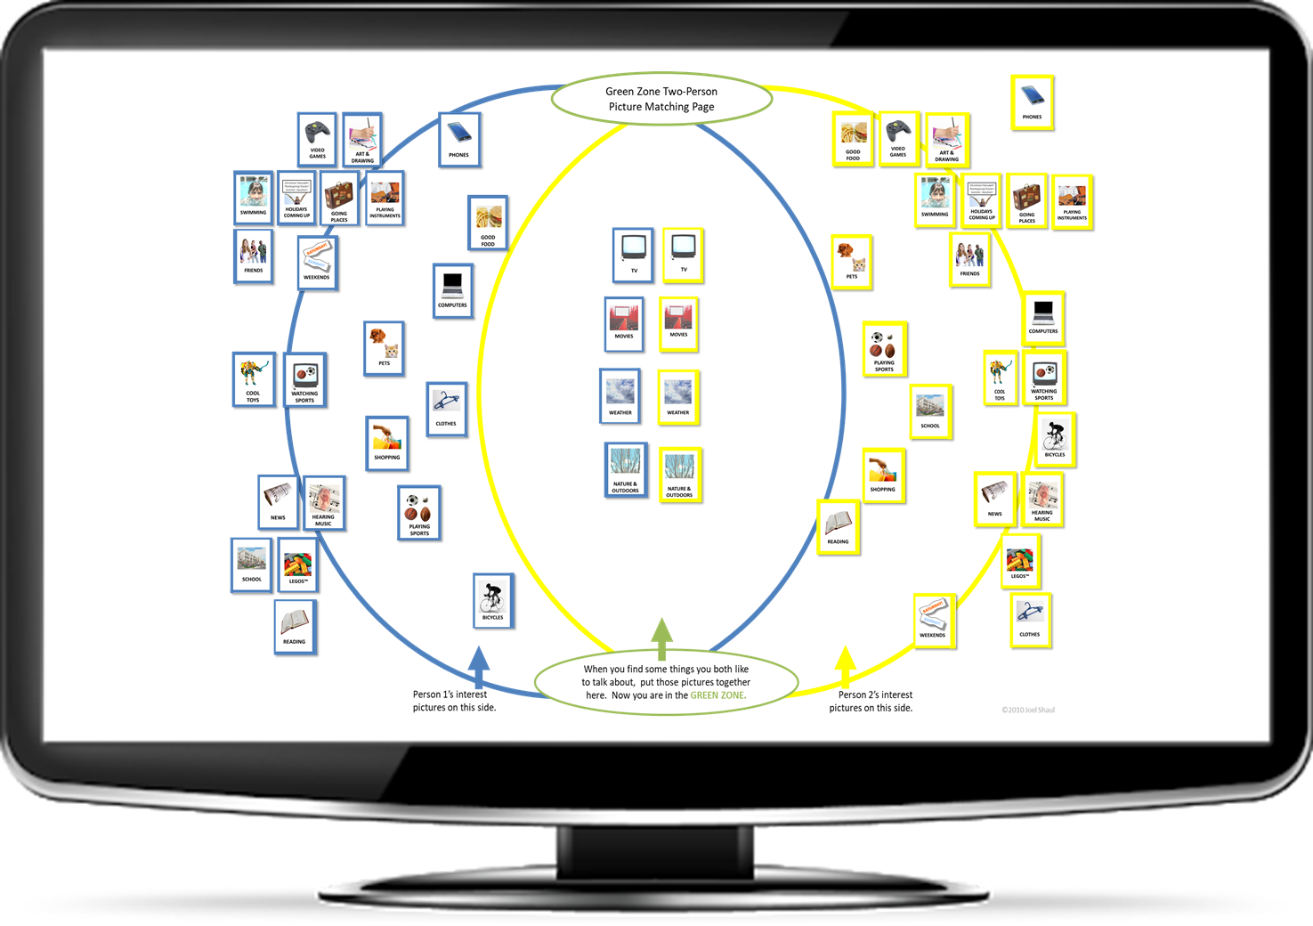
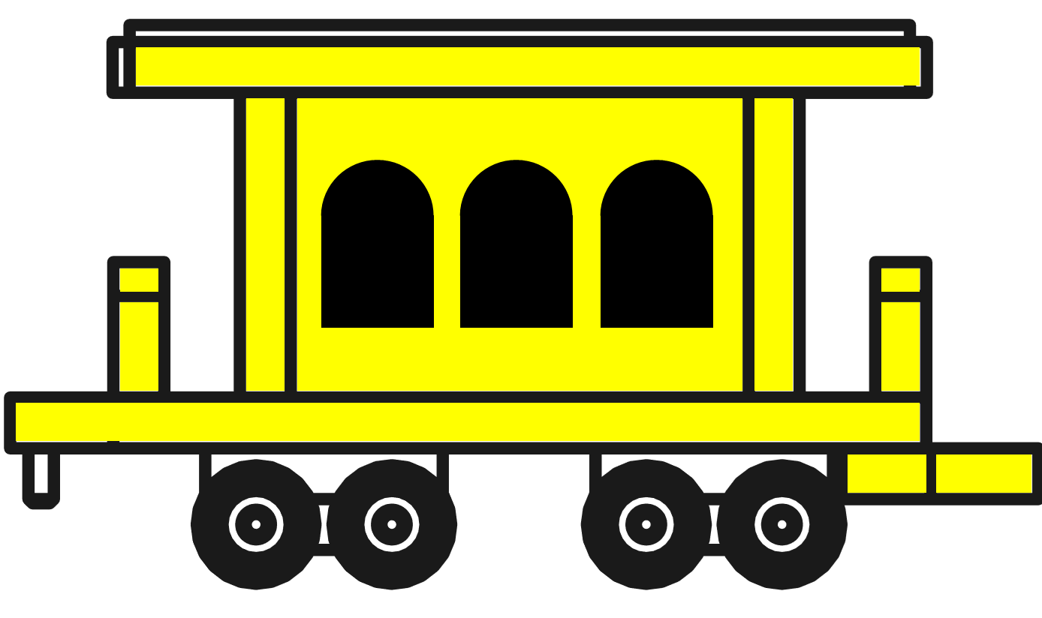
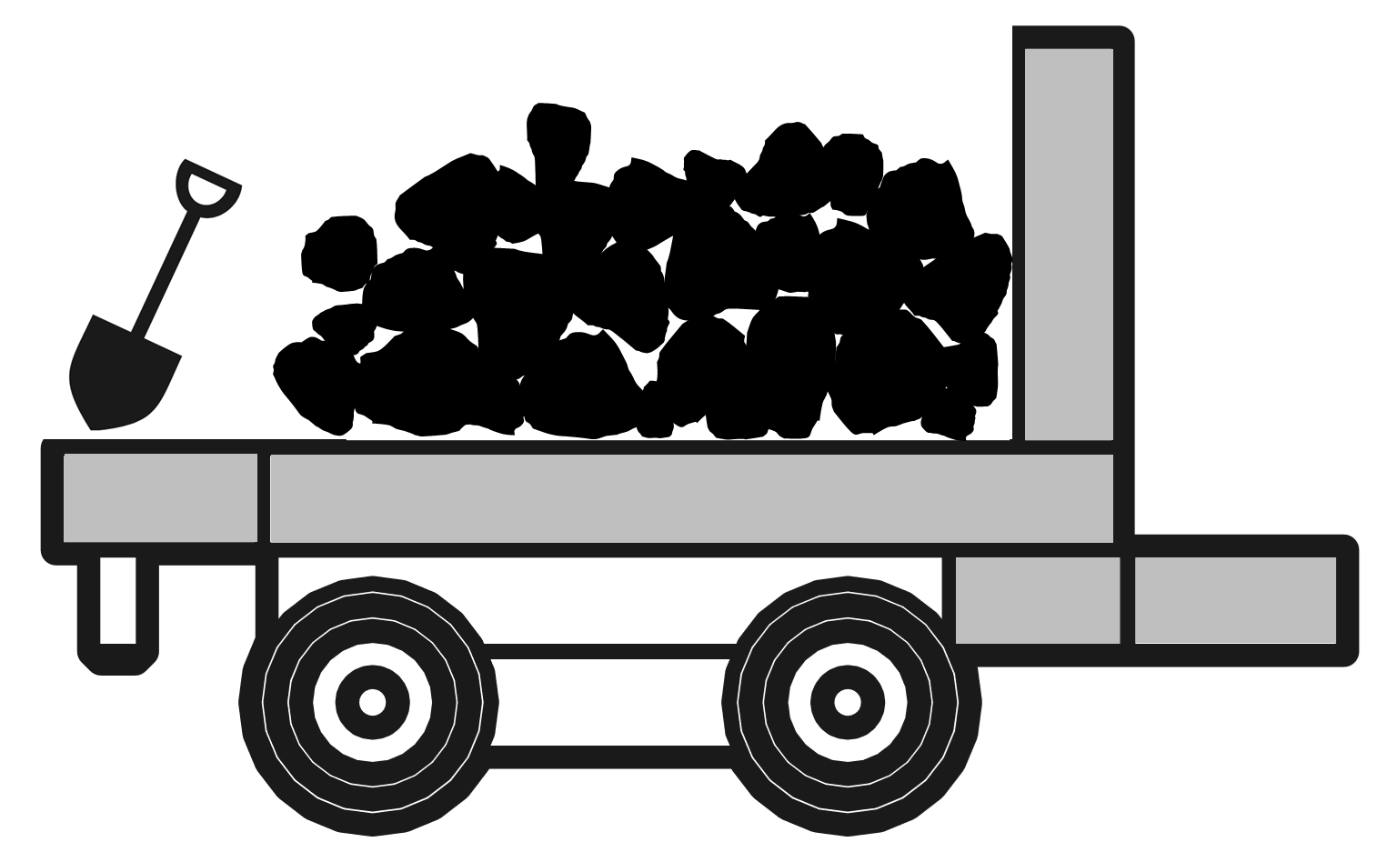
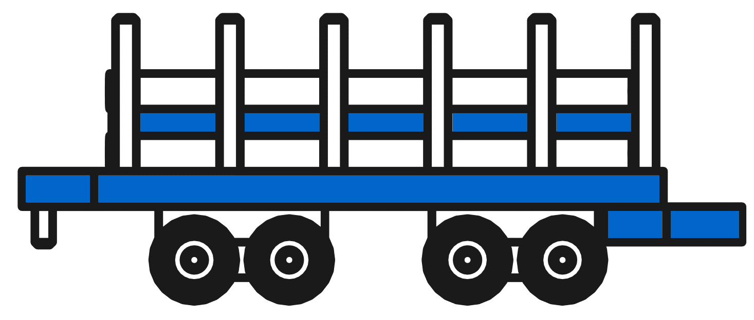
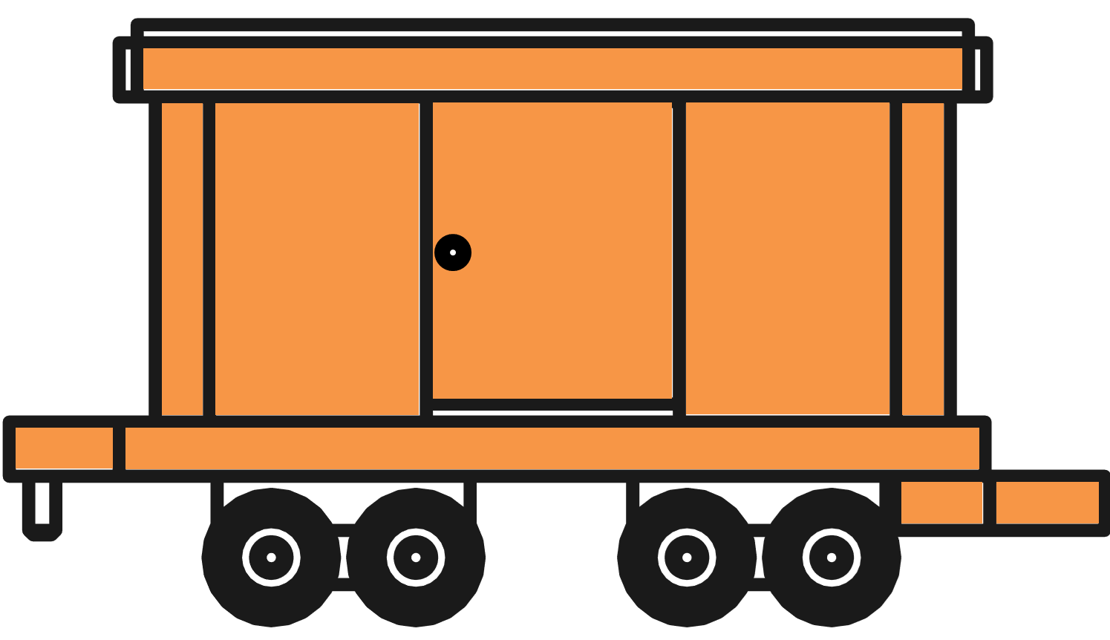
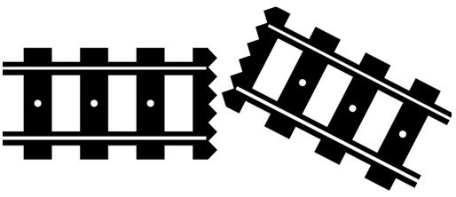
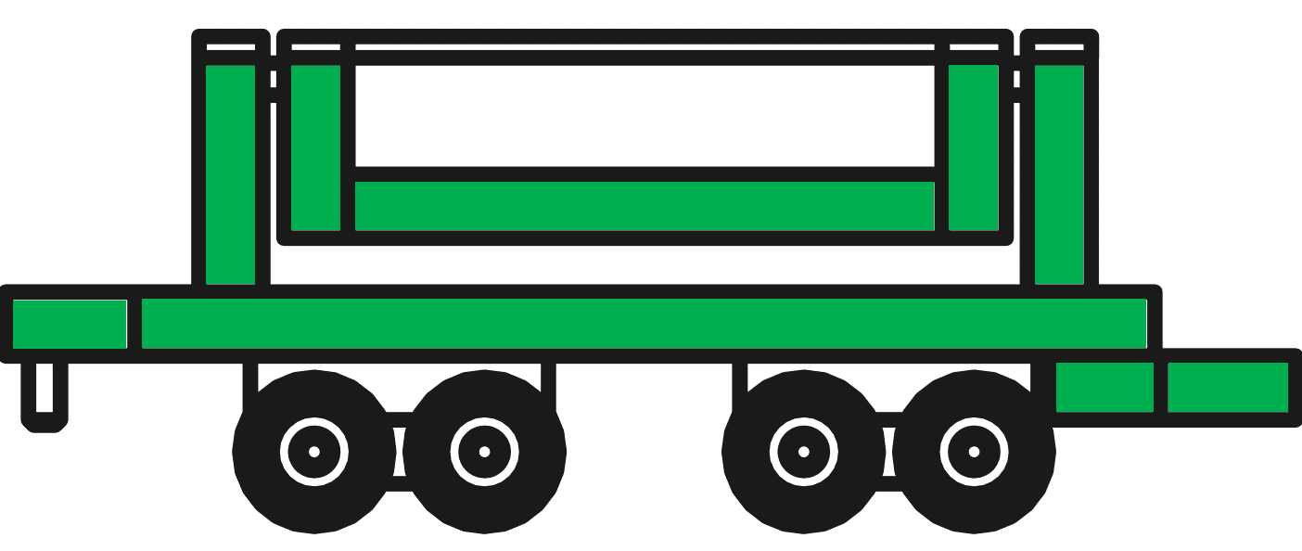
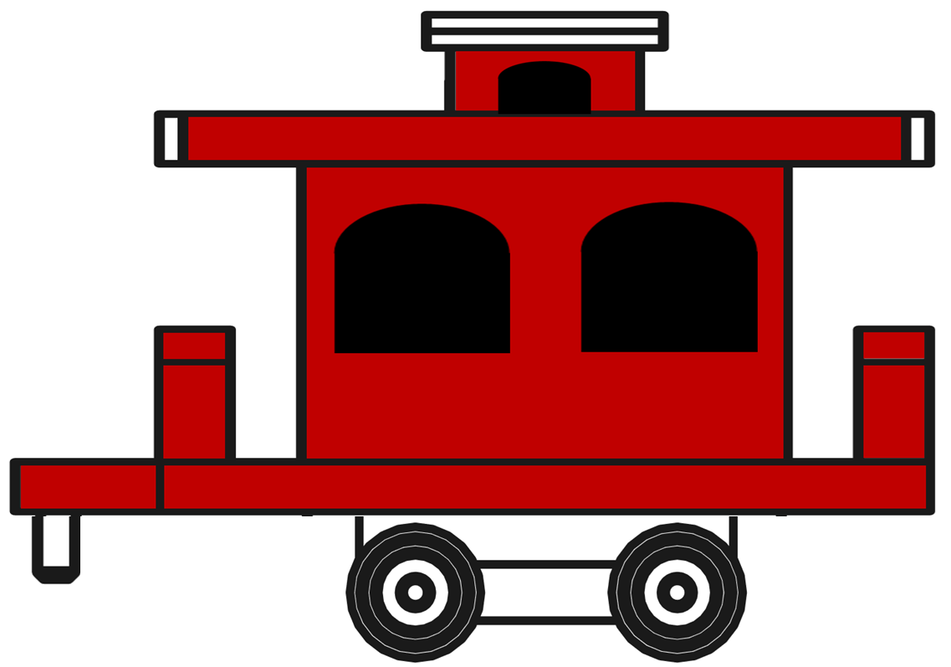
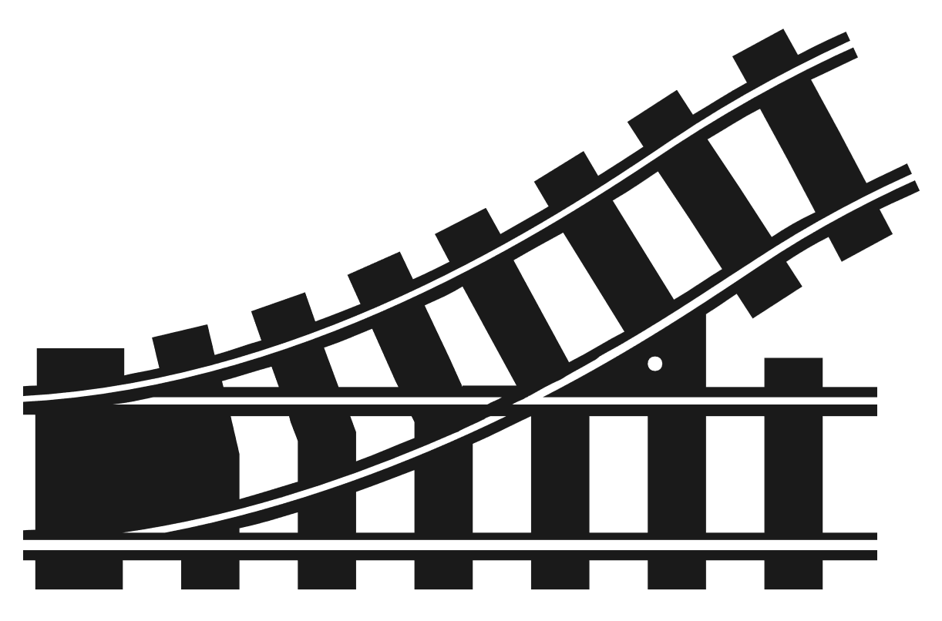
sav
Train Conversation Teletherapy Activity
with moveable train pieces, in PowerPoint
Joel Shaul
©2020 Joel Shaul

Slide 2
Notes to the adult
sav
This Train Conversation Activity employs simple concepts from my book The Conversation Train (Jessica Kingsley Publishers, 2014). The activity I provide here may be used as an extension exercise for my book.
I have prepared this download in PowerPoint so that you can easily and quickly move the various train pictures across the screen. You do this in real time, while your student/client is having a role play conversation. I have tested it many times and it works well. I created it to use in teletherapy but it will work equally well in office or classroom.
To enable the pieces to be moved around from the margins of the screen to the main part of the screen, leave the PowerPoint in
“Normal Mode”
NOT “Slide Show Mode.”
An additional suggestion is that you provide a list of conversation topics or a set of conversation topic pictures. For example, download these free Green Zone Cards: https://bit.ly/2XxD9Rw .
I hope that this train activity is really fun and helpful for the children you work with.
The next slide is a tutorial to go over with children, if you don’t already have my book.
Joel Shaul
©2020 Joel Shaul

Slide 3
sav
The different parts of a train are like the different parts of a conversation.
The Engine.
Usually, you need to greet someone (hi or hello) before you start talking.
The Coal Tender.
Usually, you ask people how they are doing (how are you, how’s it going).
Train Cars.
Each one of these means talking back and forth for one turn on a topic that you both like.
The Switch Track.
You can switch to a new topic if both people want that new topic.
Off Track!
When you start a new topic that is confusing or not interesting for the other person.
Caboose.
End the conversation. Explain why you are stopping. Use words like “goodbye” or “see you later.”
©2020 Joel Shaul
©2020 Joel Shaul

Slide 4
sav
Make some great conversations
that stay on track!
While you are talking, the grown-up will place the different parts of the train on the screen.
Start the conversation right by greeting the other person.
Ask how they are doing.
Talk back and forth about something you and the other person both want to talk about.
Try hard to not go off-track!
Switch to a new topic if you and the other person both want that topic.
End the conversation the right way
©2020 Joel Shaul

Slide 5
If you like this conversation teaching method, try my book.
It is full of useful role plays and exercises, all based on trains.

Slide 6
DRAG PLACE THE TRAIN PIECES IN ROWS IN REAL TIME DURING CONVERSATION PRACTICE

Slide 7
DRAG PLACE THE TRAIN PIECES IN ROWS IN REAL TIME DURING CONVERSATION PRACTICE

Slide 8
DRAG PLACE THE TRAIN PIECES IN ROWS IN REAL TIME DURING CONVERSATION PRACTICE

Slide 9
DRAG PLACE THE TRAIN PIECES IN ROWS IN REAL TIME DURING CONVERSATION PRACTICE

Slide 10
DRAG PLACE THE TRAIN PIECES IN ROWS IN REAL TIME DURING CONVERSATION PRACTICE

Slide 11
DRAG PLACE THE TRAIN PIECES IN ROWS IN REAL TIME DURING CONVERSATION PRACTICE

Slide 12
DRAG PLACE THE TRAIN PIECES IN ROWS IN REAL TIME DURING CONVERSATION PRACTICE

Slide 13
DRAG PLACE THE TRAIN PIECES IN ROWS IN REAL TIME DURING CONVERSATION PRACTICE

Slide 14
DRAG PLACE THE TRAIN PIECES IN ROWS IN REAL TIME DURING CONVERSATION PRACTICE

Slide 15
DRAG PLACE THE TRAIN PIECES IN ROWS IN REAL TIME DURING CONVERSATION PRACTICE

Slide 16
DRAG PLACE THE TRAIN PIECES IN ROWS IN REAL TIME DURING CONVERSATION PRACTICE

