Slide 1
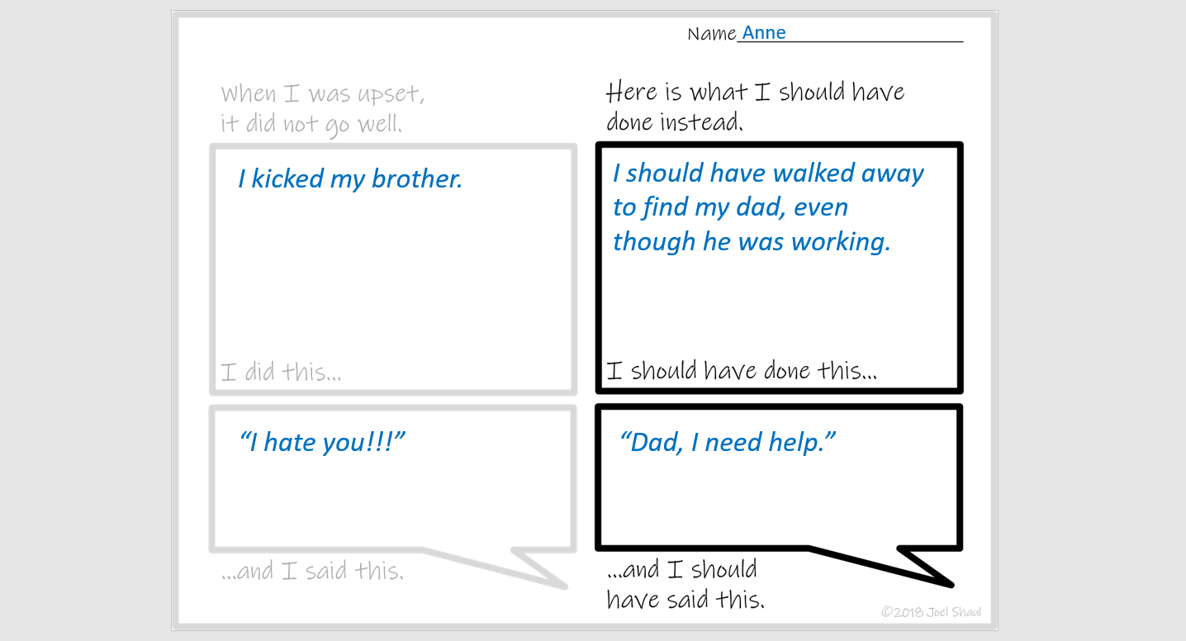
What I Should Have Done Different – Telehealth Version
A simple worksheet to work on a problem, on computer screens.
Many children can work on a problem better if they are asked to write a few words about it.
Here is a very simple, generic, problem-solving worksheet. It is also available in a print-out version.
The version in this download is designed for working directly on a computer screen. This is useful for telehealth applications. You fill out the text on the worksheet as the child tells you what to write.
Joel Shaul

Slide 2
xxxxx
Xxxx
Xxxx
“xxx
“xxx

Slide 3
xxxxx
Xxxx
Xxxx
“xxx
“xxx

Slide 4
xxxxx
Xxxx
Xxxx
“xxx
“xxx

Slide 5
xxxxx
Xxxx
Xxxx
“xxx
“xxx

Slide 6
xxxxx
Xxxx
Xxxx
“xxx
“xxx

Slide 7
xxxxx
Xxxx
Xxxx
“xxx
“xxx

Slide 8
xxxxx
Xxxx
Xxxx
“xxx
“xxx

Slide 9
xxxxx
Xxxx
Xxxx
“xxx
“xxx

Slide 10
xxxxx
Xxxx
Xxxx
“xxx
“xxx

Slide 11
xxxxx
Xxxx
Xxxx
“xxx
“xxx

