Slide 1
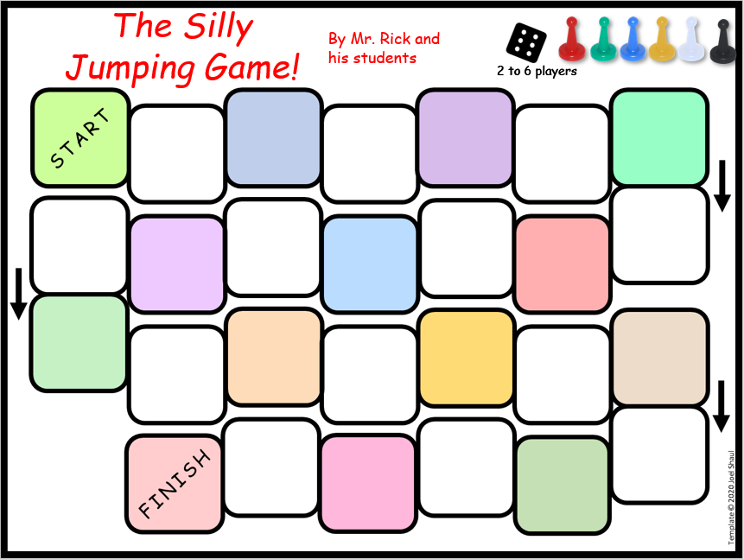
Easy kit to make and share your own PowerPoint board game. For office, class, home or telehealth.
Joel Shaul

Slide 2
How to make your own game and use it
With this kit, you can make your own game by filling in the text boxes with your own words. To view an example, see the next slide.
I suggest that you only make about 2/3 of the boxes educational or therapeutic. Include plenty of “fun” parts. On the right border are some suggestions. There are emotion emojis on the left for you to drag onto any square you like.
I suggest you try creating the game in collaboration with one or more children. Kids can take turns coming up with their own game questions. There is a separate PowerPoint slide for you to write down the game directions.
Although you can print out the game board, I designed it to play the game right on a computer screen by using Normal Mode in PowerPoint. You can drag the game pieces around the board. This has applications for telehealth sessions, as you can share the screen in Zoom or other platforms, allowing you and one or more children to play your game together on your computers.
What is a good compliment to give to a teacher or principal?
If you land on this square, bark like a dog!
Include not only therapeutic game questions, but fun ones too.
Normal Mode in PowerPoint
Joel Shaul, LCSW

Slide 3
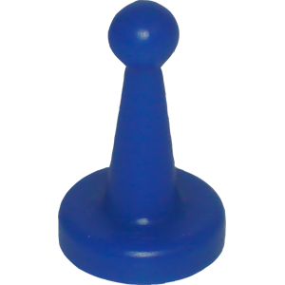

Slide 4
The xxx Game
By xxx
USE
THIS
ONE
2 to 6 players
xxxxxxxxx
xxxxxxxxx
xxxxxxxxx
xxxxxxxxx
xxxxxxxxx
xxxxxxxxx
xxxxxxxxx
xxxxxxxxx
xxxxxxxxx
xxxxxxxxx
xxxxxxxxx
xxxxxxxxx
xxxxxxxxx
Suggestions: For “fun” spaces, write: Go back to start. Roll again. Switch with another player. Go ahead X spaces. Go back X spaces.
xxxxxxxxx
xxxxxxxxx
xxxxxxxxx
xxxxxxxxx
xxxxxxxxx
xxxxxxxxx
xxxxxxxxx
xxxxxxxxx
xxxxxxxxx
xxxxxxxxx
xxxxxxxxx
xxxxxxxxx
Suggestions: Drag faces to “Go back to start” spaces, etc.

Slide 5
The _________
Game
About the game:
XXXXXXXXXXXXXXXXXXXXXXXXXXXXXXXXXXXXXXXXXXXXXXXXXxxxxxxxxxxxxxxx
Directions for play:
X
X
x

Slide 6
The xxx
Game
By xxxx
X
X
X
X
X
X
X
X
X
X
X
X
X
Suggestions: For “fun” spaces, write: Go back to start. Roll again. Switch with another player. Go ahead X spaces. Go back X spaces.
X
X
X
X
X
X
X
X
X
X
X
X
Suggestions: Drag faces to “Go back to start” spaces, etc.

Slide 7
The _________
Game
About the game:
XXXXXXXXXXXXXXXXXXXXXXXXXXXXXXXXXXXXXXXXXXXXXXXXXxxxxxxxxxxxxxxx
Directions for play:
X
X
x

