Slide 1
Filtering Upsetting Statements Activity, telehealth version
This activity is designed to help young people with ASD and other disorders to learn ways to regulate emotional verbal outbursts. The activity raises awareness of what things are okay and not okay to say when you are upset and introduces the concept that thoughts can be “filtered” before they are turned into spoken words.
A separate version is designed to be printed and cut out. The version here is in PowerPoint, so you can drag the word cards across the screen and place them where you like. It works well in telehealth, or any time you want to do this activity without printing out everything.
There is a several-slide tutorial to go over with kids before you start the actual activity.
*Put PowerPoint in Normal Mode
not Slide Mode
for this activity.
Created by Joel Shaul
©2018 Joel Shaul

Slide 7
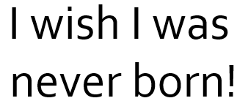
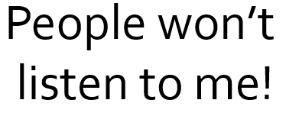
©2018 Joel Shaul
~ DRAG THE WORDS TO THE CORRECT PLACE – LEFT, MIDDLE OR CENTER ~

