Slide 1
Computer/Telehealth CBT Worksheets
Simple format for children and teens
Formatted for simple completion on computer screen
Joel Shaul

Slide 2
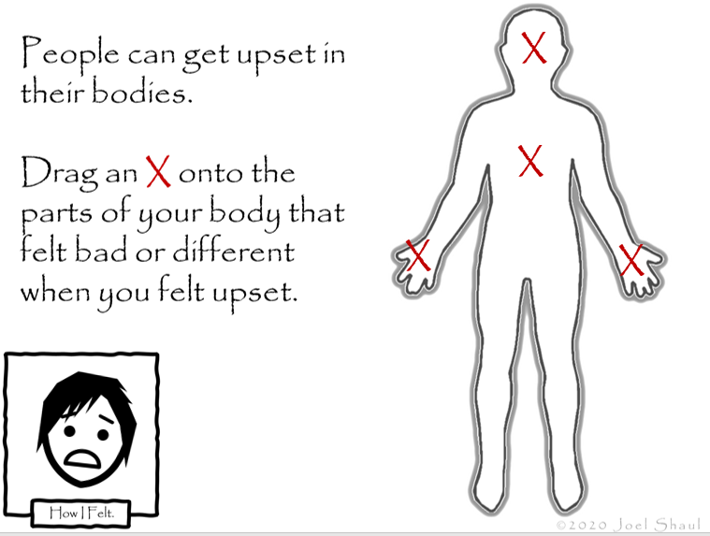
Directions:
There are many other CBT resources on my website. Before attempting this activity, I suggest going over what is available on the site and review at least one of these simple CBT YouTube videos I made: https://bit.ly/2Y0iZQ4 .
If you are looking for printable CBT worksheets, click here: https://bit.ly/2MUAWt5 .
These computer screen-based worksheets are designed for an adult and a child at a computer or for an adult doing teletherapy with a child.
Open the PowerPoint in “normal mode”
and not “slide show mode.”
This allows you to add text and to drag and drop images where you want them on the screen.
Joel Shaul

Slide 3
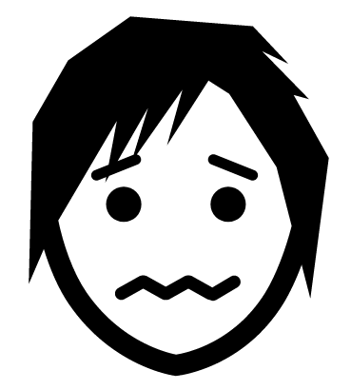
x
Select an emotion face and drag it into the How I Felt box. Enlarge it to fit.
Fill in the text box where you see an x.

Slide 4
x
x
x
x
Select an emotion face and drag it into the How I Felt box. Fill in the text boxes where you see an x.

Slide 5
x
x
x
“x
Select an emotion face and drag it into the How I Felt box. Fill in the text boxes where you see an x.

Slide 6
X
X
X
X
X
X
X
X
Select an emotion face and drag it into the How I Felt box.

Slide 7
x
x
x
x
Fill in the text boxes where you see an x.

Slide 8
x
x
x
“x
Select an emotion face and drag it into the How I Felt box. Fill in the text boxes where you see an x.

Slide 9
x
Drag the red x’s to the parts of you that felt upset. Fill in the text box.

