Slide 1
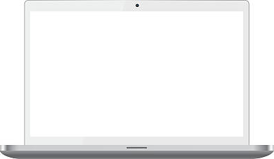
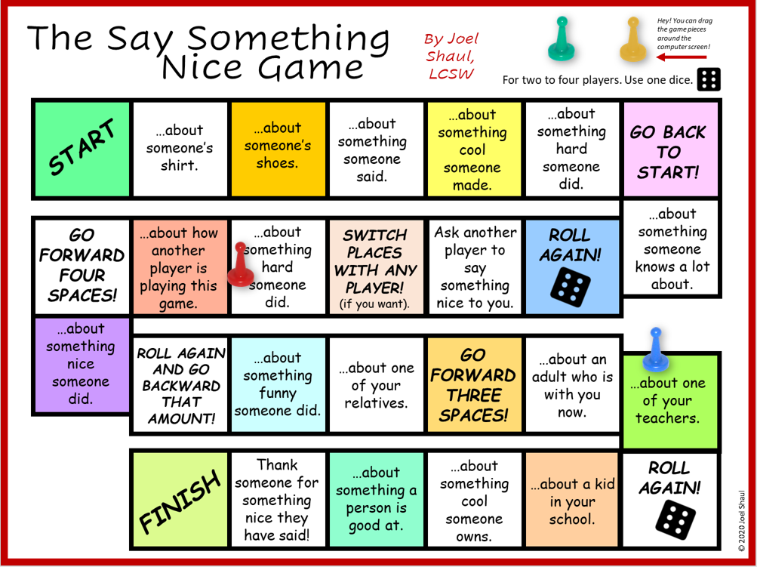
Social Skills “Board Game” that can be easily played remotely in telehealth therapy
By
Joel Shaul

Slide 2
How to set up and use the game
I created this “board game” in PowerPoint, so that when you are using PowerPoint in normal mode you can drag the game pieces around the board right on the computer screen.
Although you can print out this game if you like, I designed it to be played in telehealth situations so that one can actually play the game with one to four children using their own computers in remote locations.
To do this:
Open the “game board” on your computer.
In Zoom or whatever platform you are using, share the screen.
Move the game pieces around the board by dragging them.
You can custom design your own computer-based board game, using a simple template available for free on my website.
Normal Mode in PowerPoint
Joel Shaul, LCSW

Slide 3
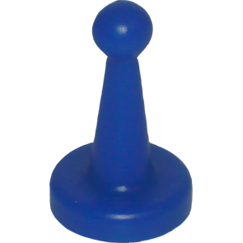
About the game:
You probably know how to say nice things, but everyone could use more practice doing it.
You can print out the game, but it is designed to play on a computer screen. You can drag the game pieces around from one square to the next.
Directions for play:
Use one die, or a spinner if you have one.
When you have your turn, try your best to “sound nice” like you really mean it.
Suggestion: The adult may decide to use play money or other tokens, awarding more based on the quality of the responses.
© 2020 Joel Shaul

Slide 4
