Slide 1
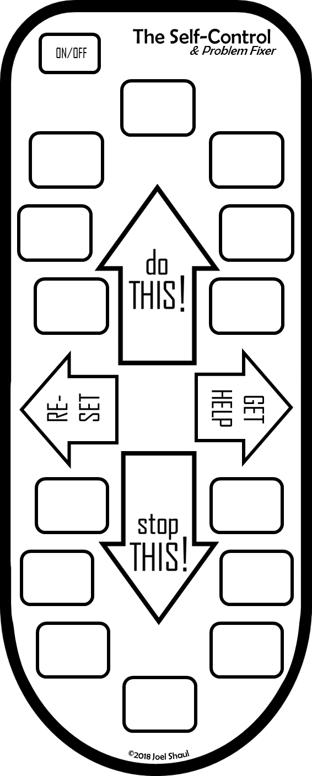
How to create individual Self-Controls in PowerPoint
You can type text onto custom Self-Controls in PowerPoint like this.
Double click on each of the X’s.
These are text boxes.
In the “do this” section, write in the things you want the child to do more. In the “stop this” section, write in the things you want the child to avoid doing.
Print it and cut it out. It’s nice if the child colors it. Use light colors so one can still read the words!
Duplicate the PowerPoint slides to create as many as you need.
*A separate PDF download provides an intro for children and additional information for adults.
** There is a completely separate Self-Control for conversation pragmatics – find it here: https://bit.ly/2HC5T4f
x
x
x
x
x
x
x
x
x
x
x
[example of completed project]
x
x
x
A free download created by Joel Shaul
autismteachstrategies.com
©2018 Joel Shaul

Slide 2
To create individual
Self-Control Problem Fixers in PowerPoint:
Double click on each of the X’s.
In the “do this” section, write things that you want the child to try do more.
In the “stop this” section, write in things that you want the child to avoid doing.
Print it and cut it out. It’s nice if the kid colors it in. Use light colors so that one can still easily read the words.
(There is a completely separate Self-Control for conversation pragmatics – find it here: https://bit.ly/2HC5T4f )
x
x
x
x
x
x
x
x
x
x
x
x
x
x
©2018 Joel Shaul

Slide 3
To create individual
Self-Control Problem Fixers in PowerPoint:
Double click on each of the X’s.
In the “do this” section, write things that you want the child to try do more.
In the “stop this” section, write in things that you want the child to avoid doing.
Print it and cut it out. It’s nice if the kid colors it in. Use light colors so that one can still easily read the words.
(There is a completely separate Self-Control for conversation pragmatics – find it here: https://bit.ly/2HC5T4f )
x
x
x
x
x
x
x
x
x
x
x
x
x
x
©2018 Joel Shaul

Slide 4
To create individual
Self-Control Problem Fixers in PowerPoint:
Double click on each of the X’s.
In the “do this” section, write things that you want the child to try do more.
In the “stop this” section, write in things that you want the child to avoid doing.
Print it and cut it out. It’s nice if the kid colors it in. Use light colors so that one can still easily read the words.
(There is a completely separate Self-Control for conversation pragmatics – find it here: https://bit.ly/2HC5T4f )
x
x
x
x
x
x
x
x
x
x
x
x
x
x
©2018 Joel Shaul

Slide 5
To create individual
Self-Control Problem Fixers in PowerPoint:
Double click on each of the X’s.
In the “do this” section, write things that you want the child to try do more.
In the “stop this” section, write in things that you want the child to avoid doing.
Print it and cut it out. It’s nice if the kid colors it in. Use light colors so that one can still easily read the words.
(There is a completely separate Self-Control for conversation pragmatics – find it here: https://bit.ly/2HC5T4f )
x
x
x
x
x
x
x
x
x
x
x
x
x
x
©2018 Joel Shaul

Slide 6
To create individual
Self-Control Problem Fixers in PowerPoint:
Double click on each of the X’s.
In the “do this” section, write things that you want the child to try do more.
In the “stop this” section, write in things that you want the child to avoid doing.
Print it and cut it out. It’s nice if the kid colors it in. Use light colors so that one can still easily read the words.
(There is a completely separate Self-Control for conversation pragmatics – find it here: https://bit.ly/2HC5T4f )
x
x
x
x
x
x
x
x
x
x
x
x
x
x
©2018 Joel Shaul

