Slide 1
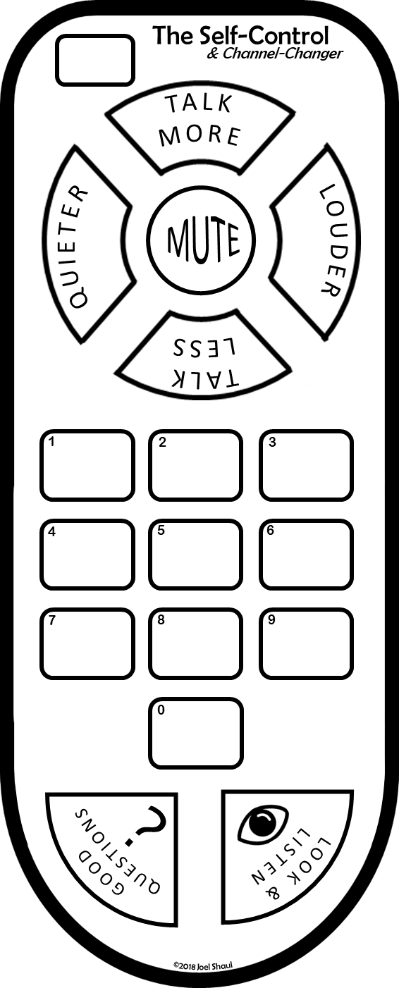
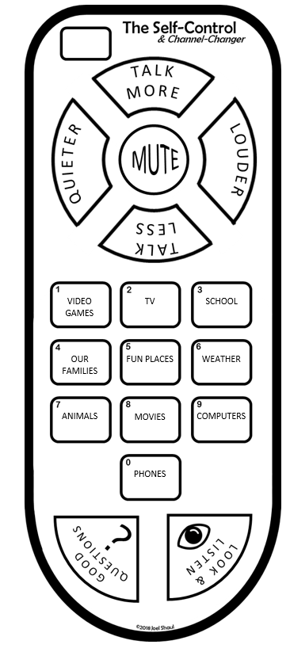
How to create individual Self-Controls in PowerPoint
You can type text onto custom Self-Controls in PowerPoint like this.
Double click on each of the X’s. These are text boxes.
Write in each of the interests that the child selects. Below you can see an example of what this looks like when you are finished.
Print it and cut it out. It’s nice if the child colors it.
Duplicate the PowerPoint slides to create as many as you need.
*A separate PDF download provides an intro for children and additional information for adults.
x
x
x
x
x
x
x
x
x
x
A free download created by Joel Shaul
autismteachstrategies.com
©2018 Joel Shaul

Slide 2
To create individual Self-Controls in PowerPoint:
Double click on each of the X’s.
Write in each of the interests that the child selects.
Print it and cut it out. It’s nice if the child colors it in.
x
x
x
x
x
x
x
x
x
x
©2018 Joel Shaul

Slide 3
To create individual Self-Controls in PowerPoint:
Double click on each of the X’s.
Write in each of the interests that the child selects.
Print it and cut it out. It’s nice if the child colors it in.
x
x
x
x
x
x
x
x
x
x
©2018 Joel Shaul

Slide 4
To create individual Self-Controls in PowerPoint:
Double click on each of the X’s.
Write in each of the interests that the child selects.
Print it and cut it out. It’s nice if the child colors it in.
x
x
x
x
x
x
x
x
x
x
©2018 Joel Shaul

Slide 5
To create individual Self-Controls in PowerPoint:
Double click on each of the X’s.
Write in each of the interests that the child selects.
Print it and cut it out. It’s nice if the child colors it in.
x
x
x
x
x
x
x
x
x
x
©2018 Joel Shaul

