Slide 1
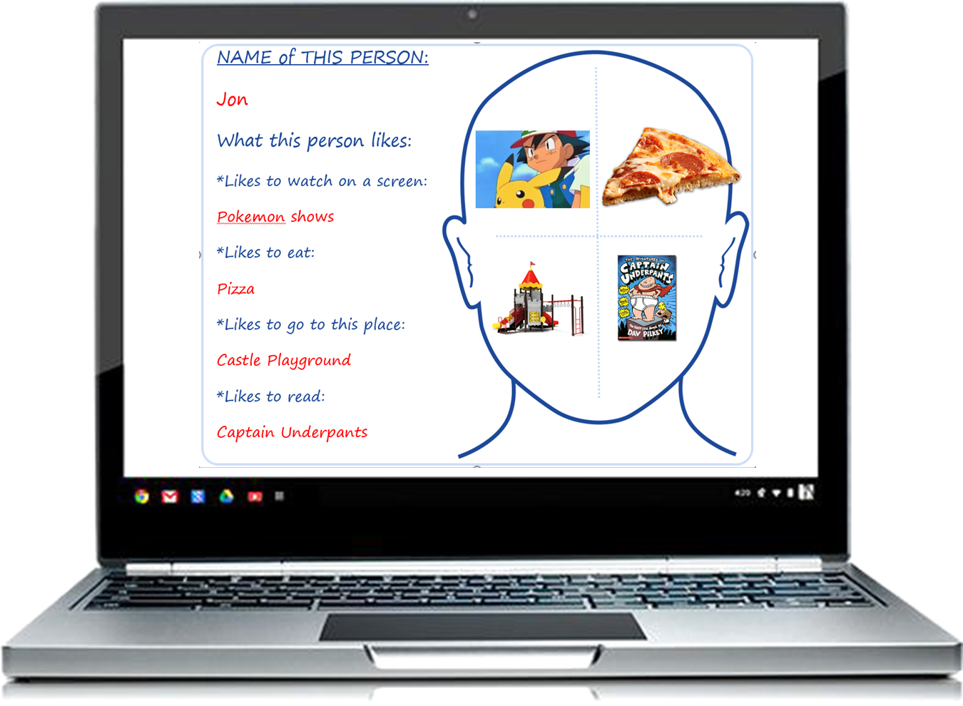
Head Outline PowerPoint Activity
To help children learn the interests of peers
By Joel Shaul
©2018 Joel Shaul

Slide 2
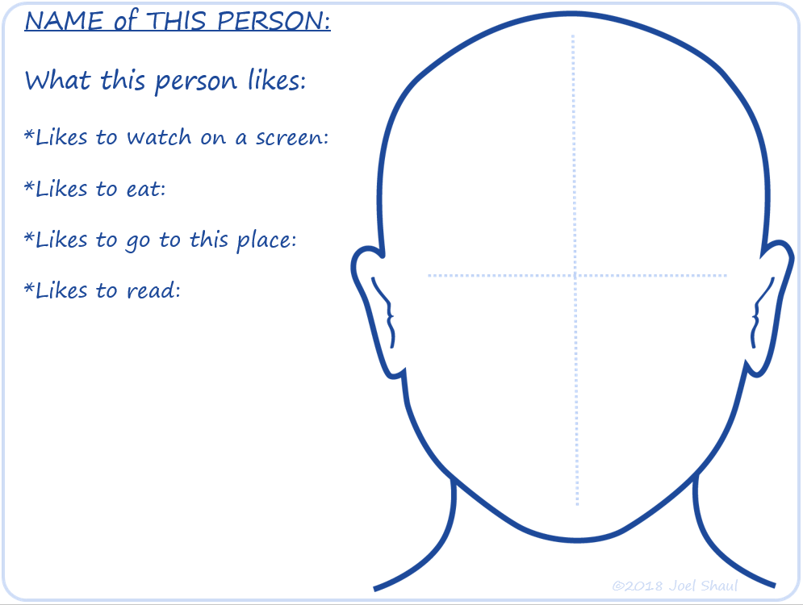
Step 1:
Go to the first blank slide (slide number 10).
©2018 Joel Shaul

Slide 3
Step 2:
Write the person’s interests on the left side of the slide.
©2018 Joel Shaul

Slide 4
Step 3:
Copy and paste Google images inside the head.
©2018 Joel Shaul

Slide 5
Step 4:
Do the same for each person in your group or class.
It’s best to do it on a big screen in real time while kids watch.
©2018 Joel Shaul

Slide 6
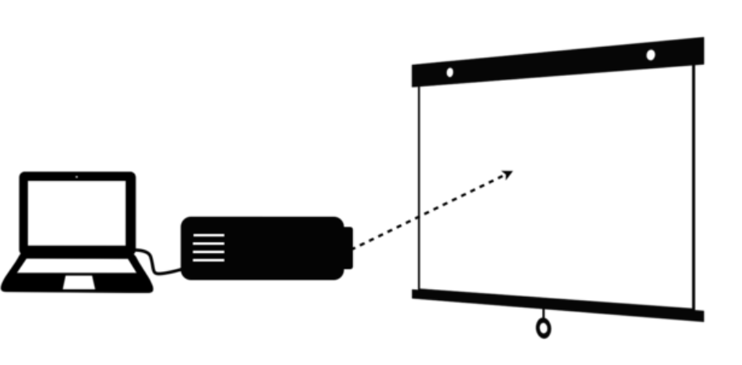
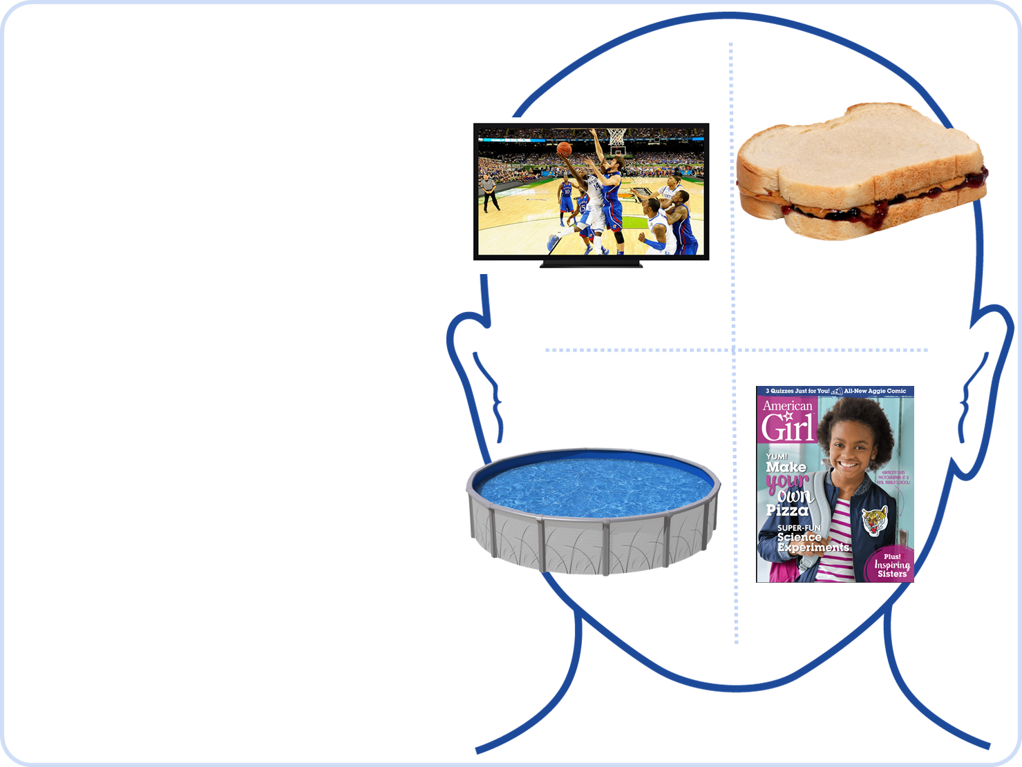
Step 5:
Use the slides you have created to help kids learn about each other and set up conversation role plays.
Option A: Show / project the slides to the children.
©2018 Joel Shaul

Slide 7
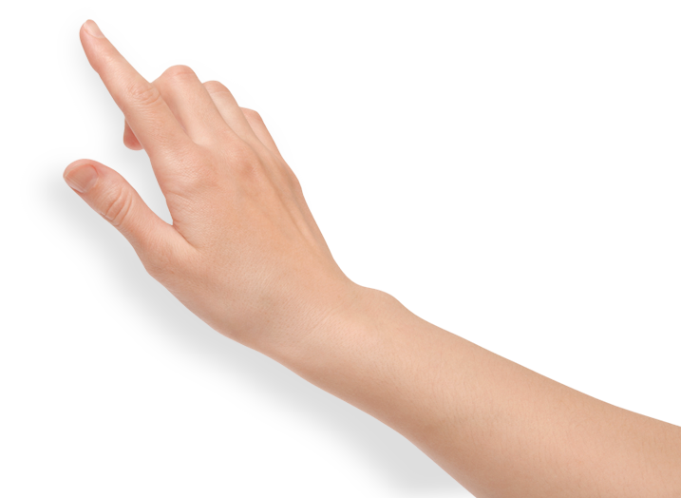
Option B: Print out pages and give them to children to study.
©2018 Joel Shaul

Slide 8
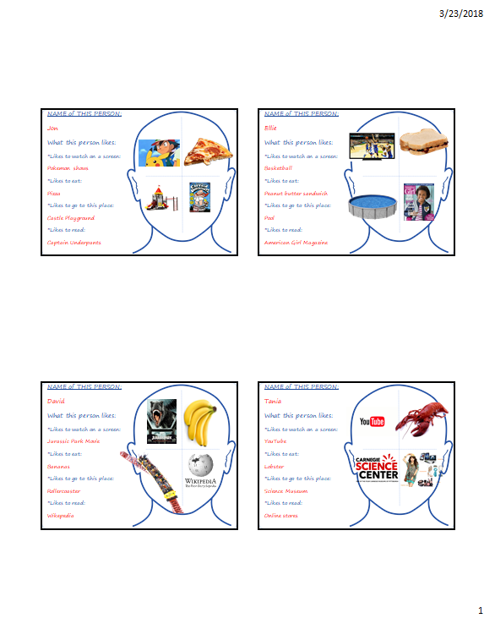
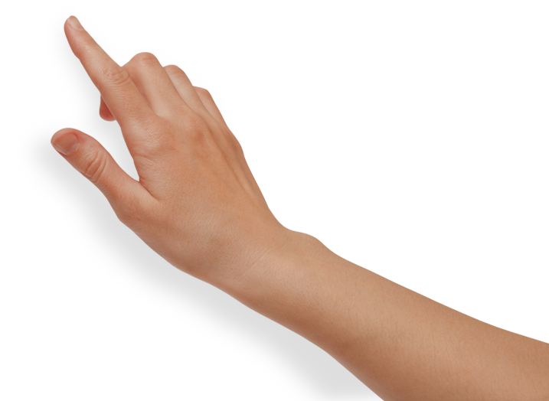
Option C:
Print out the slides in different formats to get more pictures on a page.
©2018 Joel Shaul

Slide 9
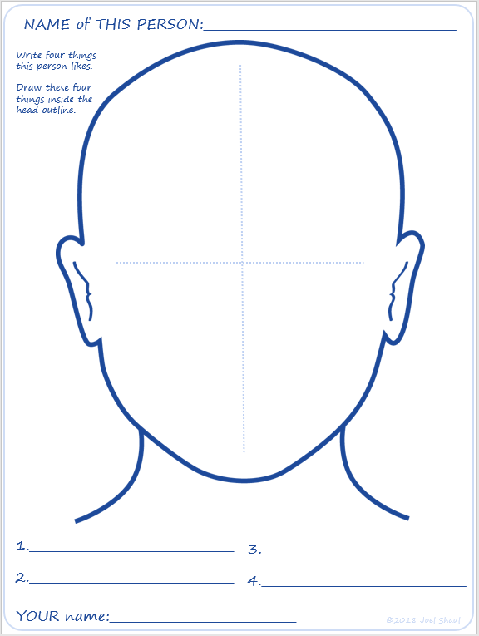
Step 6:
Optional: Print out worksheets for children to use. Find this separate download on the blog post.
©2018 Joel Shaul

Slide 10
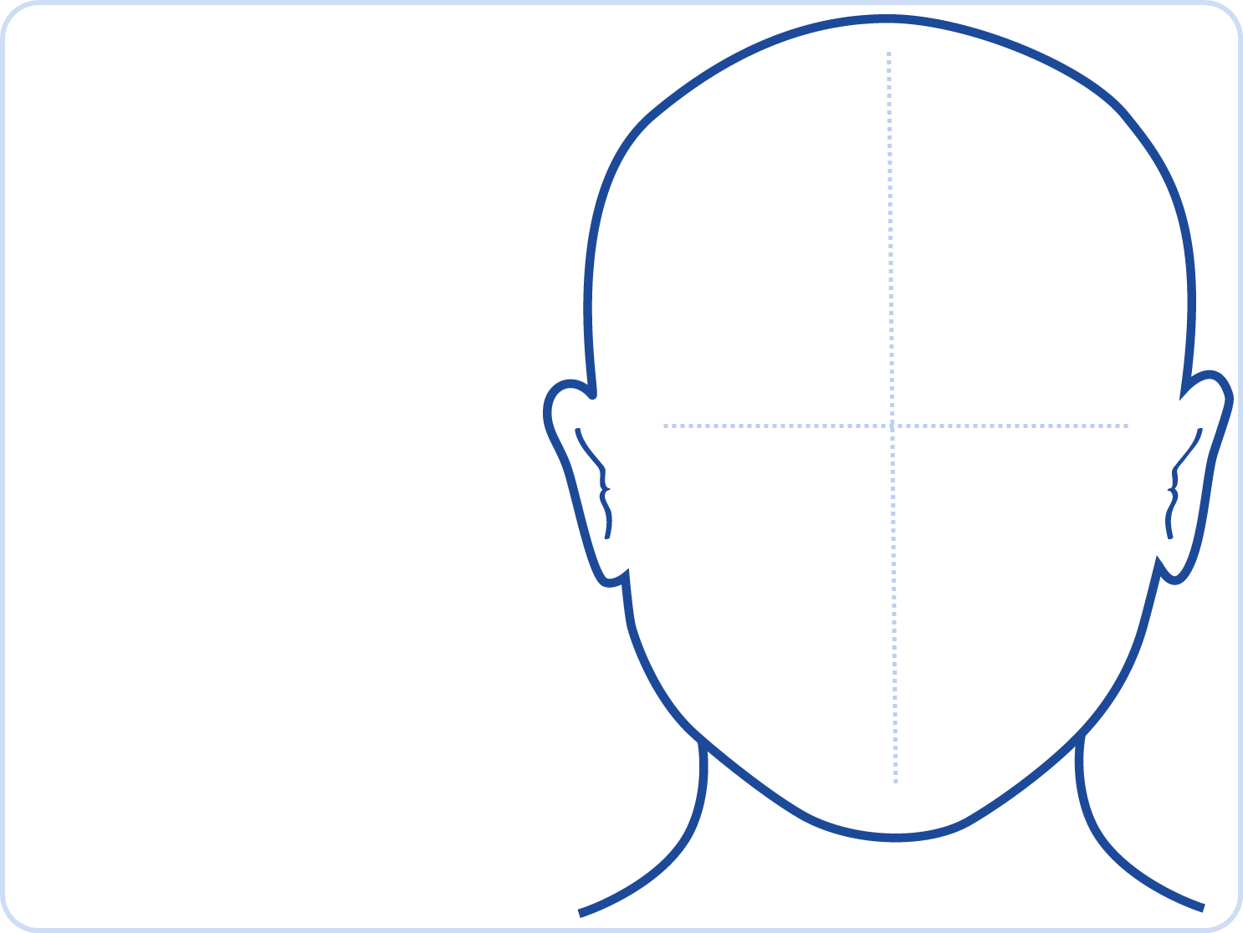
NAME of THIS PERSON:
What this person likes:
*Likes to watch on a screen:
*Likes to eat:
*Likes to go to this place:
*Likes to read:
©2018 Joel Shaul

Slide 11
NAME of THIS PERSON:
What this person likes:
*Likes to watch on a screen:
*Likes to eat:
*Likes to go to this place:
*Likes to read:
©2018 Joel Shaul

Slide 12
NAME of THIS PERSON:
What this person likes:
*Likes to watch on a screen:
*Likes to eat:
*Likes to go to this place:
*Likes to read:
©2018 Joel Shaul

Slide 13
NAME of THIS PERSON:
What this person likes:
*Likes to watch on a screen:
*Likes to eat:
*Likes to go to this place:
*Likes to read:
©2018 Joel Shaul

Slide 14
NAME of THIS PERSON:
What this person likes:
*Likes to watch on a screen:
*Likes to eat:
*Likes to go to this place:
*Likes to read:
©2018 Joel Shaul

Slide 15
NAME of THIS PERSON:
What this person likes:
*Likes to watch on a screen:
*Likes to eat:
*Likes to go to this place:
*Likes to read:
©2018 Joel Shaul

Slide 16
NAME of THIS PERSON:
What this person likes:
*Likes to watch on a screen:
*Likes to eat:
*Likes to go to this place:
*Likes to read:
©2018 Joel Shaul

Slide 17
NAME of THIS PERSON:
What this person likes:
*Likes to watch on a screen:
*Likes to eat:
*Likes to go to this place:
*Likes to read:
©2018 Joel Shaul

Slide 18
NAME of THIS PERSON:
What this person likes:
*Likes to watch on a screen:
*Likes to eat:
*Likes to go to this place:
*Likes to read:
©2018 Joel Shaul

Slide 19
NAME of THIS PERSON:
What this person likes:
*Likes to watch on a screen:
*Likes to eat:
*Likes to go to this place:
*Likes to read:
©2018 Joel Shaul

Slide 20
NAME of THIS PERSON:
What this person likes:
*Likes to watch on a screen:
*Likes to eat:
*Likes to go to this place:
*Likes to read:
©2018 Joel Shaul

Slide 21
NAME of THIS PERSON:
What this person likes:
*Likes to watch on a screen:
*Likes to eat:
*Likes to go to this place:
*Likes to read:
©2018 Joel Shaul

